Slide 1
Status of FENDL-3
and the future
R.A. Forrest
Nuclear Data Section
Department of Nuclear Sciences and Applications

Slide 2
Contents
History of CRP
Status of FENDL-3
n-,p-,d-induced GP
Shadow library
n-,p-,d-induced activation
Processed files
Decisions
Testing
CRP Final report
Future work

Slide 3
History
FENDL-2.1 dates from 2004
A Technical Meeting aiming at identifying possible detailed objectives for a CRP was held at October/November 2007
1st RCM held December 2008
2nd RCM held March 2010
Web site http: //www-nds.iaea.org/fendl3

Slide 4
Objectives
Update the FENDL-2.1 library with presently available evaluations
Extend the neutron induced library to energies up to 150 MeV
Include p- and d-induced general purpose and activation libraries for incident energies up to 150 MeV
Creation of a library based on model calculations which contains covariances files

Slide 5
n-induced GP
180 materials
List available on FENDL-3 web site
Upper energy limit typically 150, 200 MeV but all files have upper limit ≥ 60 MeV
Covariance data still limited
Complete - 11
TENDL - 23
Partial - 11
None - 135
Some remaining problems

Slide 6
p-induced GP
Same 180 materials as for n-induced
Based on TENDL-2011
Some replacements by better files from JENDL-HE and LA-150
Processing will be done during next 3 months

Slide 7
d-induced GP
Same 180 materials as for n-induced
Based completely on TENDL-2011
Will use processed files produced by NRG

Slide 8
Shadow library
Same 180 materials as for n-induced
Based completely on TENDL-2011
Contains complete covariances
Purpose:
Calculation needs complete covariances
Calculate with FENDL-3 (R₁ ± ΔR₁)
Calculate with Shadow library (R₂ ± ΔR₂)
Answer = R₁ ± ΔR₂ (check that R₂ ≈ R₁)

Slide 9
n-induced Activation
Identical to EAF-2010, but the EAF format file has been converted to ENDF format, including the uncertainty information
A GND (xml) version is also available
Can use the validation work that has already been done for EAF-2010

Slide 10
p-induced Activation
Based on EAF-2007
Contains data for 67,925 reactions
No uncertainty data
Available in EAF format

Slide 11
d-induced Activation
Based on EAF-2007, but includes improved data for some channels
Contains data for 66,864 reactions
No uncertainty data
Available in EAF format

Slide 12
Processing (GP)
n-induced (Done)
PEND files
ACE files
MG (211 groups, VITAMIN+) - upper limit is 55 MeV
p-induced (Soon)
PEND files
ACE files
d-induced (Done)
PEND files
ACE files

Slide 13
Decisions
Missing reactions
Choice of data for low mass targets
Covariance data in n-induced GP not consistent, options to make file ‘clean’:
Remove all covariance data
Formally extend by raising upper limit
Use TENDL data
211-group covariance library useful?
How to include ‘last minute’ improvements

Slide 14
Testing and validation
Because of delays no testing has been done
CRP formally extended (but no extra money!) so that testing can be done over next 6 months
For GP files corrections will be made for a small number of materials
Files finalised 30 June 2012

Slide 15
Final report
Discuss at this meeting
Include work of CRP participants
FENDL-3 library description
Validation results
Parts can be produced now, aim for completed version 30 Sept 2012

Slide 16
The Future
Recognise that while FENDL-3 is a major step forward it is not as good as we can make it
Suggest that work continues as DDP during 2013 to respond to new data and feedback to replace data for materials
Aim for FENDL-3.1 (containing same set of materials and same energy range) at start of 2014
What else?

Slide 17
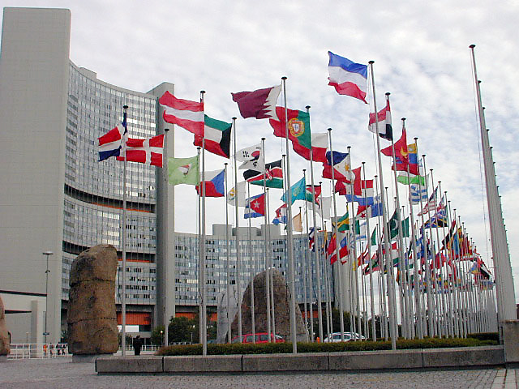
Thank you all for your contributions!

