Slide 1

Benchmark test with OKTAVIAN data and
Comment on kerma factor
3nd RCM of CRP on FENDL-3, 6-10 December 2011
Yukinobu Watanabe
Department of Advanced Energy Engineering Science,
Kyushu University

Slide 2
Contents
Action assignment in 2nd RCM : Si and Sn
Benchmark test using OKTAVIAN data
(by C. Konno)
Comment on KERMA factor in FENDL/MC-2.1 & FENDL/MG-2.1 (from C. Konno)

Slide 3
Assignment-1: Si isotopes
Keep from ENDF/B-VII, but check and consider using the new JENDL evaluation due to unsatisfactory benchmark results.
In summary report from the 2nd RCM; INDC(NDS)-0567 (2010)
C. Konno et al., “Benchmark Test of JENDL-4.0 Based on Integral Experiments at JAEA/FNS” presented at Joint Int. Conf. on Supercomputing in Nuclear Applications + Monte Carlo 2010, October 17-21, 2010, Tokyo, Japan.

Slide 4
FNS SiC TOF Experiment - (1)

Slide 5
FNS SiC TOF Experiment - (2)

Slide 6
FNS SiC In-situ Experiment - (3)

Slide 7
FNS SiC In-situ Experiment - (4)
Reference :
C. Konno et al., “Benchmark Test of JENDL-4.0 Based on Integral Experiments at JAEA/FNS” presented at Joint Int. Conf. on Supercomputing in Nuclear Applications + Monte Carlo 2010, October 17-21, 2010, Tokyo, Japan.

Slide 8
Conclusion on Si
From the result of this benchmark, I cannot find a reasonable reason to adapt JENDL-4.0 instead of ENDF/B-VII. Therefore, it would be better to keep ENDF/B-VII for Si isotopes in FENDL-3.0.
By YW
Jan. 18, 2011

Slide 9
Si
FENDL-3 (SLIB2) :
ENDF/B-VII.0
JENDL-4 is slightly better than the others.

Slide 10
Assigment-2: Sn isotopes
Isotopic evaluations from RUSFOND files (or JENDL-4 if available) to be joined to TENDL at E > 20 MeV. Otherwise use TENDL only. Action on Watanabe to justify switch to JENDL-4.
In summary report from the 2nd RCM; INDC(NDS)-0567 (2010)
The data of Sn isotopes in RUSFOND are taken from ENDF/B-VII and both data are same.

Slide 11
Sn isotopes
Since there is no integral benchmark test for Sn isotopes, our optimum selection of evaluated library should be based on only comparison of differential data.
Here we focus on γ-ray production cross sections, because they are important to estimate the influence of γ-ray heating on superconducting coil (Nb₃Sn) for nuclear fusion technology.
ENDF/B-VII.0, RUSFOND, TENDL-2010, and JENDL-4.0 are compared with available experimental data.

Slide 12
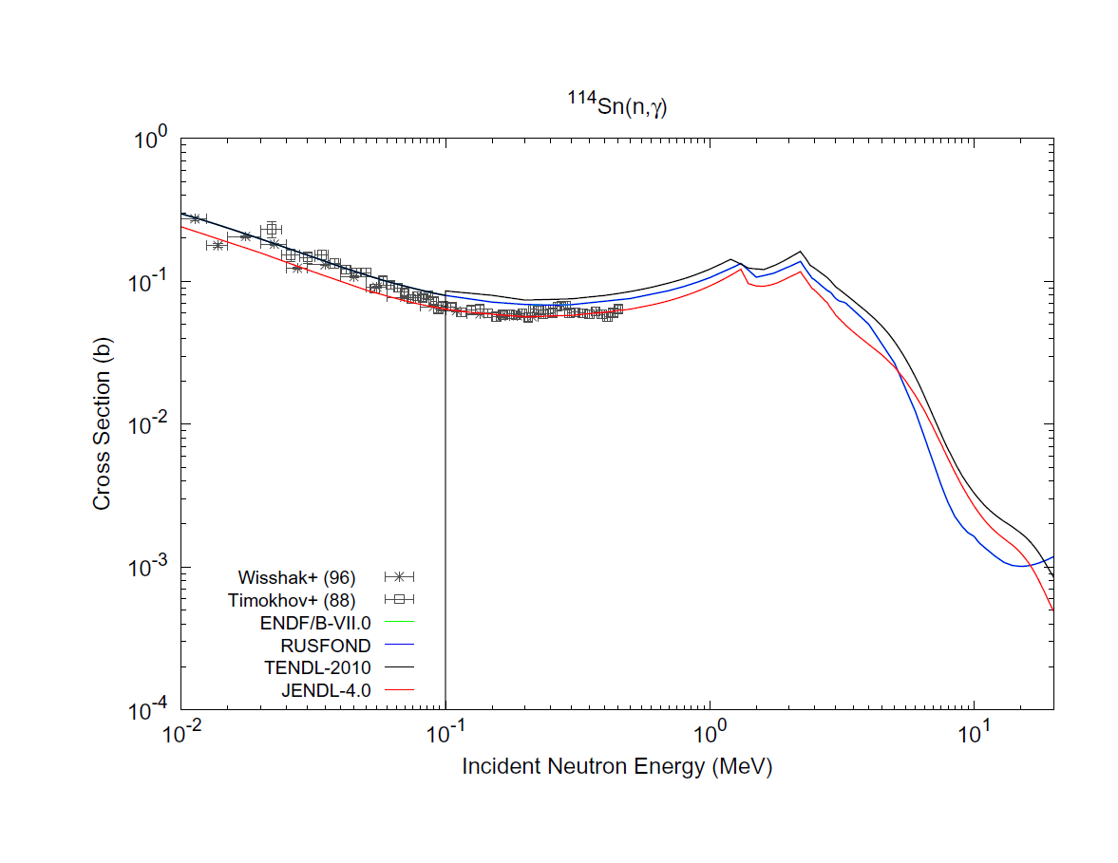
¹¹⁴Sn(n,γ)

Slide 13
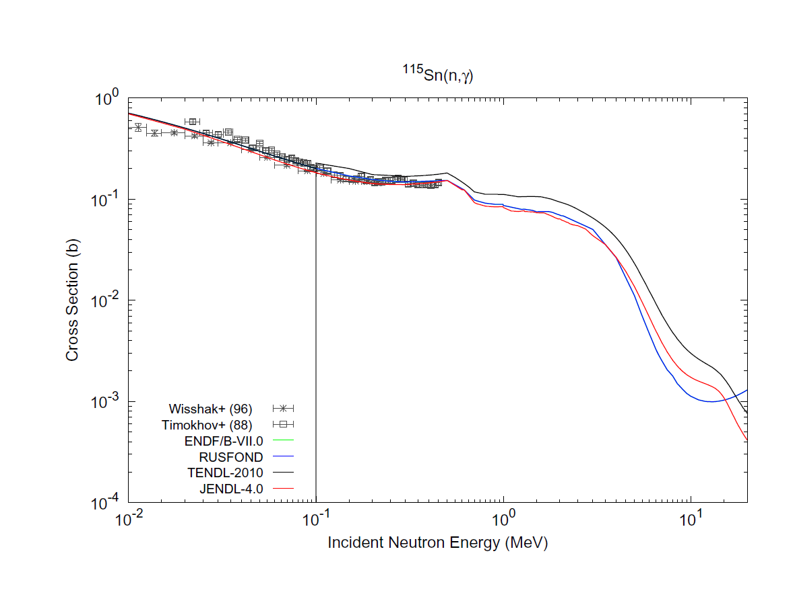
¹¹⁵Sn(n,γ)

Slide 14
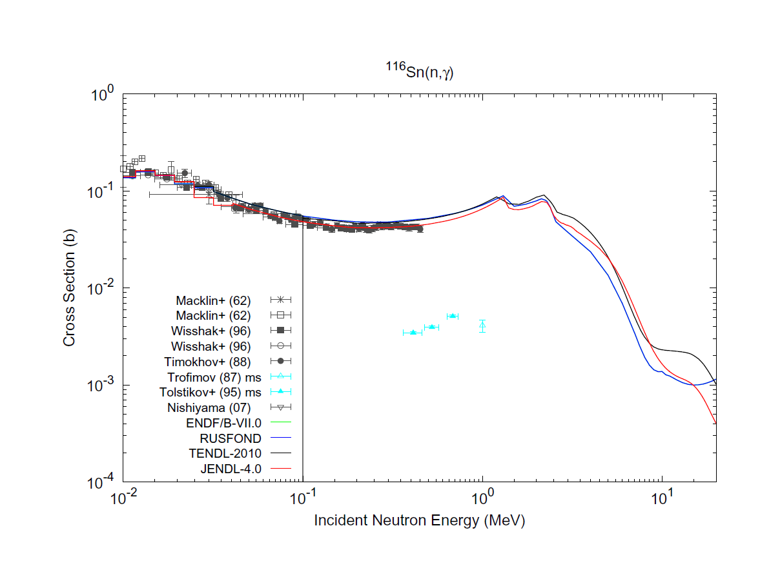
¹¹⁶Sn(n,γ)

Slide 15
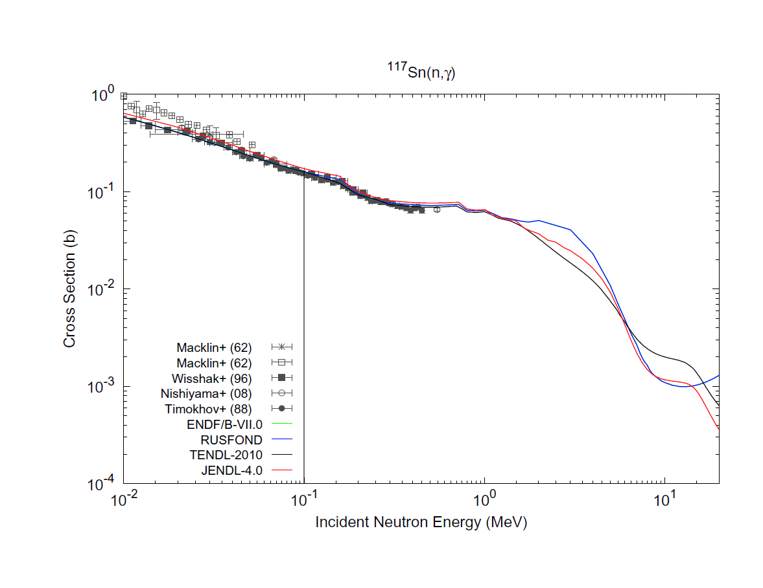
¹¹⁷Sn(n,γ)

Slide 16
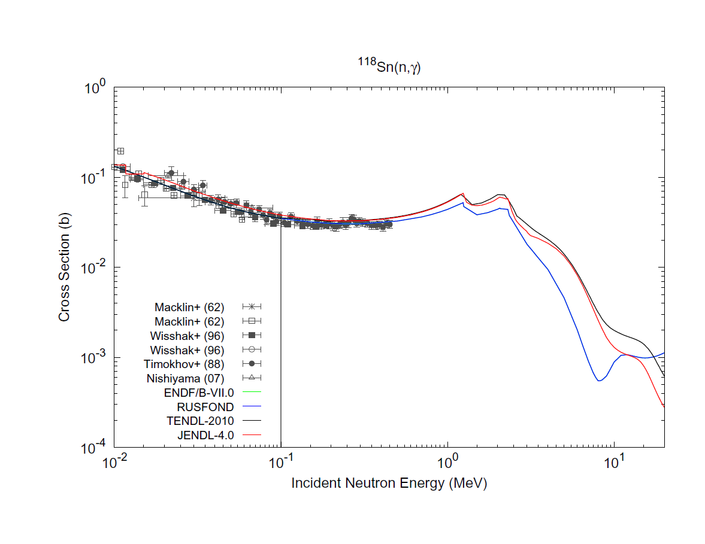
¹¹⁸Sn(n,γ)

Slide 17
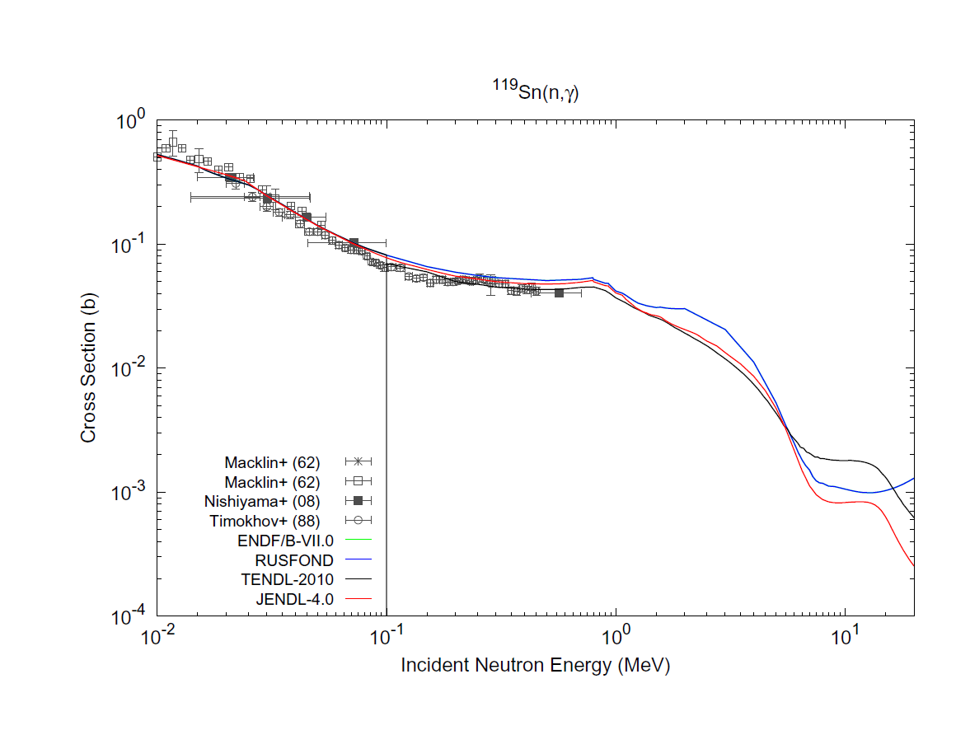
¹¹⁹Sn(n,γ)

Slide 18
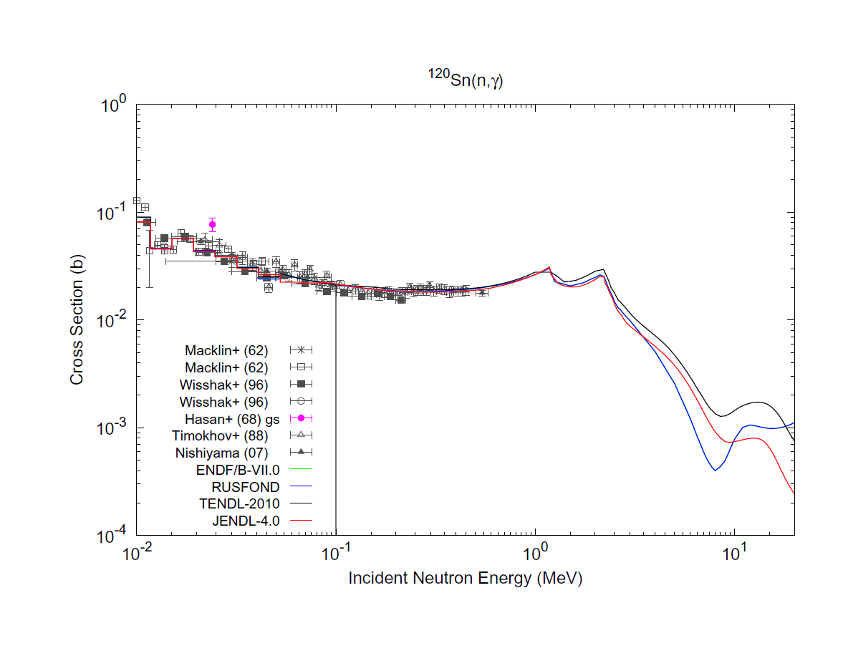
¹²⁰Sn(n,γ)

Slide 19
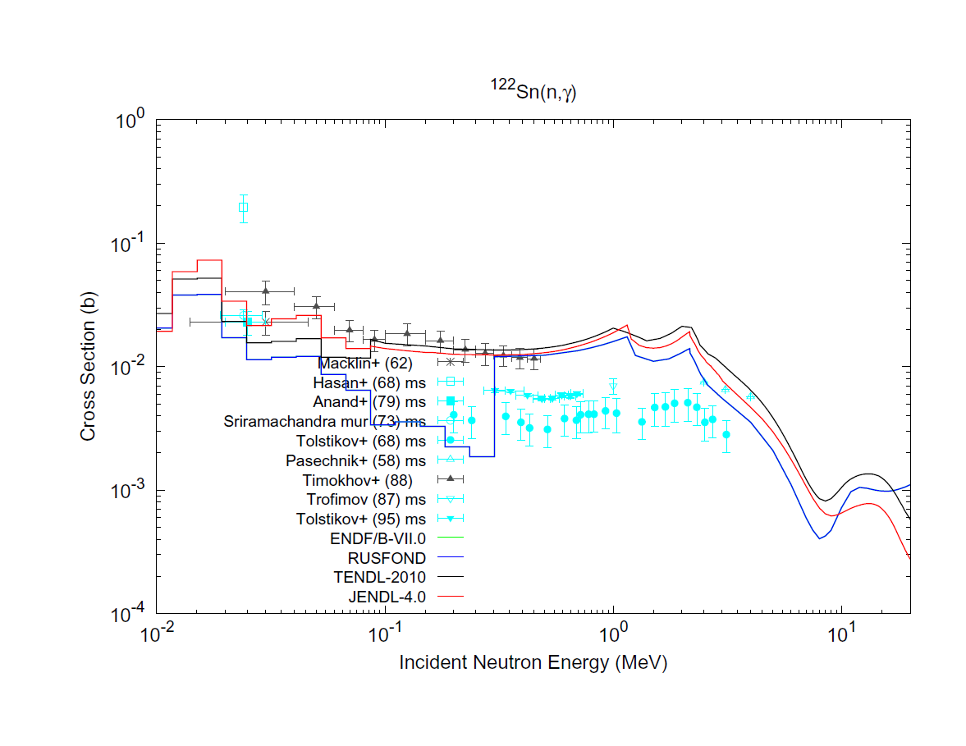
¹²²Sn(n,γ)

Slide 20
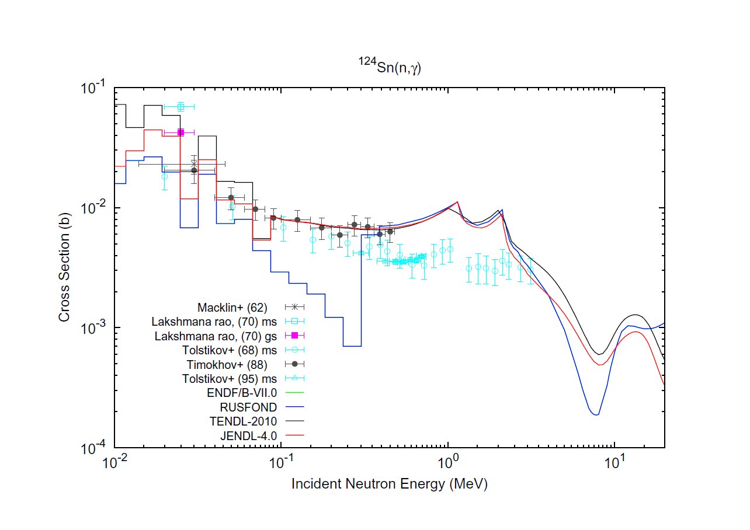
¹²⁴Sn(n,γ)

Slide 21
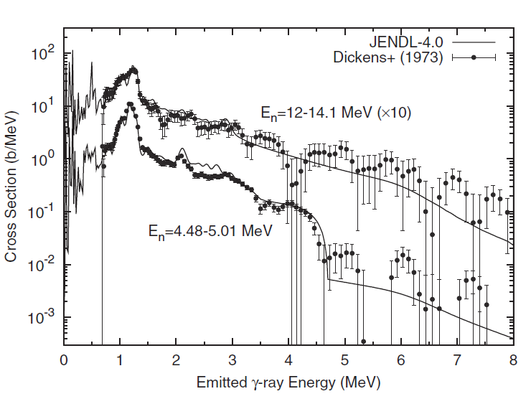
γ-ray emission spectra of natural Sn

Slide 22
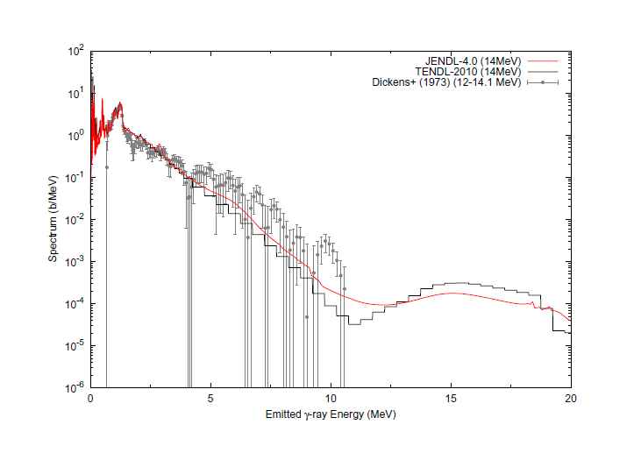
γ-ray emission spectra of natural Sn

Slide 23
Results
JENDL-4.0 is in slightly better agreement with the experimental (n,γ) data of ^{112,114,116}Sn than the other evaluations.
All the evaluations for ^{118,120}Sn reproduce the measurements to similar extent.
As for ^{122,124}Sn, JENDL-4.0 is better than RUSFOND (i.e., ENDF/B-VII.0). Thus, as far as the (n,γ) cross sections are concerned, the JENDL-4.0 looks superior to RUSFOND and TENDL-2010.
Gamma-ray emission spectra of natural Sn at 4.75 and 13.05 MeV incident energies are shown with JENDL-4 data and measurements.
A comparison with TENDL-2010 is also presented. The data of JENDL-4 agrees with the measurements better than that of TENDL-2010.

Slide 24
Conclusion on Sn
I recommend that we should adapt JENDL-4.0 instead of RUSFOND at energies below 20 MeV. Since there is no high energy data of JENDL for Sn isotopes, TENDL-2010 should be connected with JENDL-4.0 at 20 MeV.
By YW
Jan. 18, 2011

Slide 25
Contents
Action assignment in 2nd RCM : Si and Sn
Benchmark test using OKTAVIAN data
(by C. Konno)
Comment on KERMA factor in FENDL/MC-2.1 & FENDL/MG-2.1 (from C. Konno)

Slide 26
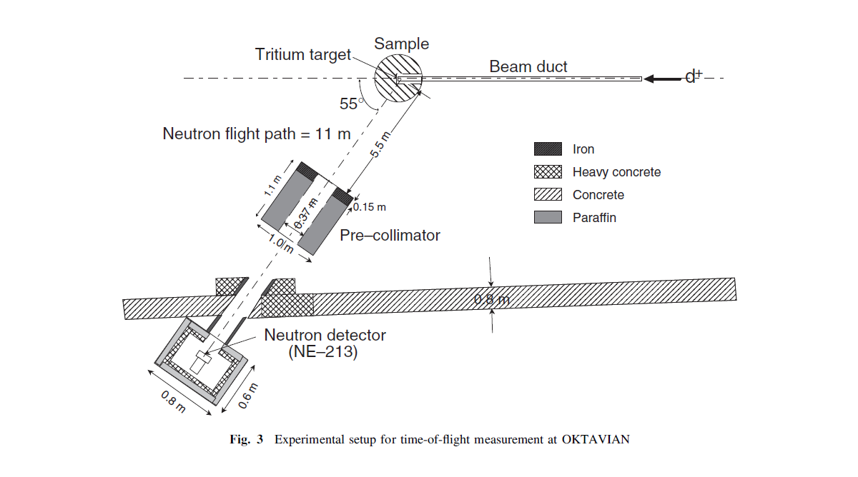
Benchmark Test using OKTAVIAN data
Measurement of leakage neutron spectrum from a spherical pile with incident 14 MeV neutrons
Benchmark test was done by FNS/JAEA using MCNP-5.14 code
Presented at 2011 symposium on nuclear data, 16-17 Nov. 2011, Tokai, Japan

Slide 27
Si
FENDL-3 (SLIB2):
ENDF/B-VII.0

Slide 28
Cu
FENDL-3 (SLIB2)
ENDF/B-VII

Slide 29
Zr
FENDL-3 (SLIB2):
JENDL/HE

Slide 30
Nb
FENDL-3 (SLIB2):
JENDL/HE

Slide 31
Mo
FENDL-3 (SLIB2):
JENDL/HE

Slide 32
W
FENDL-3 (SLIB2):
IAEA

Slide 33
Contents
Reply to assignments in 2nd RCM : Si and Sn
Benchmark test using OKTAVIAN data
KERMA factor in FENDL/MC-2.1 & FENDL/MG-2.1

Slide 34
KERMA factor in FENDL/MC-2.1
and FENDL/MG-2.1
JAEA
C. Konno

Slide 35
Neutron KERMA in FENDL-2.1
Neutron KERMA factors are stored in FENDL/MC-2.1 (ACE file) and FENDL/MG-2.1 (MATXS file), not in FENDL/E-2.1.
Pointwise neutron KERMA factors in FENDL/MC-2.1 are deduced with the energy balance method in the heatr module of the NJOY code. They are used for tally F6 in MCNP.
Two neutron KERMA factors of 175 groups, “heat” and “kerma”, are stored in FENDL/MG-2.1. “heat” is deduced with the energy balance method in NJOY heatr, while “kerma” is deduced with the kinematic method in NJOY heatr. Note that “kerma” is an upper limit of KERMA and that “heat” should be less than “kerma”. They are extracted with the TRANSX code and are used as response data for heating calculation with Sn codes.

Slide 36
Problem in Neutron KERMA in FENDL-2.1
As well known, the energy balance method gives inadequate KERMA, e.g. negative KERMA, if the total energy is not conserved inside nuclear data. In this case the kinematic method should be adopted.
This problem appears in 28 nuclei of FENDL/MC-2.1 (see next slides).
  Au-197, Bi-209, Fe-56, Ga-nat, Mn-55, Mo-92, Mo-94, Mo-95, Mo-96, Mo-97, Mo-98, Mo-100, N-14, Nb-93, P-31, Sn-nat, Ta-181, Ti-46, Ti-47, Ti-48, Ti-49, Ti-50, V-nat, W-182, W-183, W-184, W-186, Zn-96
We would like to propose that this problem should be resolved in FENDL/MC-3.0.

Slide 37
Inadequate KERMA in FENDL-2.1 -(1)

Slide 38
Inadequate KERMA in FENDL-2.1 -(2)

Slide 39
Inadequate KERMA in FENDL-2.1 -(3)

Slide 40
Inadequate KERMA in FENDL-2.1 -(4)

Slide 41
Inadequate KERMA in FENDL-2.1 -(5)

Slide 42
Inadequate KERMA in FENDL-2.1 -(6)

Slide 43
Inadequate KERMA in FENDL-2.1 -(7)

Slide 44
Proposal concerning neutron KERMA
The energy balance method gives inadequate KERMA, e.g. negative KERMA, if the total energy is not conserved inside nuclear data. In this case the kinematic method should be adopted.
This problem appears in 28 nuclei of FENDL/MC-2.1 :
  Au-197, Bi-209, Fe-56, Ga-nat, Mn-55, Mo-92, Mo-94, Mo-95, Mo-96, Mo-97, Mo-98, Mo-100, N-14, Nb-93, P-31, Sn-nat, Ta-181, Ti-46, Ti-47, Ti-48, Ti-49, Ti-50, V-nat, W-182, W-183, W-184, W-186, Zn-96
This problem should be resolved in processing of FENDL/MC-3.0.

Slide 45
Appendix

Slide 46
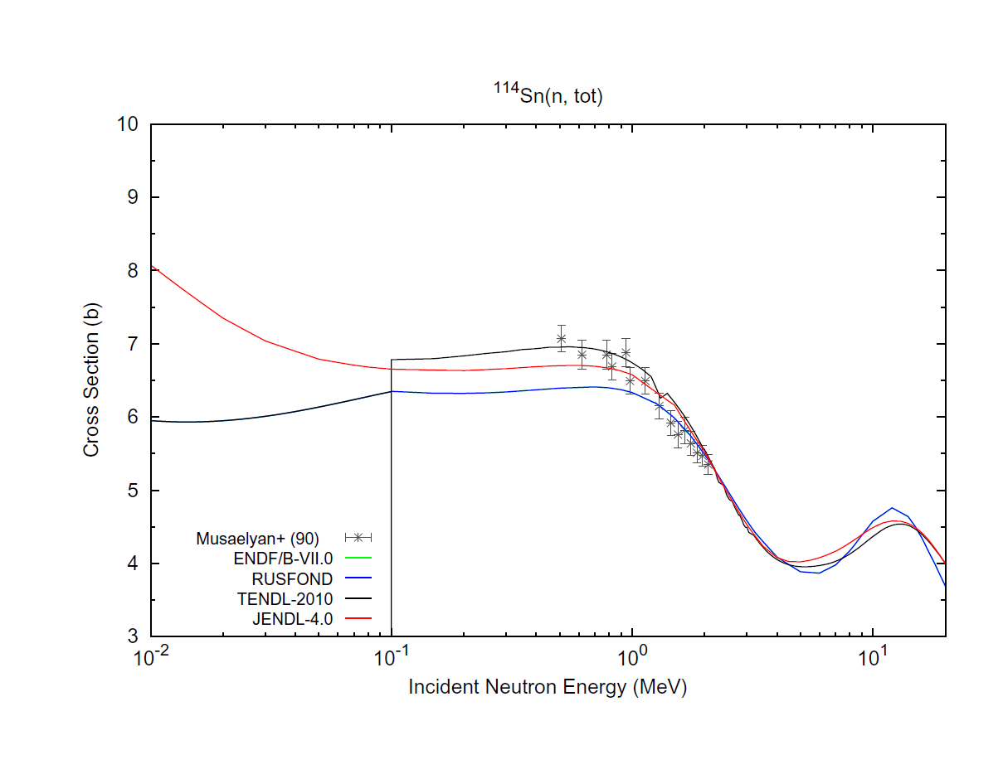
¹¹⁴Sn(n,tot)

Slide 47
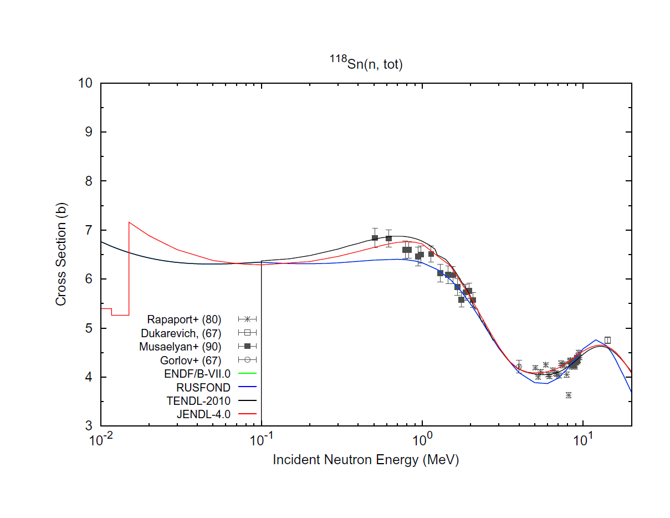
¹¹⁸Sn(n,tot)

Slide 48
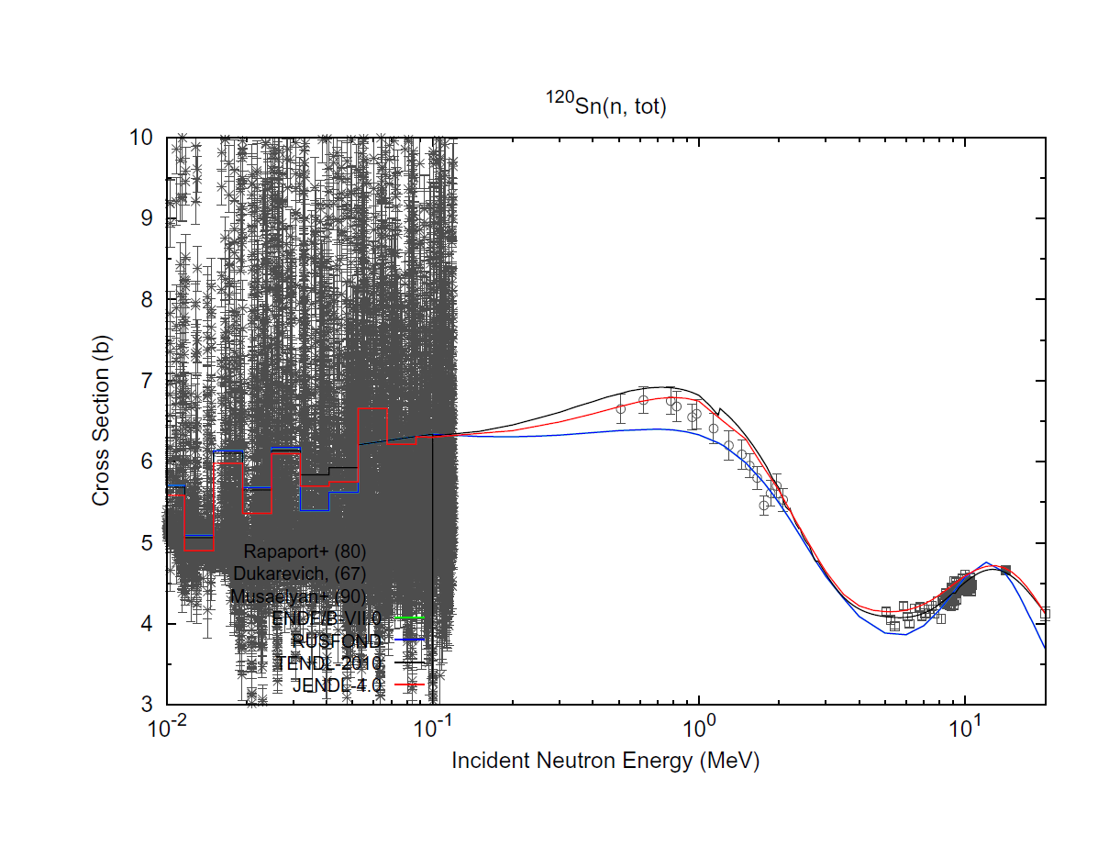
¹²⁰Sn(n,tot)

