Slide 1
Application of the FENDL-3 Test Data Library to IFMIF
U. Fischer, K. Kondo, A. Serikov, P. Pereslavtsev

Slide 2
Overview
Test application of FENDL-3 neutron data library for IFMIF neutronics calculations
Use of McDeLicious-11 Monte Carlo code and a new detailed Test Facility model converted from CAD by McCad software
Calculations of n- and γ-fluxes, nuclear heating, gas production and displacement damage in test rigs (Eurofer specimens)
Shielding calculations for assessment of biological dose rate behind thick concrete walls during operation
Comparison of nuclear responses calculated with FENDL-3 (SLIB-R2) and the standard IFMIF library
Comparison of relevant cross-section data extracted from ACE data library
U. Fischer, KIT, FENDL-3 Test Application to IFMIF

Slide 3
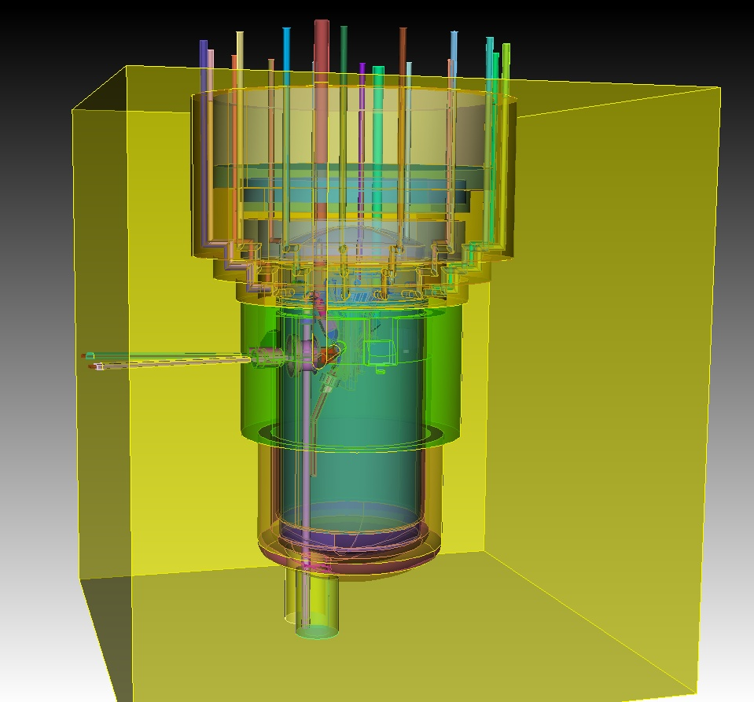
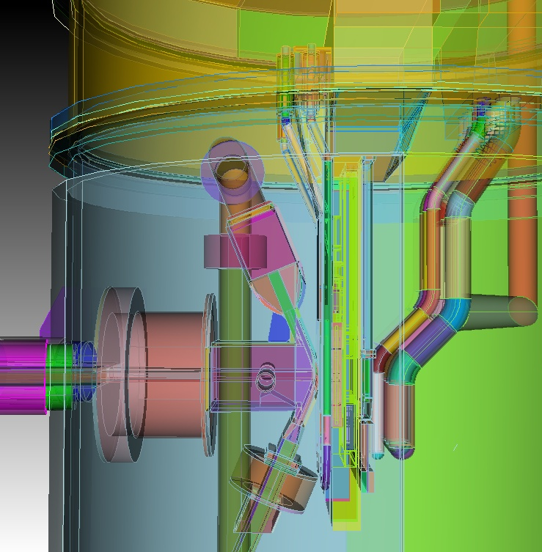
CAD Model of IFMIF Target and Test Cell (TTC) including vessel, Target assembly, concrete cover, Test Modules and pipes (2010)
U. Fischer, KIT, FENDL-3 Test Application to IFMIF

Slide 4
Converted IFMIF TTC model visualised by MCNP plotter (2D cuts)
Target and Test Module Region
Full TTC model
HFTM
CFTM
Liquid Lithium
Moderator (Tungsten)
TRTM
D beam
LFTM
Total:
17520 cells,
3243 surfaces
Graphite
U. Fischer, KIT, FENDL-3 Test Application to IFMIF

Slide 5
Dedicated TTC model for IFMF shielding calculations
Access cell
Access cell floor
250 cm
Test cell ceiling
Access/Maintenance Room
400 cm
U. Fischer, KIT, FENDL-3 Test Application to IFMIF

Slide 6
IFMIF TTC model: HFTM module section (vertical cut)
HFTM
Specimen (Eurofer & NaK filling)
Lithium Target
Beam level
Eurofer: NaK = 74:26 (volume ratio)
Na:K = 22:78 (weight ratio)
U. Fischer, KIT, FENDL-3 Test Application to IFMIF

Slide 7
IFMIF TTC model: HFTM module front view (vertical cut)
Specimen (Eurofer & NaK filling)
Heater (Eurofer & NiCr)
Beam footprint
Beam level
8.1 cm
U. Fischer, KIT, FENDL-3 Test Application to IFMIF

Slide 8
IFMIF TTC model: Target, HFTM, MFTM and LFTM moduled (horizontal cut)
Specimens of CFTM
HFTM
Lithium Target
TRTM
d-beam
Graphite
W moderator
MFTM
LFTM
U. Fischer, KIT, FENDL-3 Test Application to IFMIF

Slide 9
Standard IFMIF Data Library vs. FENDL-3/SLIB, release2 : Sources of Data Evaluations
The major isotopes in heavy concrete wall are O-16 (55 at%), Fe-56 (21 at%), H-1 (8 at%) and Ca-40 (5 at%)
U. Fischer, KIT, FENDL-3 Test Application to IFMIF

Slide 10
Neutron spectra in Target Back Plate, HFTM, CFTM, TRTM,LFTM and in vessel liner
LFTM surrounded by graphite reflector
U. Fischer, KIT, FENDL-3 Test Application to IFMIF

Slide 11
DPA distribution (horizontal) in HFTM
1 2 3 4 5 6 7 8 : Column
Row: 1 2 3
DPA (1/fpy)
U. Fischer, KIT, FENDL-3 Test Application to IFMIF

Slide 12
DPA distribution (vertical) in HFTM
Rigs region
DPA (/fpy)
U. Fischer, KIT, FENDL-3 Test Application to IFMIF

Slide 13
He/DPA distribution (vertical) in HFTM
1 2 3 4 5 6 7 8 : Column
Row: 1 2 3
U. Fischer, KIT, FENDL-3 Test Application to IFMIF

Slide 14
Total neutron fluxes and DPA accumulation in Back Plate and Test Modules: FENDL-3/SLIB-R2 vs. IFMIF Standard Library
No significant differences in the calculated neutron fluxes in the Test Mdoules
Differences of DPA accumulation is due to the ⁵⁶Fe(n,dpa) cross section.
U. Fischer, KIT, FENDL-3 Test Application to IFMIF

Slide 15
Comparison of ⁵⁶Fe displacement damage cross-sections
⁵⁶Fe(n,dpa) (MT=444)
1
IFMIF-standard (LA150)
Cross section (barn)
ENDF/B-VII.0
10⁻¹
FENDL-3, release 2 (JEFF-3.1)
FENDL-3, release 3 (JEFF-3.1.1)
10⁻²
10⁻³
10⁻³ 10⁻² 10⁻¹ 1 10 10²
Neutron energy (MeV)
U. Fischer, KIT, FENDL-3 Test Application to IFMIF

Slide 16
Comparison of nuclear responses in HFTM irradiation rigs
d-beam
1 2 3 4
Relative differences are almost the same in all HFTM irradiation rigs
No differences in neutron fluxes
Large differences in DPA, T and He production
U. Fischer, KIT, FENDL-3 Test Application to IFMIF

Slide 17
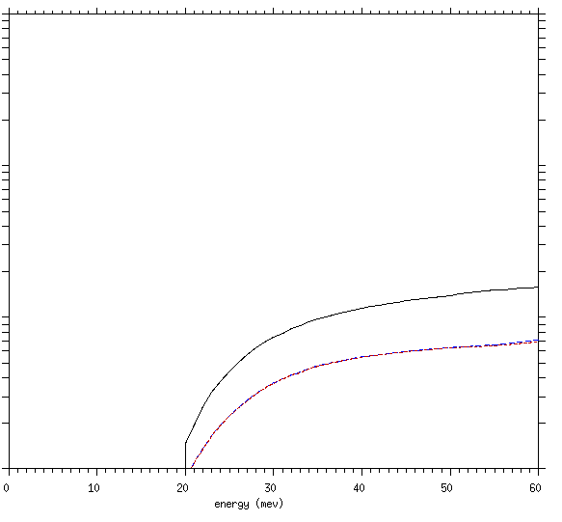
Comparison of T - and He - production cross-sections of ⁵⁶Fe
⁵⁶Fe(n,xt) (MT=205)
⁵⁶Fe(n,xα) (MT=207)
1
1
FENDL-3, release 3 (JEFF-3.1.1)
Cross section (barn)
FENDL-3, release 2 (JEFF-3.1)
ENDF/B-VII.0
10⁻¹
10⁻¹
IFMIF-standard (LA150)
FENDL-3, release 2 (JEFF-3.1)
10⁻²
10⁻²
ENDF/B-VII.0
IFMIF-standard (LA150)
10⁻³
10⁻³
0 10 20 30 40 50 60
0 10 20 30 40 50 60
Neutron energy (MeV)
Neutron energy (MeV)
U. Fischer, KIT, FENDL-3 Test Application to IFMIF

Slide 18
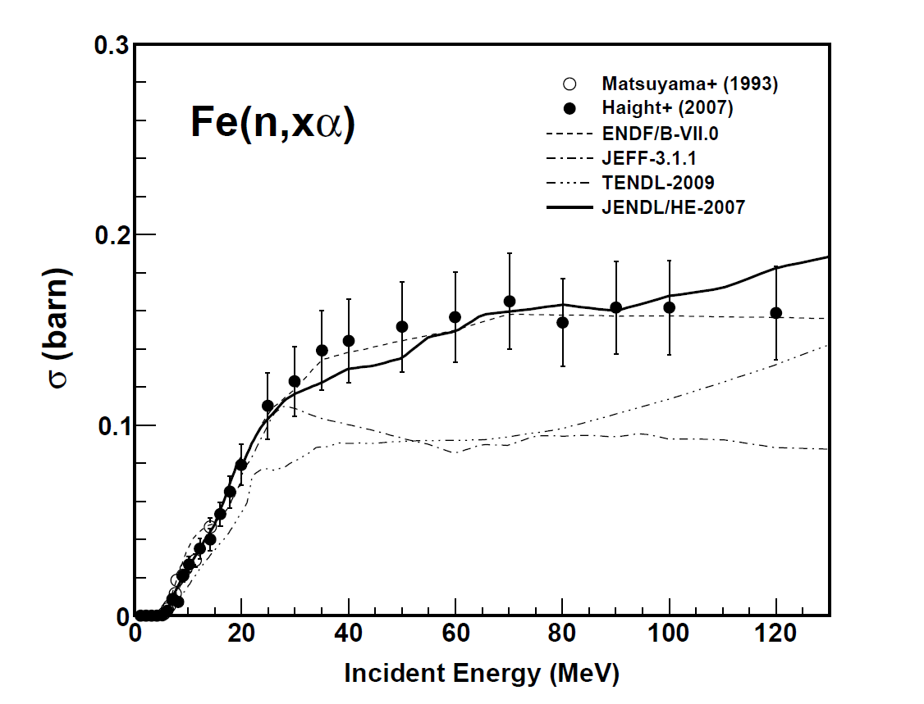
He production cross-section of Fe (nat)
U. Fischer, KIT, FENDL-3 Test Application to IFMIF

Slide 19
Impact of of (n,xα) cross section of ⁵⁶Fe
He/dpa ratio is one of the most important quantities for the material behaviour under irradiation
He/dpa calculated with (n,xa) cross section inFENDL-3/SLIB2 *
He/dpa calculated with (n,xa) cross section of ENDF/B-VII.0 *
Difference of the He production is 12 – 15%
* Using dpa cross section in LA150.
U. Fischer, KIT, FENDL-3 Test Application to IFMIF

Slide 20
IFMIF shielding calculations: neutron flux profile across Test Cell front wall
Front wall : heavy concrete
(density: 3.6 g/cc, thickness: 390 cm)
U. Fischer, KIT, FENDL-3 Test Application to IFMIF

Slide 21
IFMIF shielding calculations: neutron flux profile across Test Cell front wall (linear scale)
U. Fischer, KIT, FENDL-3 Test Application to IFMIF

Slide 22
IFMIF shielding calculations: Profile of biological dose rate across Test Cell front wall (linear scale)
U. Fischer, KIT, FENDL-3 Test Application to IFMIF

Slide 23
Summary
FENDL-3, Release 2 test library, successfully applied for full IFMIF neutronics calculations (TTC model with all materials included).
FENDL-3, R2, ACE data library, with some modifications in routine use for IFMIF design and shielding analyses – it works.
High energy extension for H-1 data essential for shielding calculations – works with new prepared for Release 3.
Major concern is on the Fe-56 data in FENDL-3.
Still a matching problem at 20 MeV in the dpa cross section, which gives about 20 % smaller values than with LA150.
There is a significant difference of the He-4 production cross section as compared to the measured data at LANCE/LANL (R. Haight et al.).
U. Fischer, KIT, FENDL-3 Test Application to IFMIF

