Slide 1
50 years of Nuclear Data Section Photo Album
by Lidija VRAPCENJAK
in May 2014

Slide 3
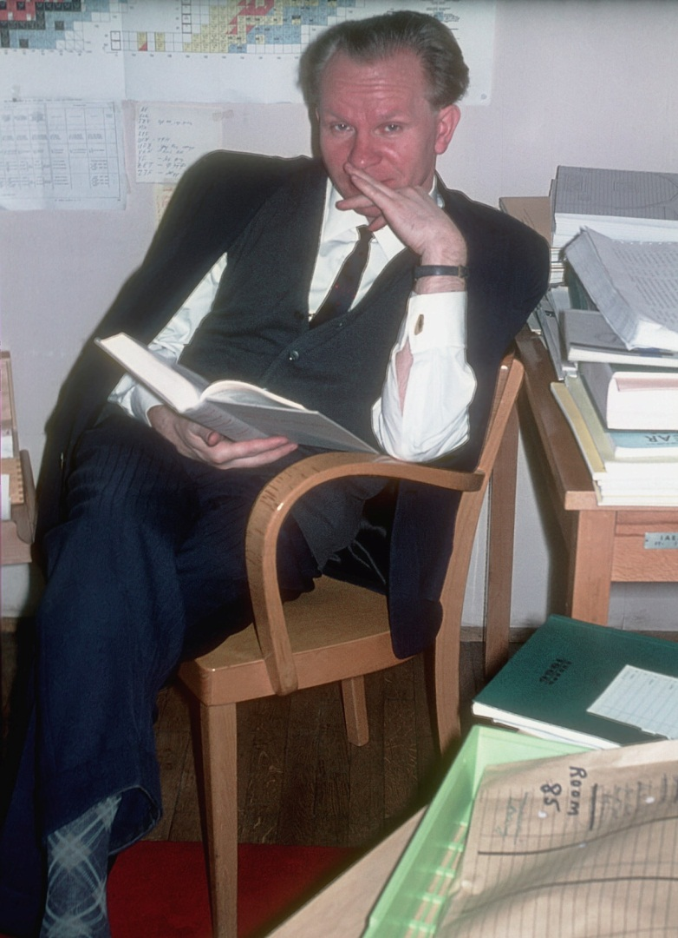
1968-Otstavnov

Slide 4
1964

Slide 5
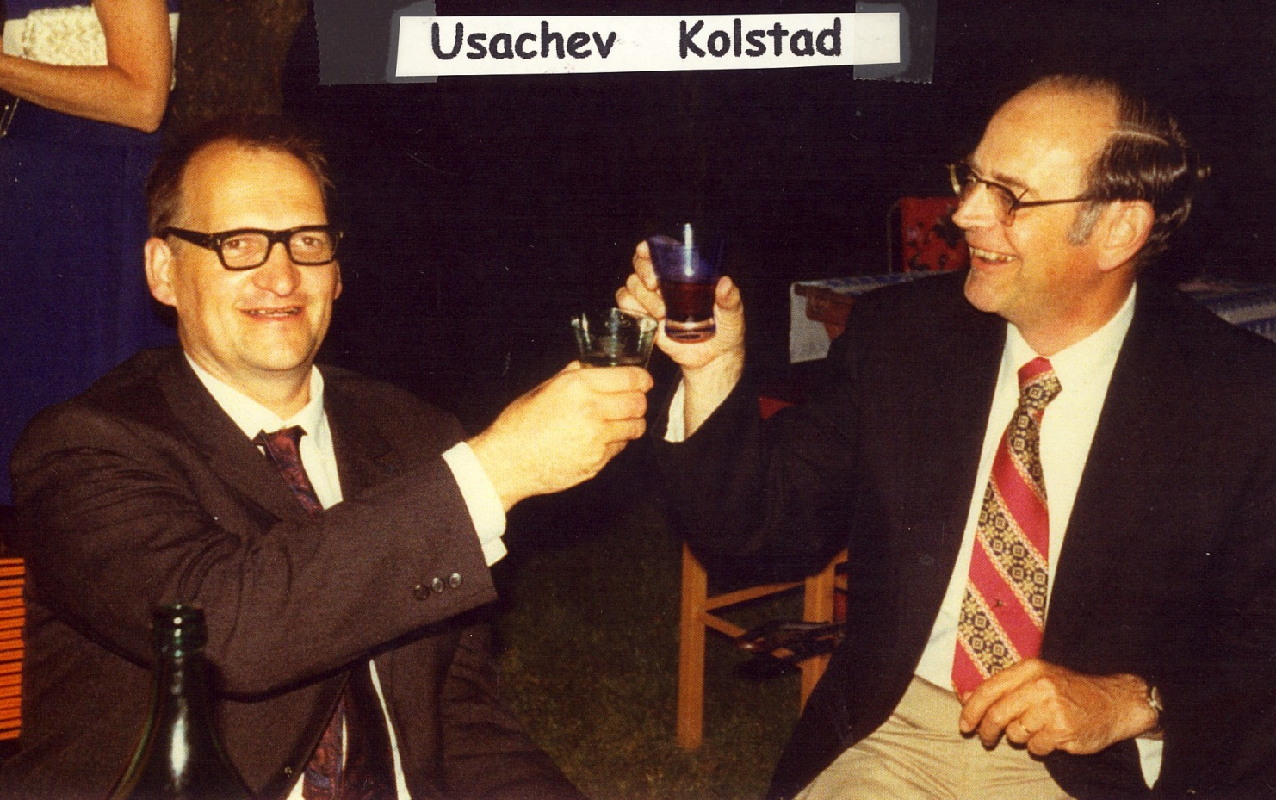

Slide 6
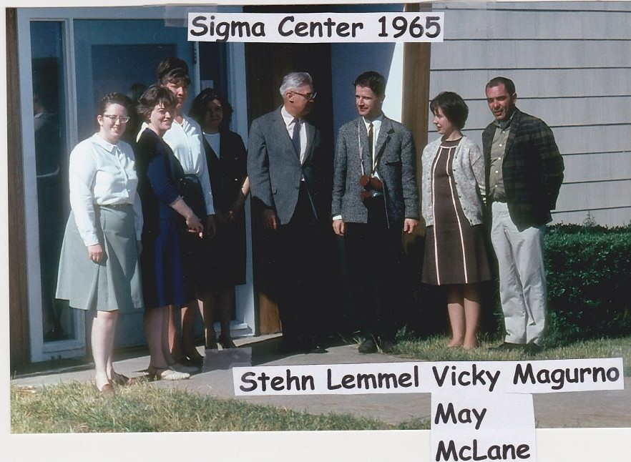

Slide 7
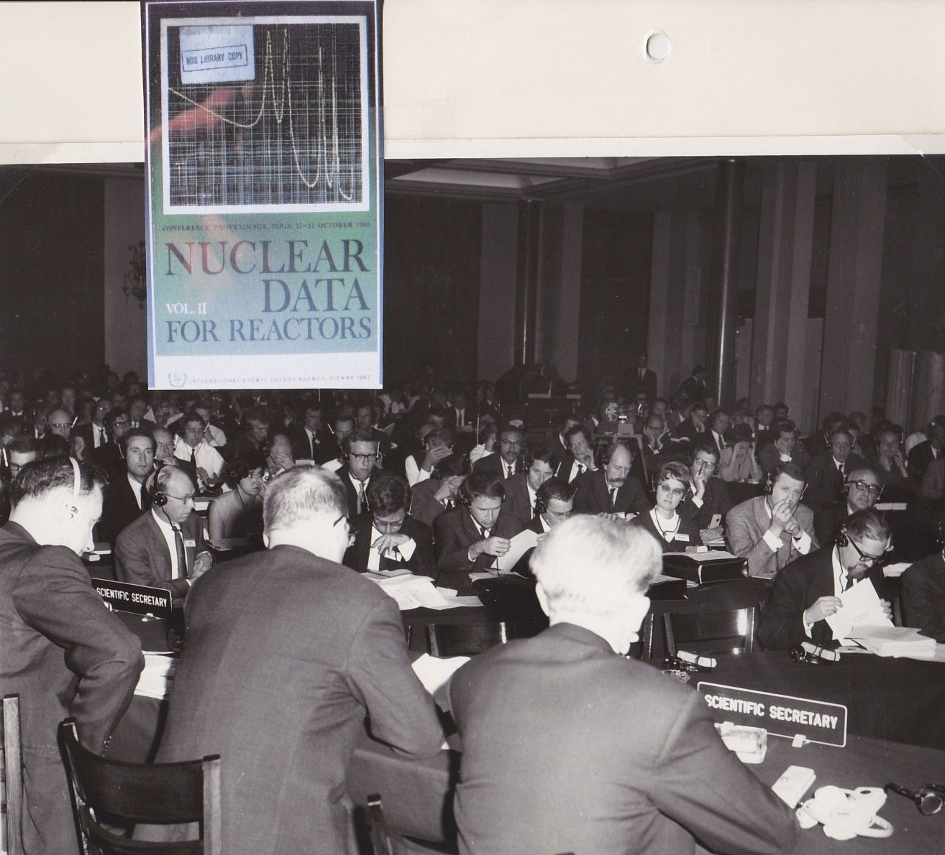
1966-ND Conference, Paris

Slide 8
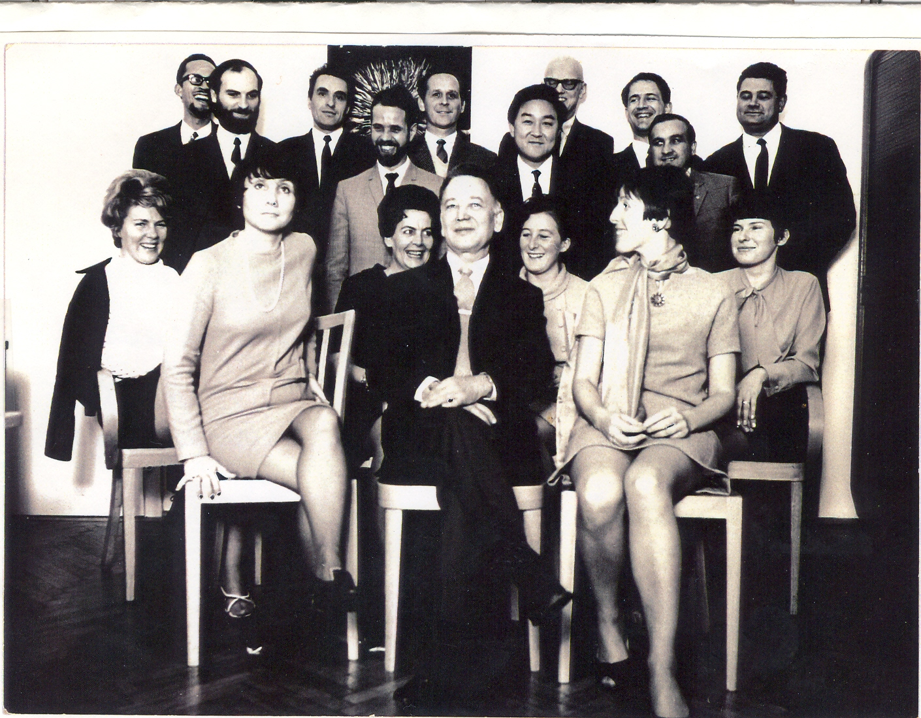
1969-Nuclear Data Section
Notes:
NDS-1969

Slide 9
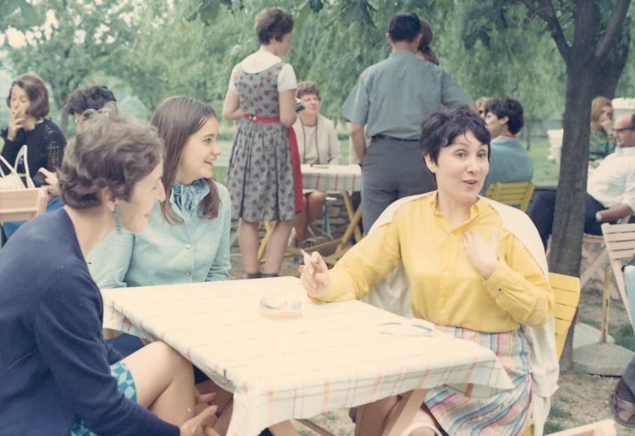
1968-Eva-Paper-Chase
Notes:
1968-EvaPaperChase

Slide 10
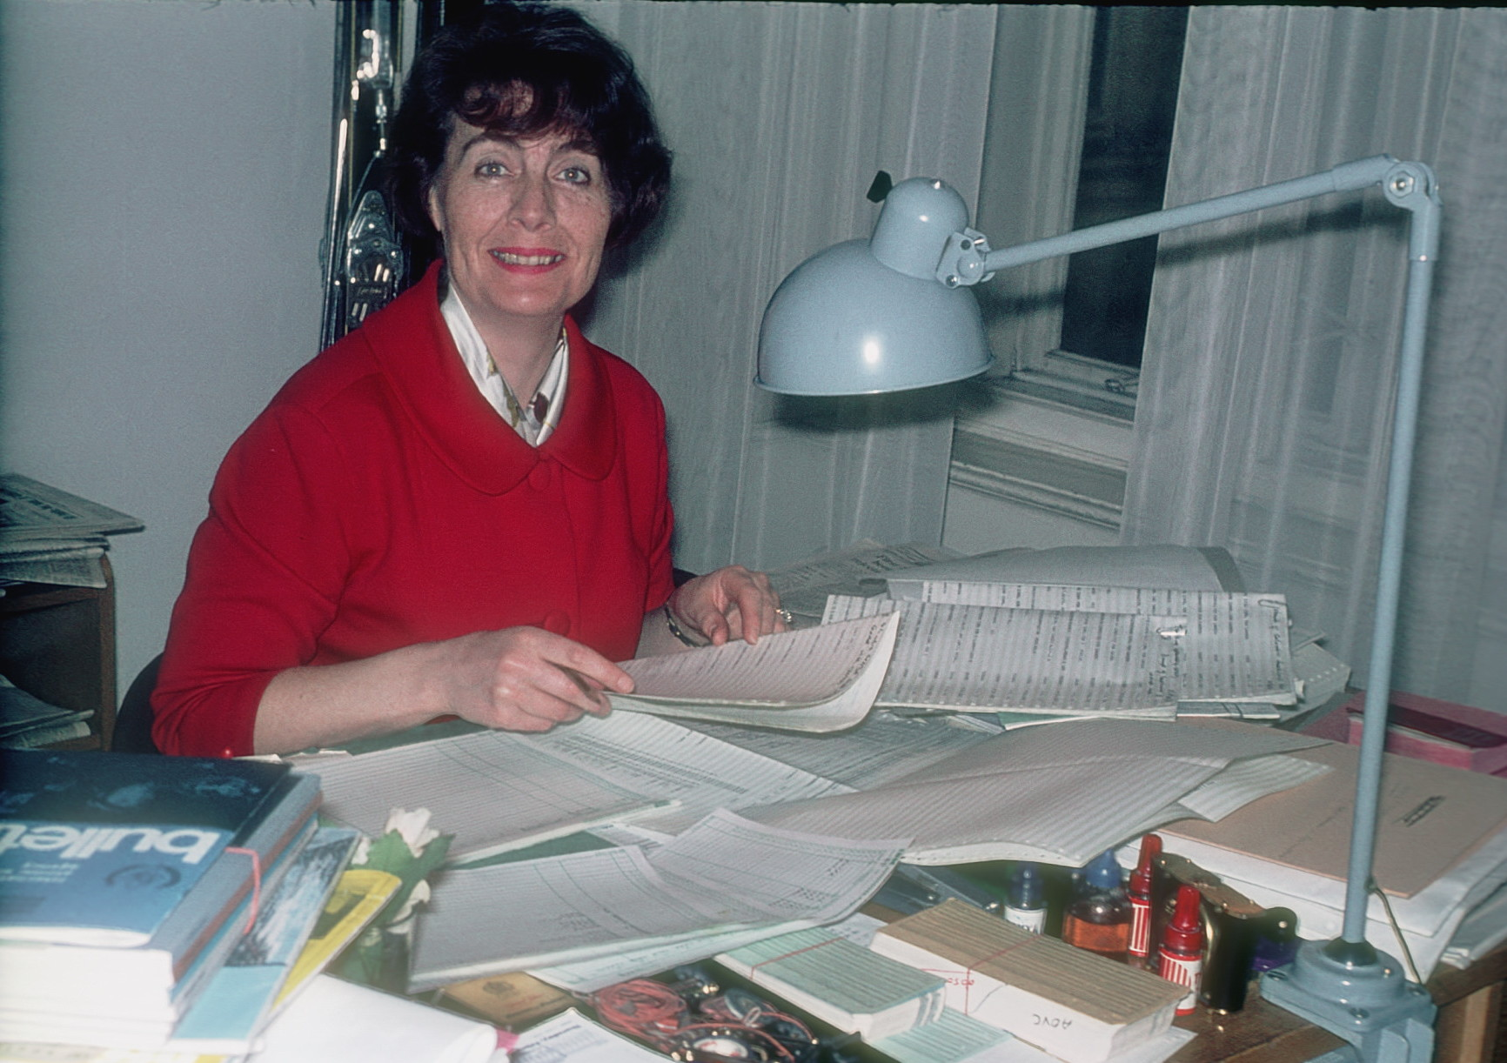
1968-Pamela Atree

Slide 11
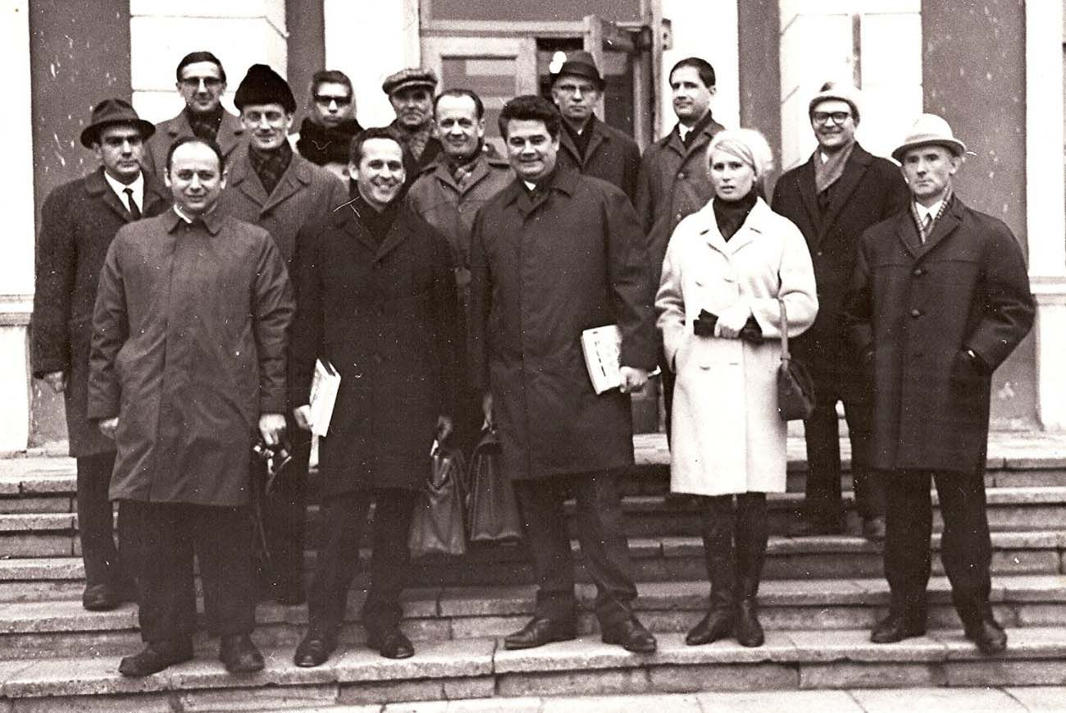
1969 June- 9th Four Centre Meeting, Moscow, USSR
Notes:
1969 June
Ninth Four-Centre Meeting Moscow, USSR
Participants
RUSSIA: Alexander Abramov, Anatoly Ignatyuk, Valery Ivanovich Popov, S.I.
Sukhoruchkin, Yu.G. Klimov, Irina Goreva Tichonov (interpreter) UNITED STATES OF AMERICA: Sol Pearlstein CCDN: Victor Bell, Horst Liskien IAEA: Hans Lemmel, Alex Lorenz, Joseph Schmidt 1st Row: Sol Pearlstein, Alex Lorenz, Joe Schmidt, Irina Goreva (interpreter,foreign office, IPPE), Yu.G. Klimov 2nd Row: Valery Popov, Vic Bell, Alexander Abramov, Dmitri Kardashev 3rd Row: Horst Liskien, Valya Kondretova, A. Sokolov (Foreign Office), Peter Otstavnov, Hans Lemmel

Slide 12
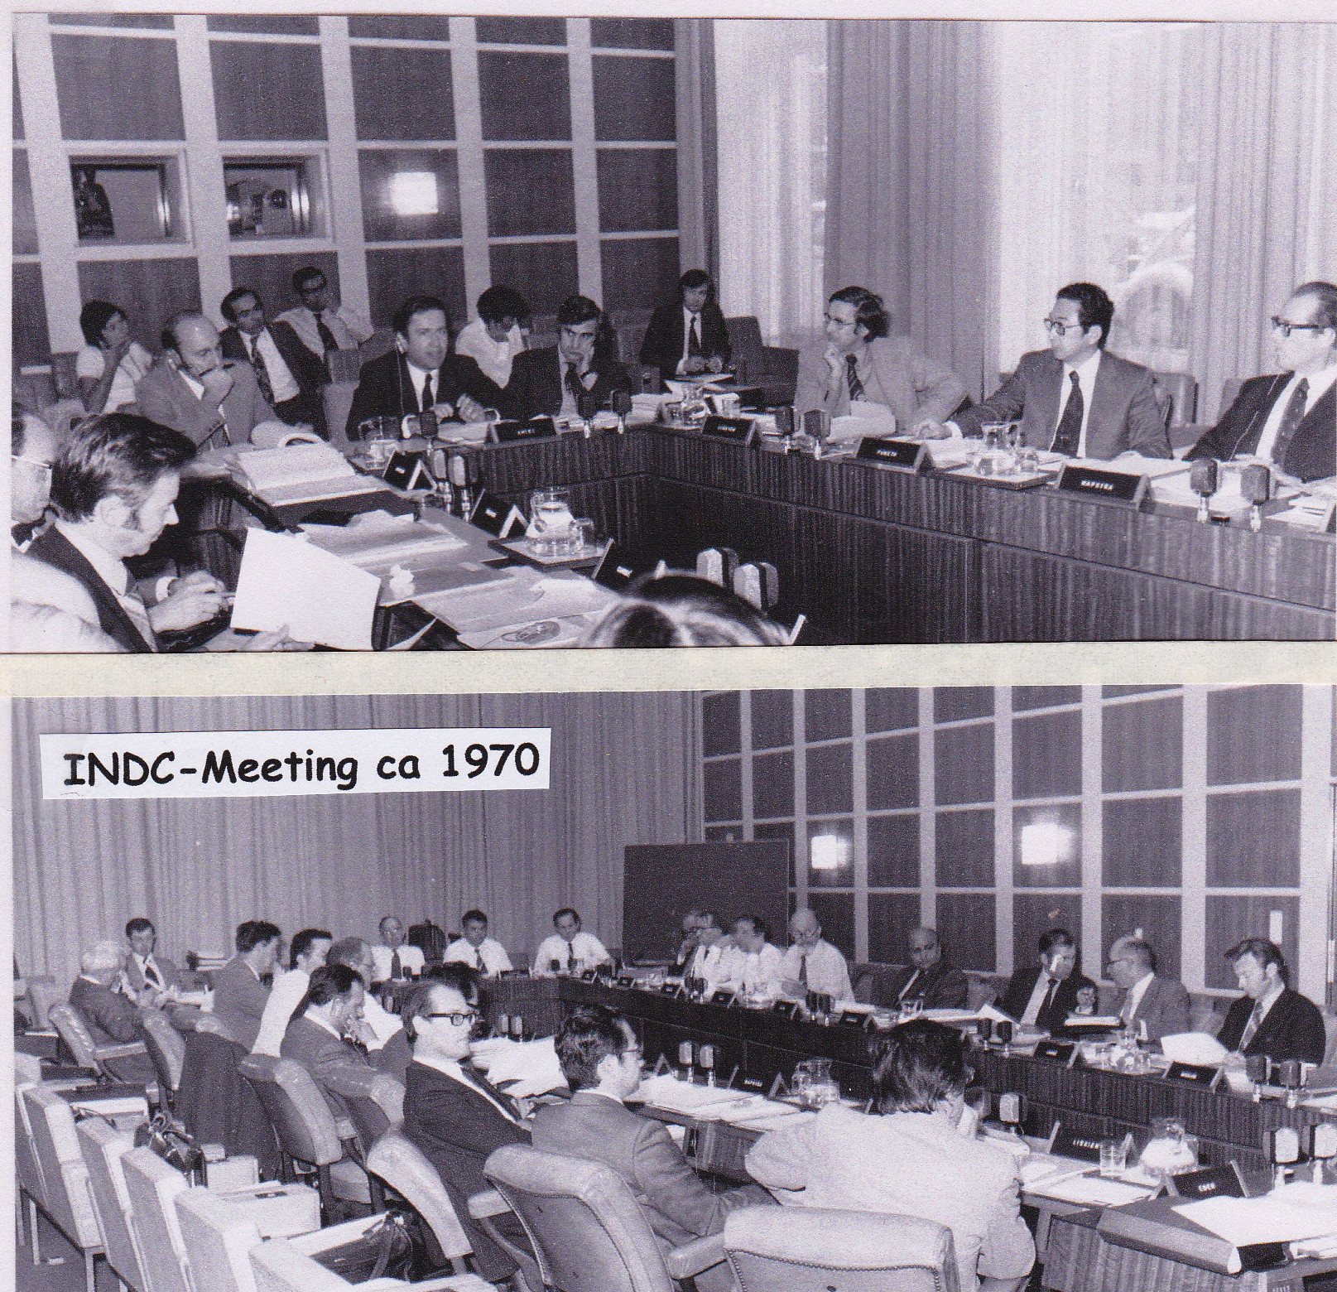

Slide 13
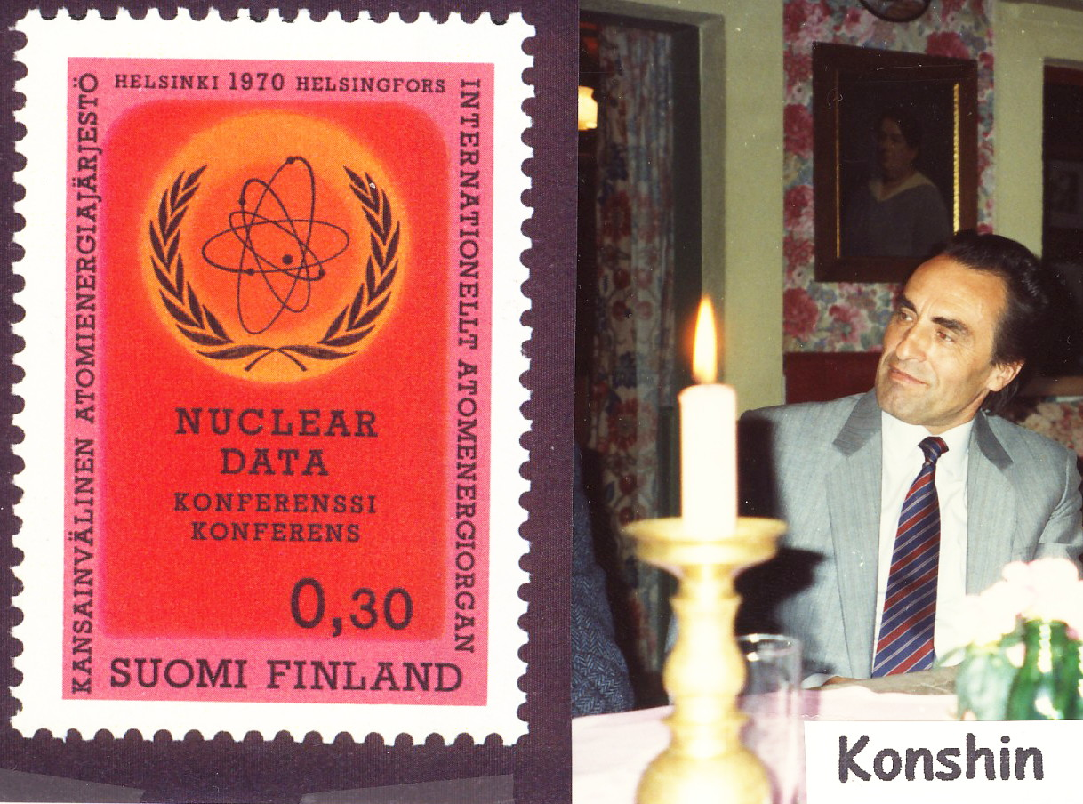

Slide 14
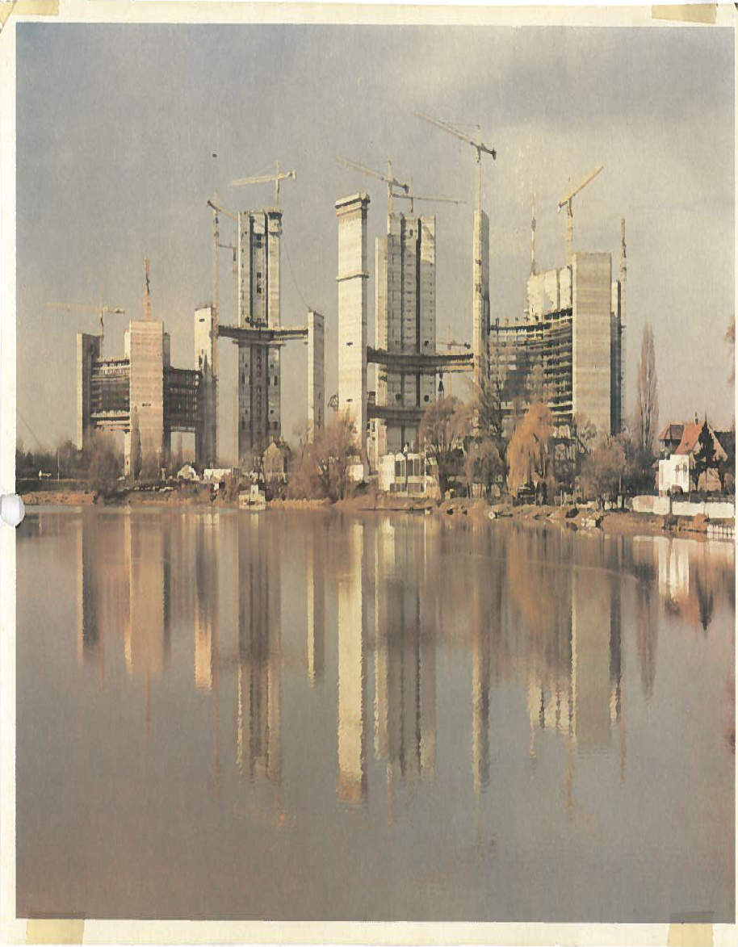
VIC building site
Notes:
VIC building site

Slide 15
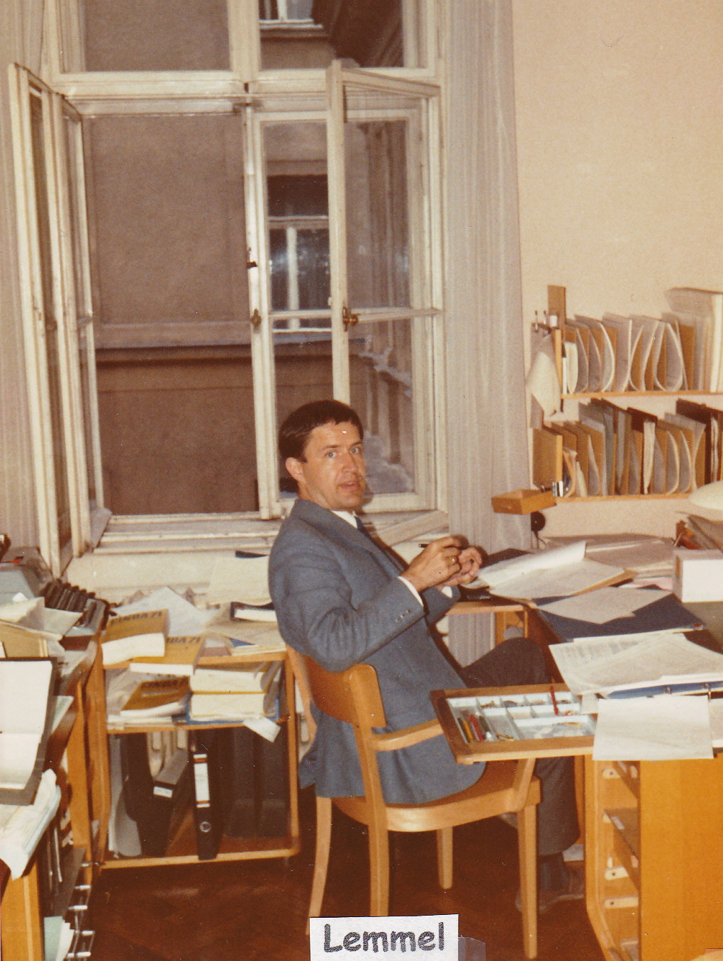
1972

Slide 16
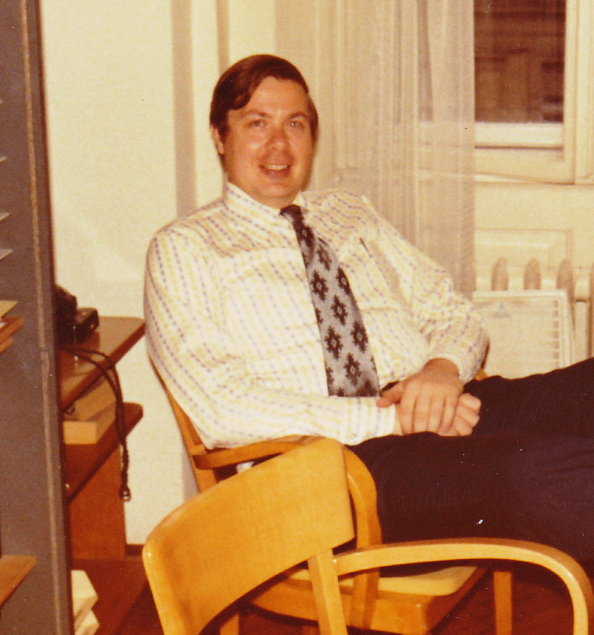
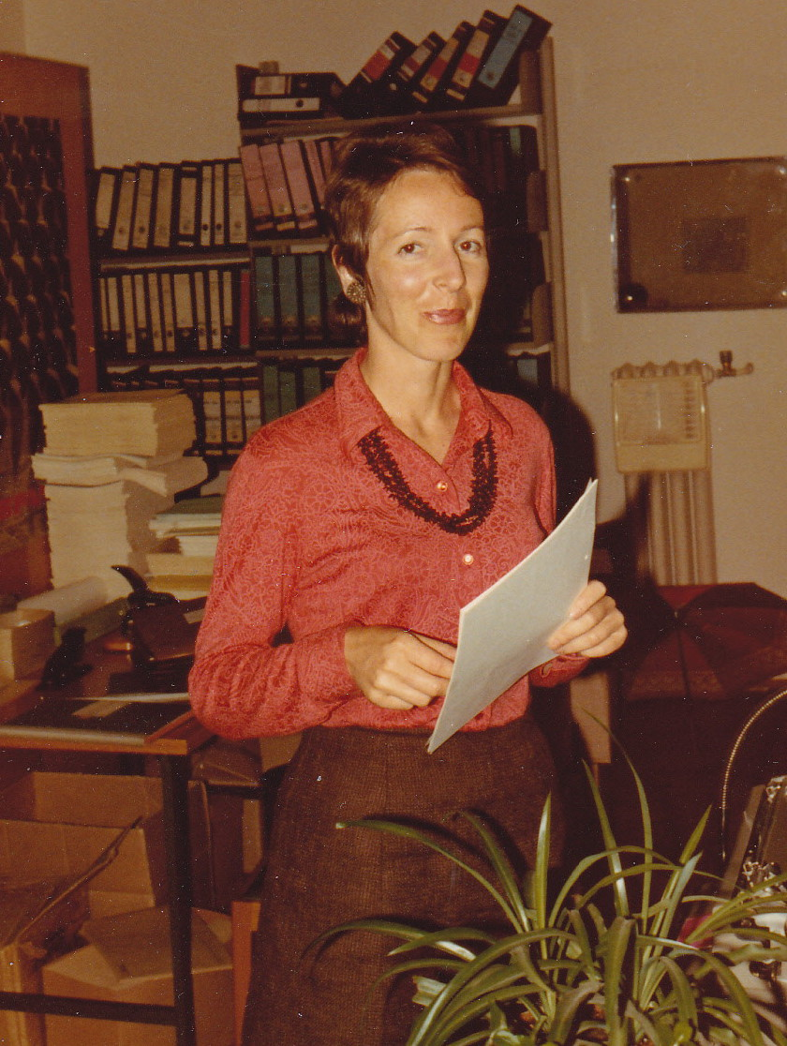
Charlie Dunford – Eva Kiovsky

Slide 17
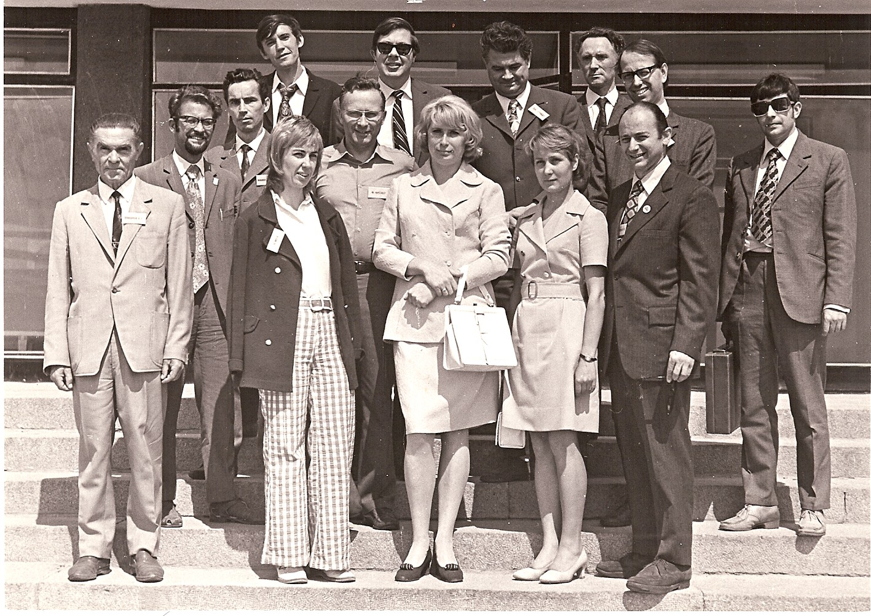
1973 June-Nuclear Reaction Data Centre Meeting
Notes:
1973-Nuclear Reaction Data Centre Meeting-1973 June
Front: A. Sokolov (foreign office, IPPE), Vicki McLane May, Irina Goreva (interpreter), Lyuba
Tarasko, Sol Pearlstein
Back (left to right): Vladimir Vozyakov, Vasili Manokhin, Yuri Bobkov, Fritz Fröhner, Charlie
Dunford, Joe Schmidt, Yuri Klimov (Minatom), Hans Potters, Anatoly Bakunyaev
(Minatom)

Slide 18
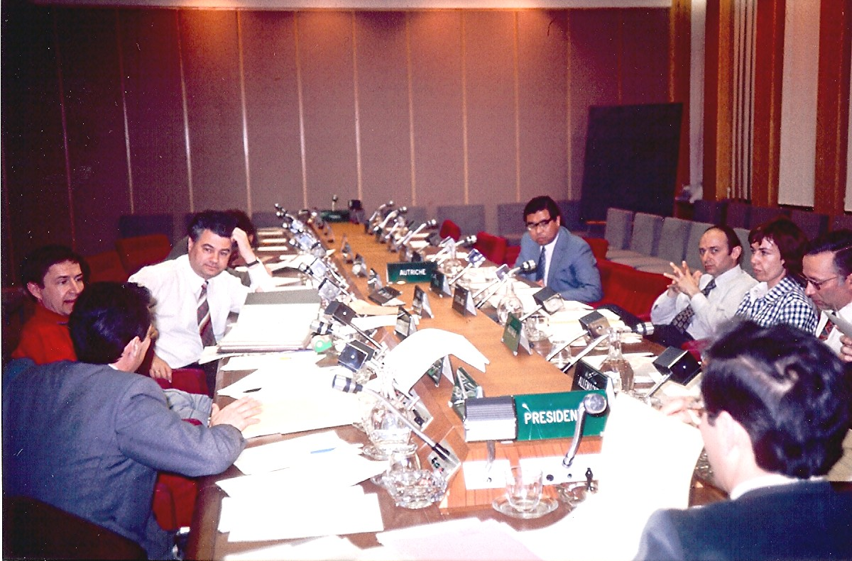
1974-Nuclear Reaction Data Centre Meeting
Notes:
1974-Nuclear Reaction Data Centre Meeting

Slide 19
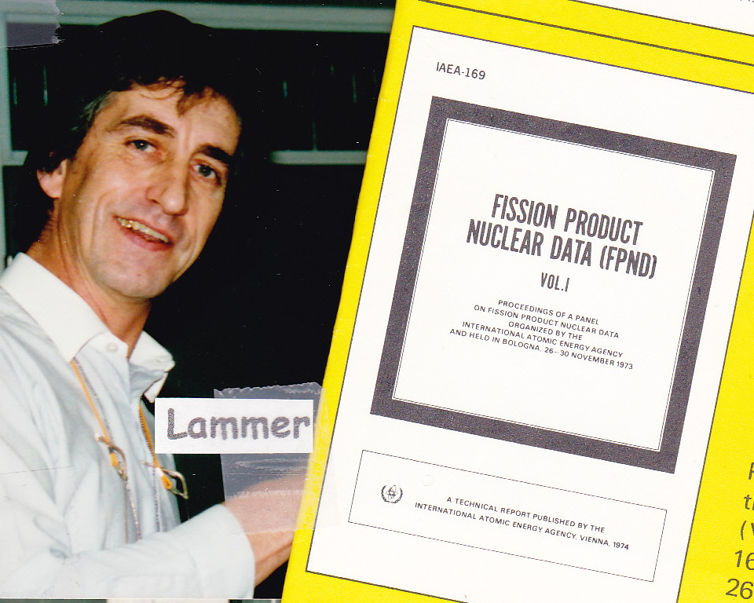
1974

Slide 20
1974

Slide 21
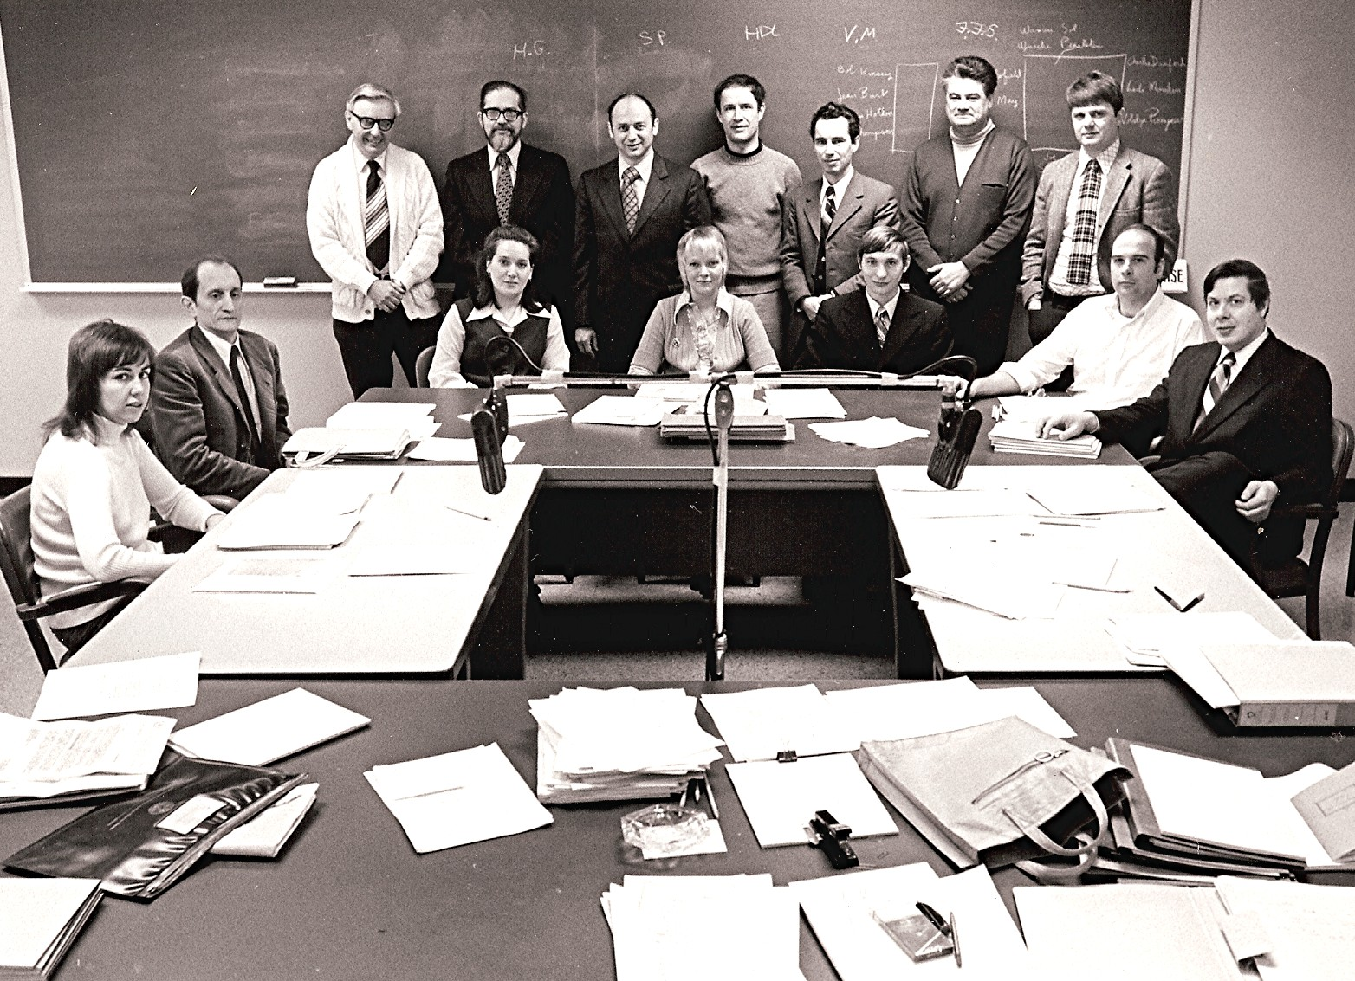
1975-Nuclear Reaction Data Centre Meeting
Notes:
1975-Nuclear Reaction Data Centre Meeting

Slide 22
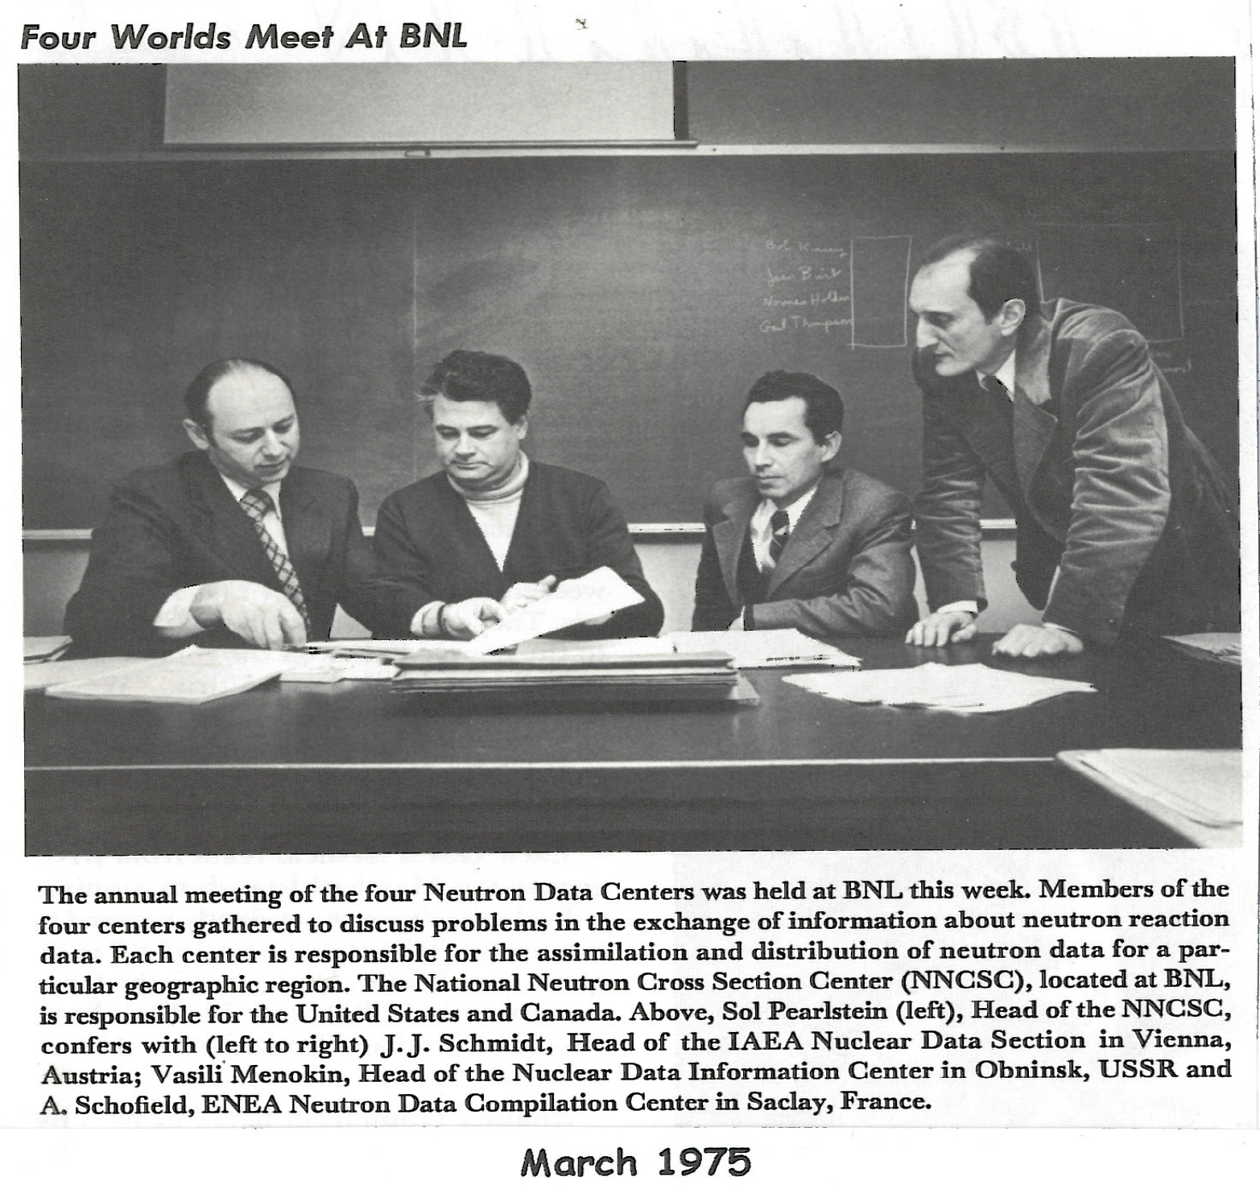

Slide 23
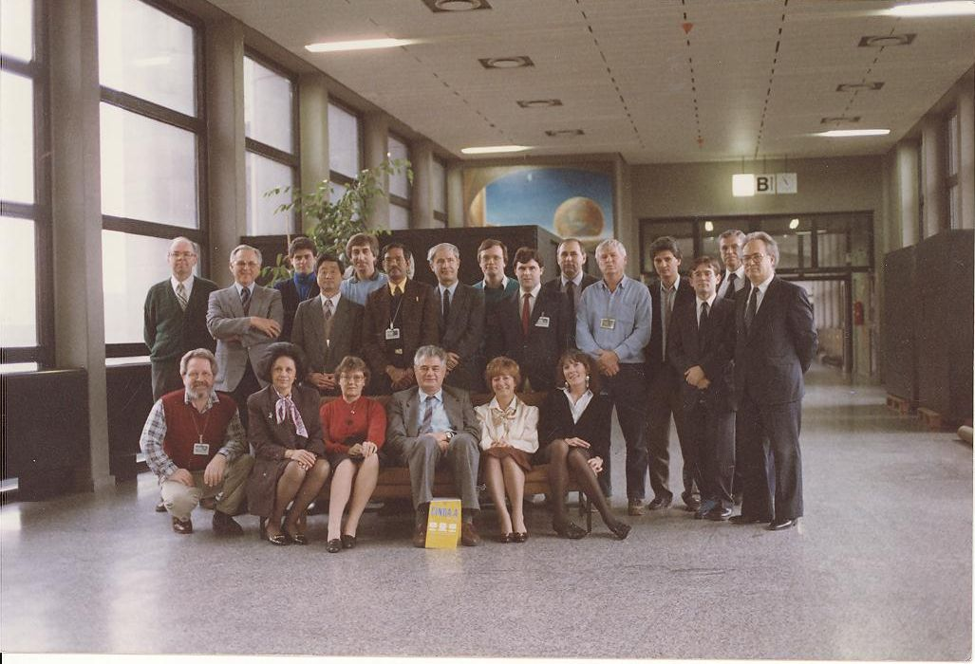
1980-Nuclear Data Section
Notes:
1980-NDS

Slide 24
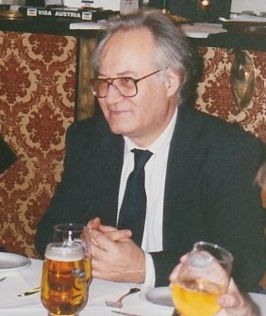
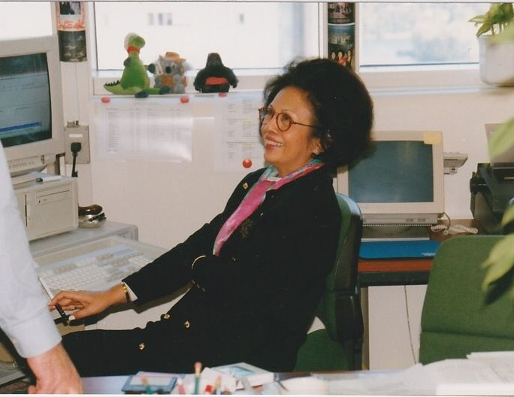
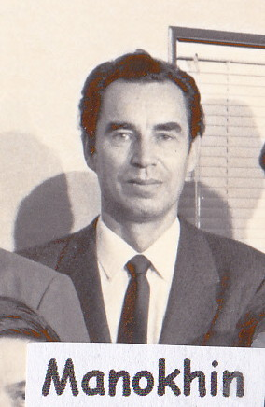
R. Janev S. Aung

Slide 25
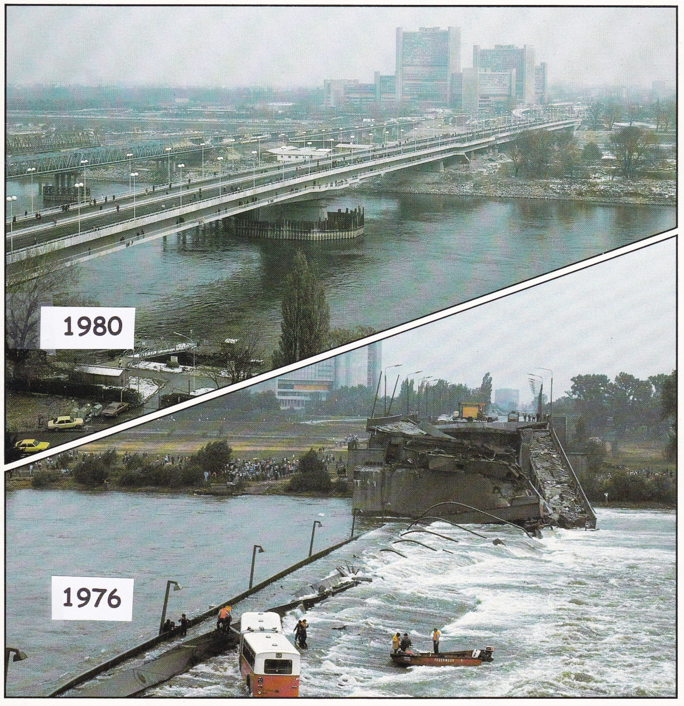
Reichsbruecke

Slide 26
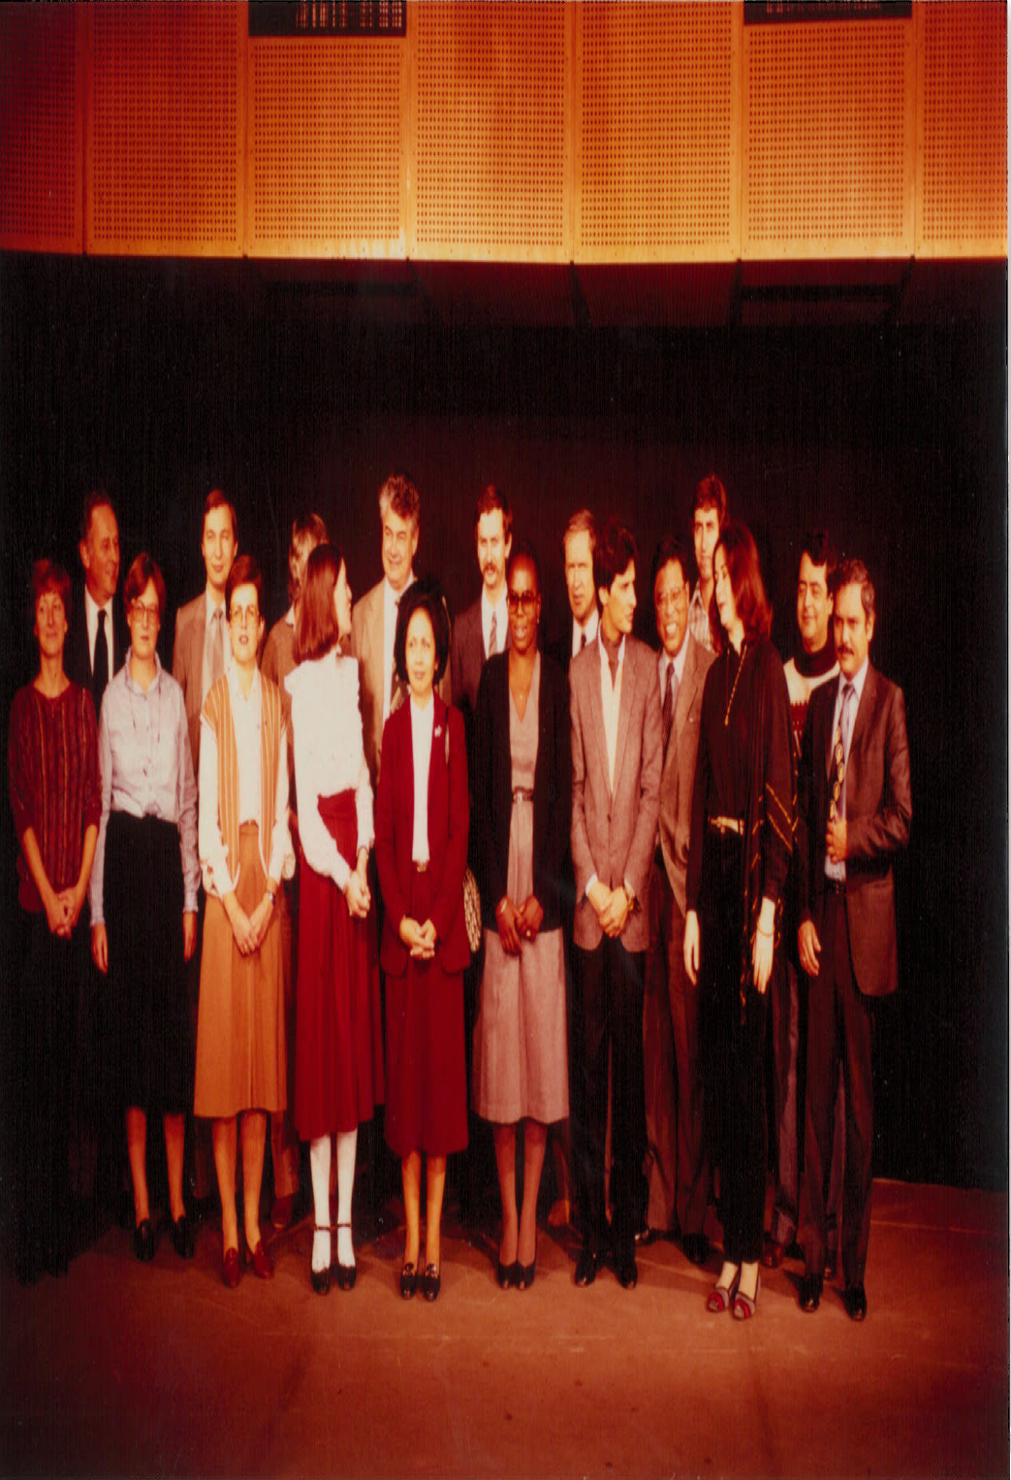
1982-Nuclear Data Section

Slide 27
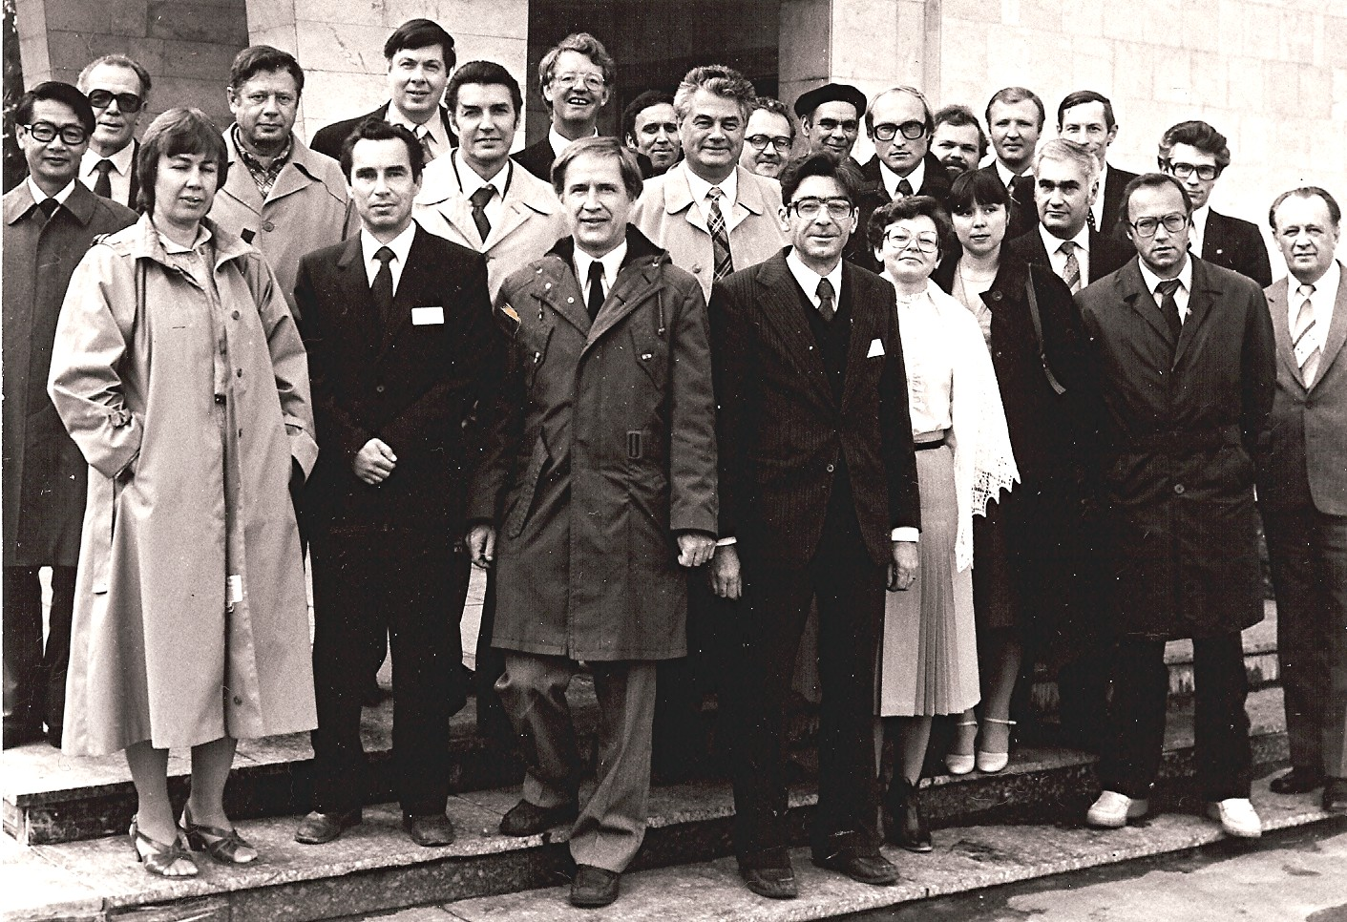
1983-Nuclear Reaction Data Centre Meeting
Notes:
1983-Nuclear Reaction Data Centre Meeting

Slide 28
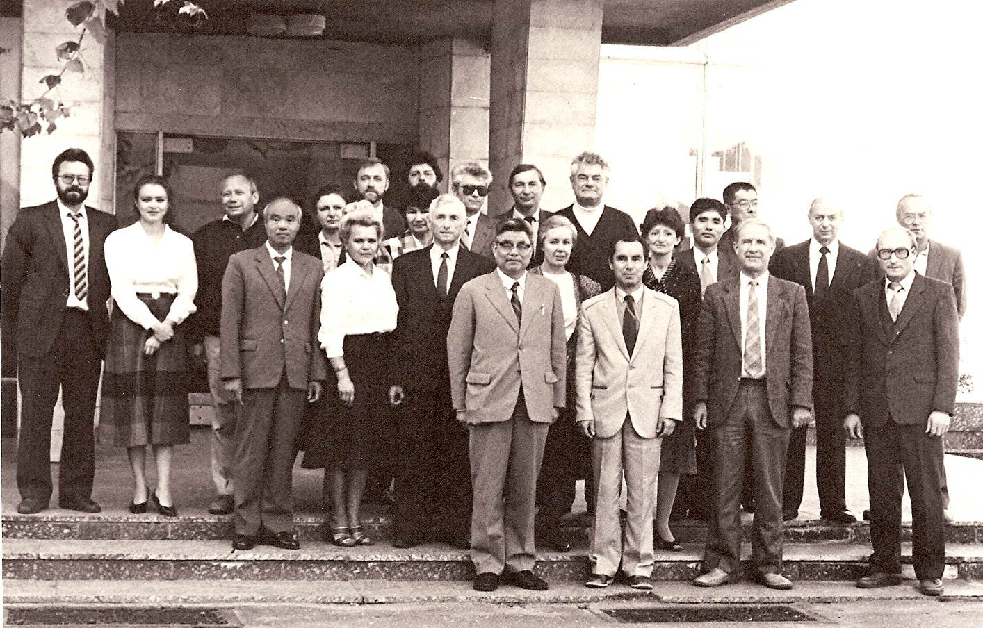
1983-Nuclear Reaction Data Centre Meeting
Notes:
1983-Nuclear Reaction Data Centre Meeting

Slide 29
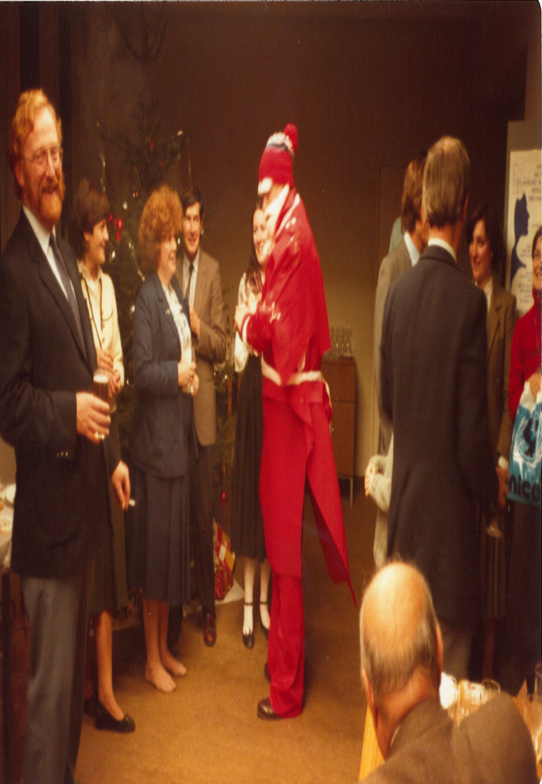
1983-Christmas Party

Slide 30
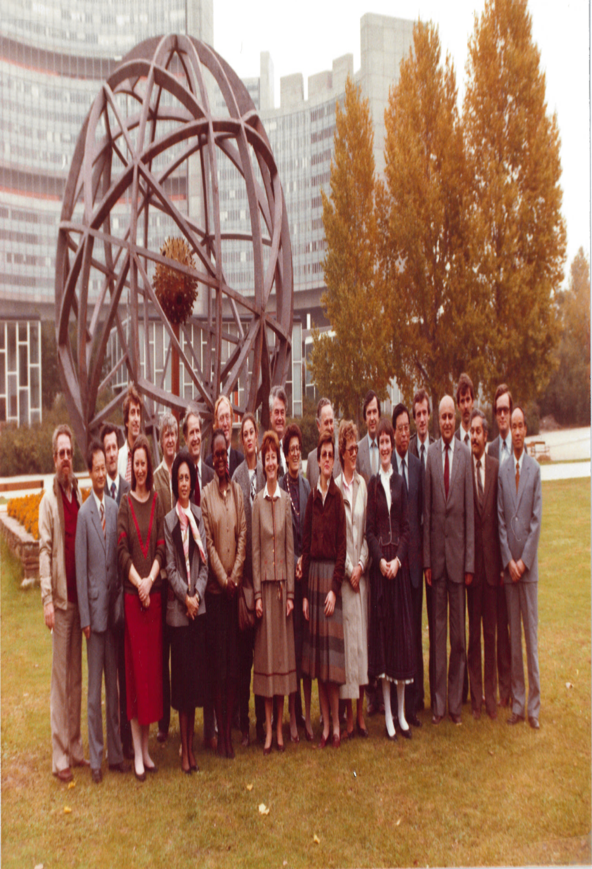
1984-Nuclear Data Section

Slide 31
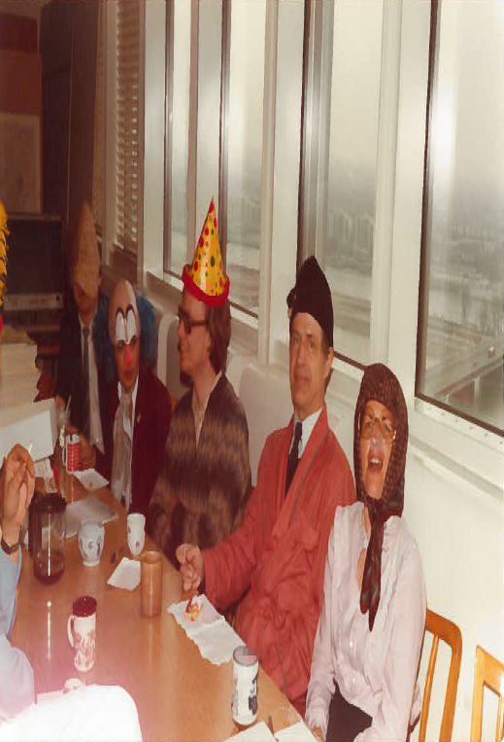
1984-Fasching in NDS (1)

Slide 32
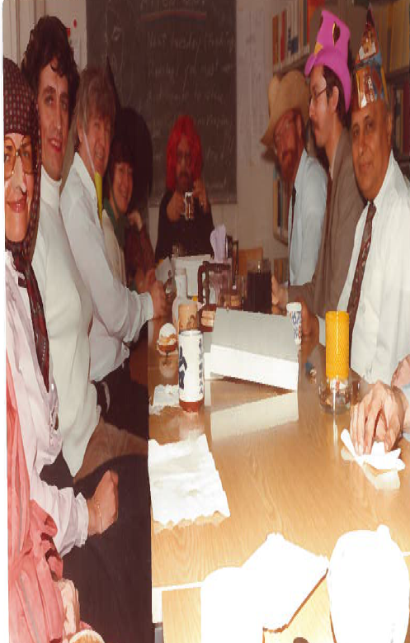
1984-Facsching in NDS (2)

Slide 33
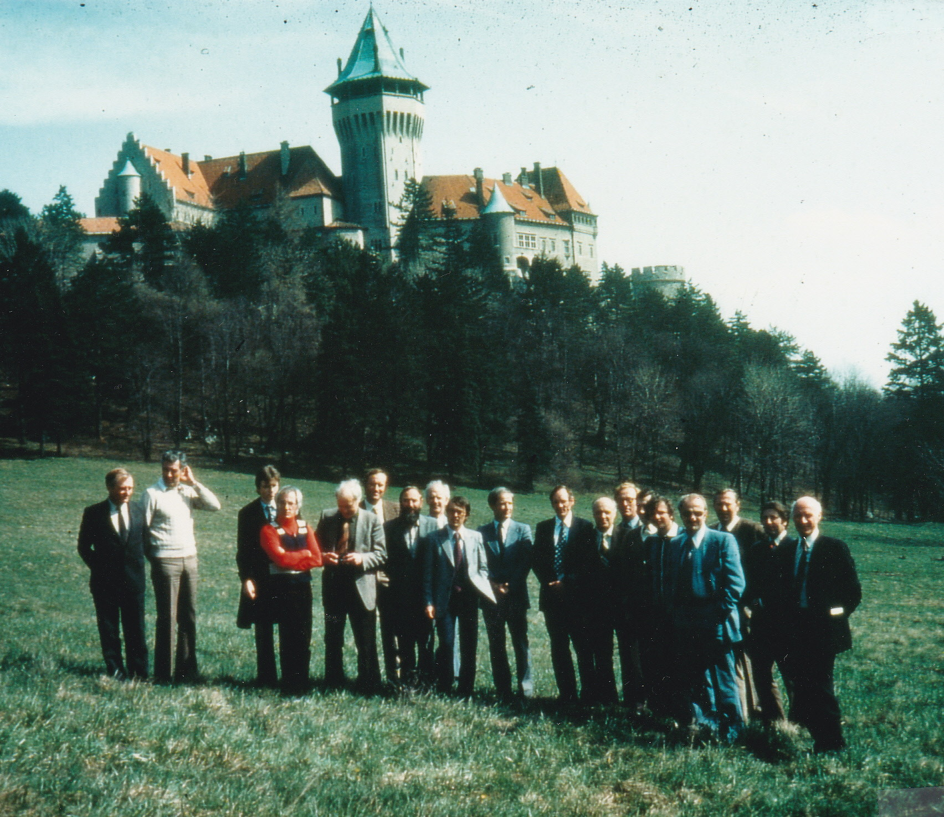
1985-NRDC Smolenice

Slide 34
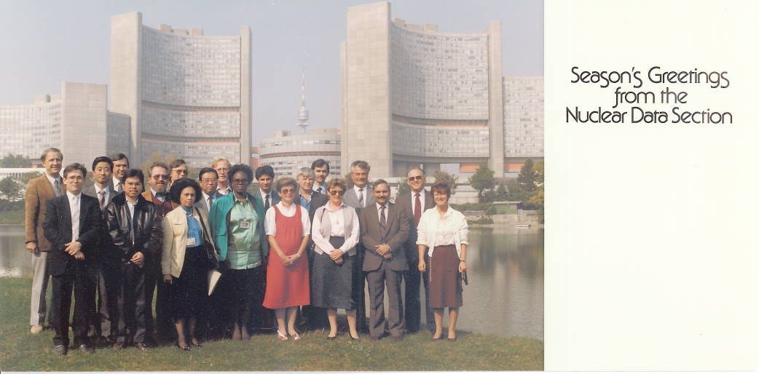
1986-Nuclear Data Section
Notes:
1986-NDS

Slide 35
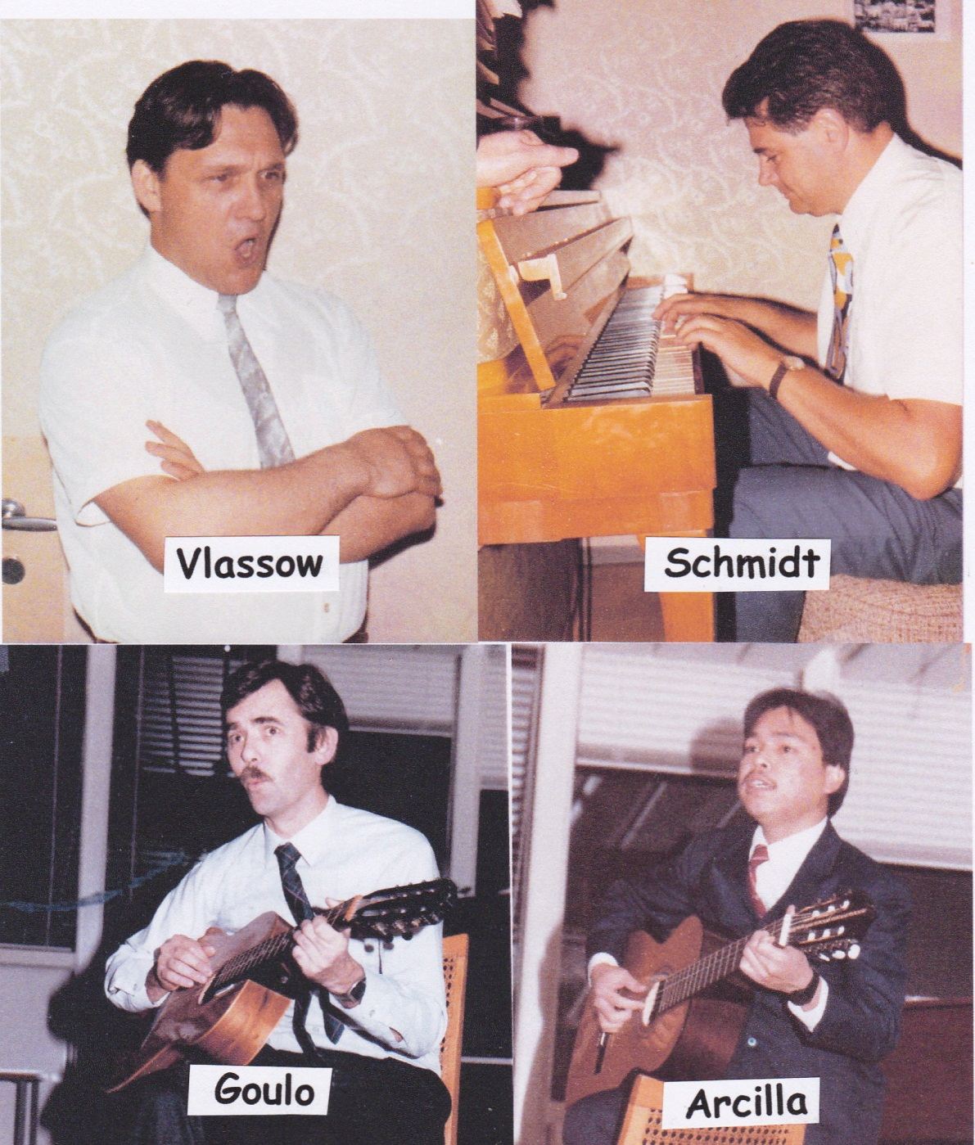

Slide 36
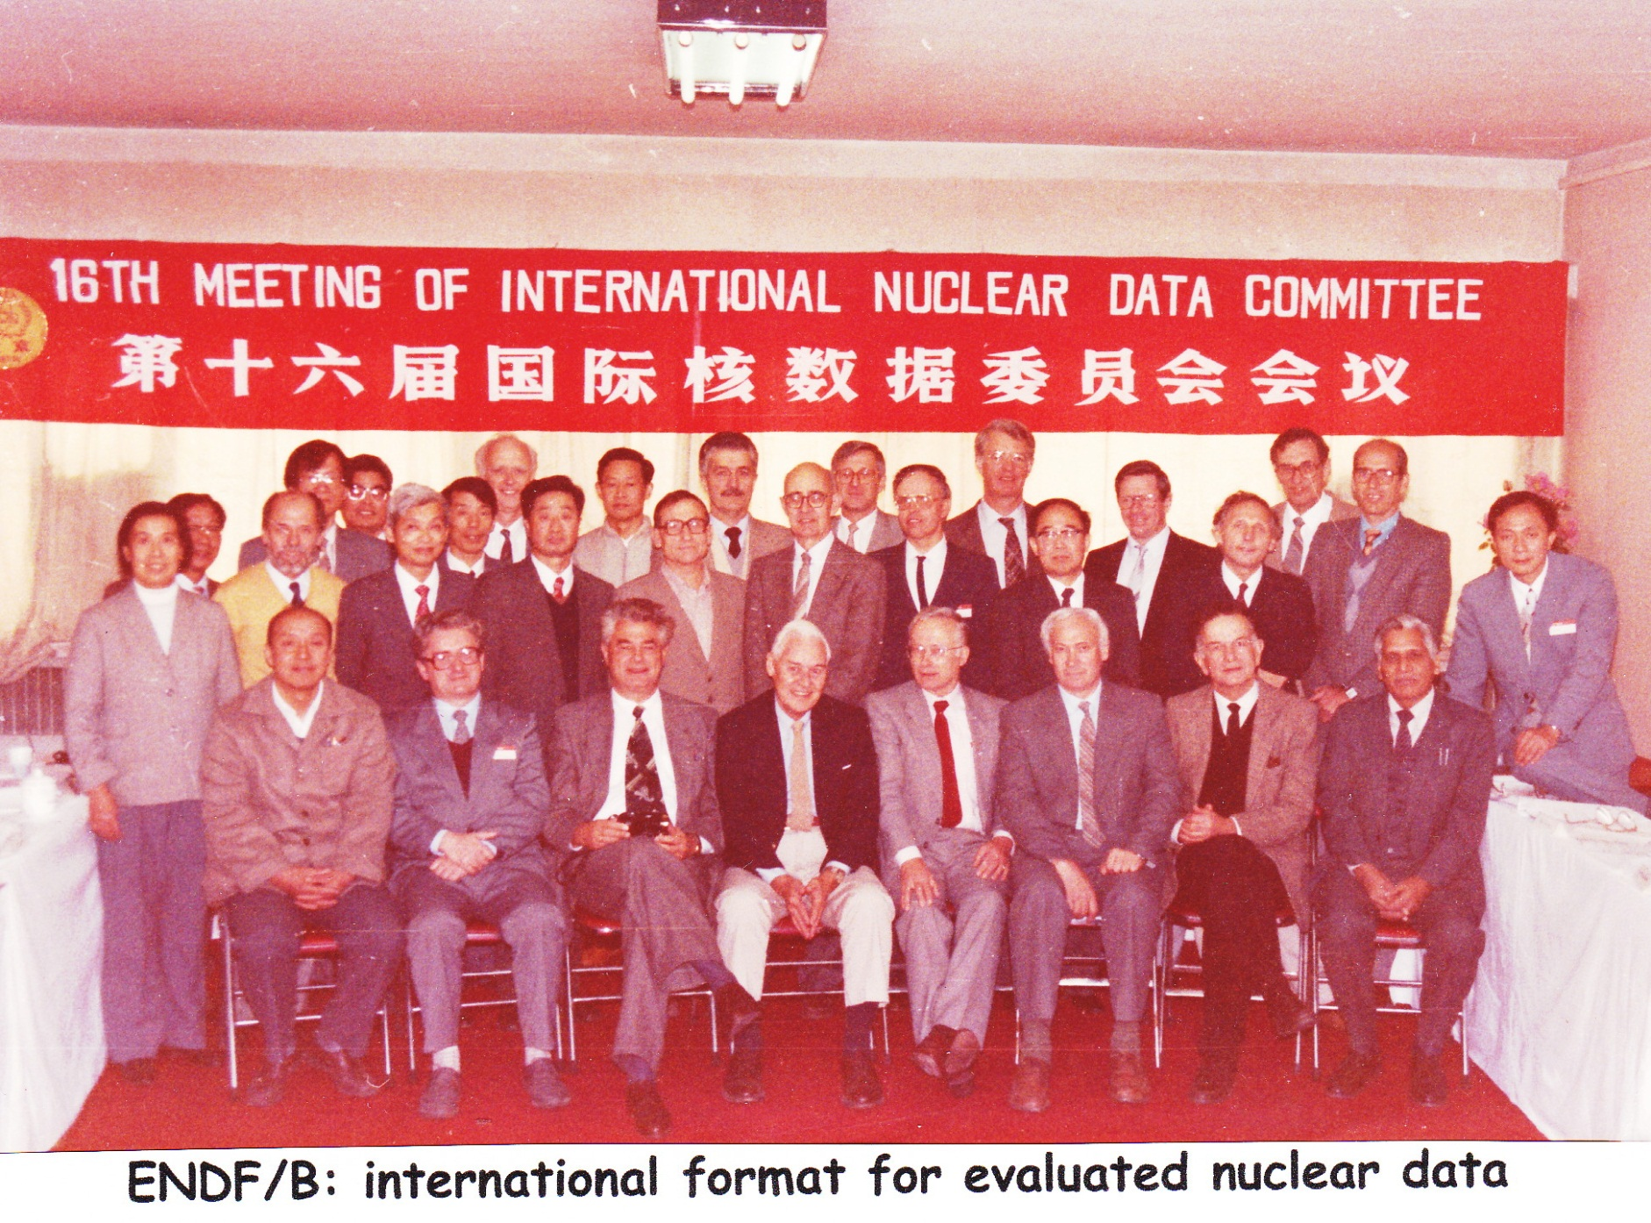
1987

Slide 37
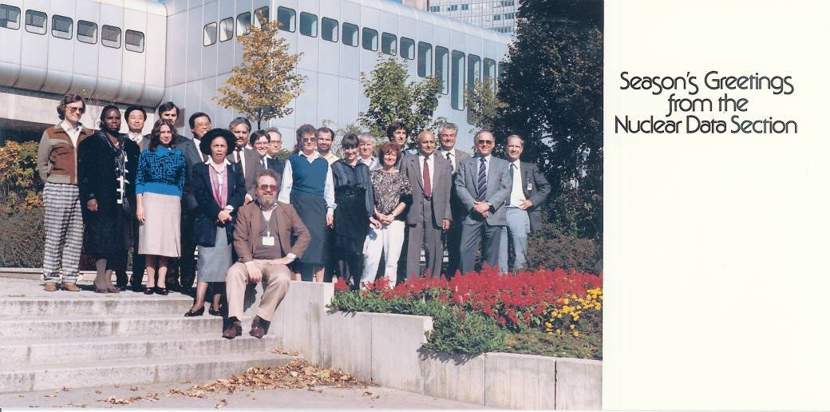
1987-Nuclear Data Section
Notes:
1987-NDS

Slide 38
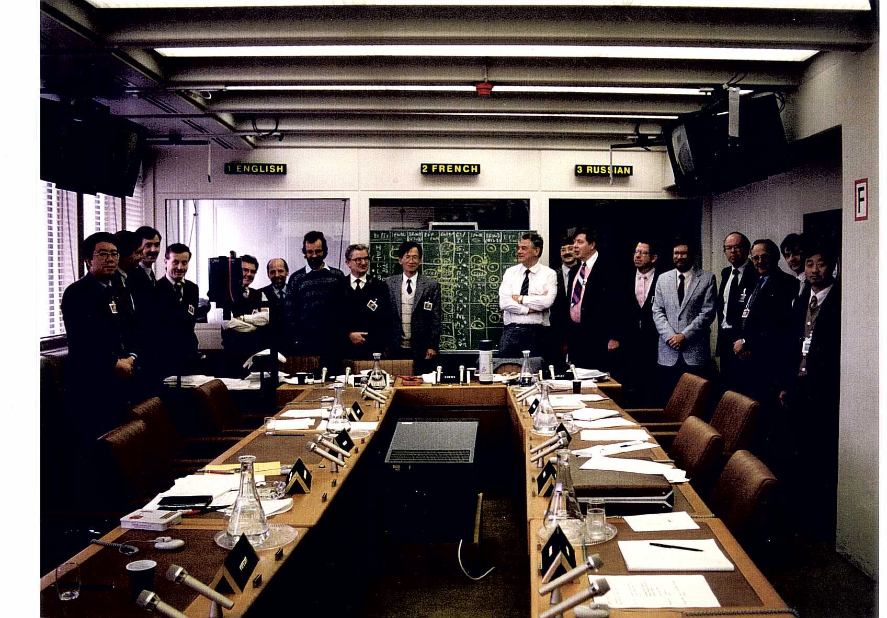
1987-1. FENDL Meeting
Notes:
1987-1. FENDL Meeting

Slide 39
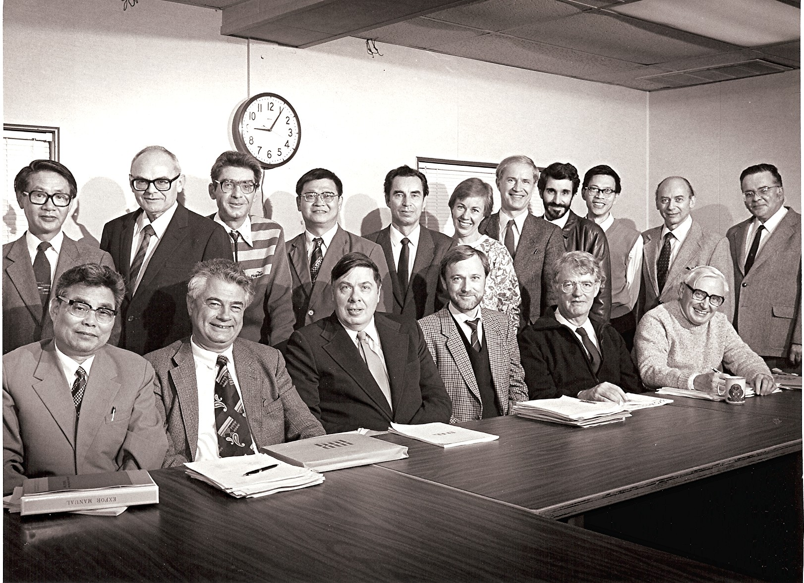
1987-Nuclear Reaction Data Centre Meeting
Notes:
1987-Nuclear Reaction Data Centre Meeting

Slide 40
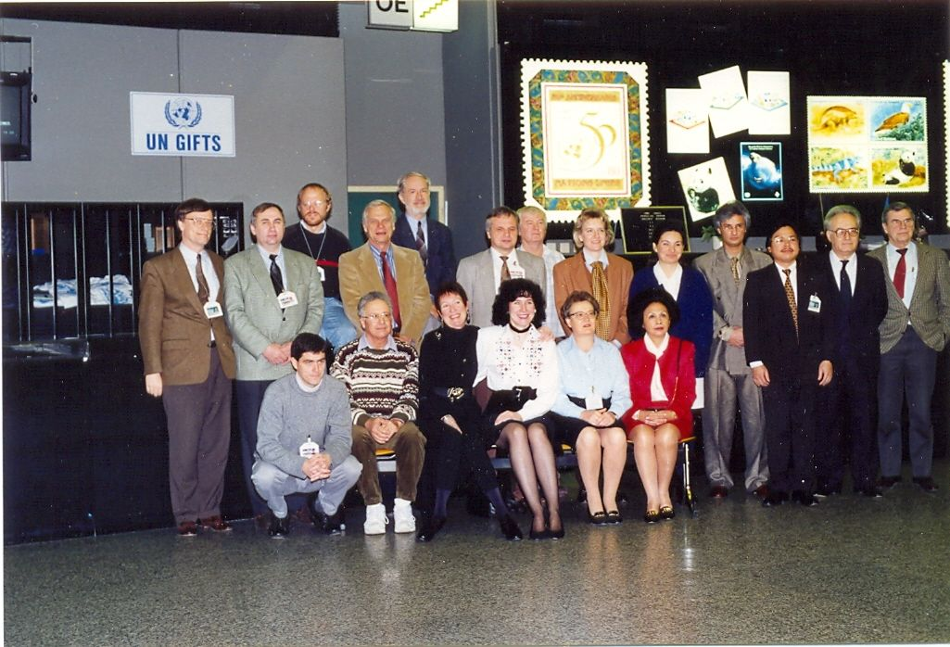
1988-Nuclear Data Section
Notes:
1988-NDS-2

Slide 41
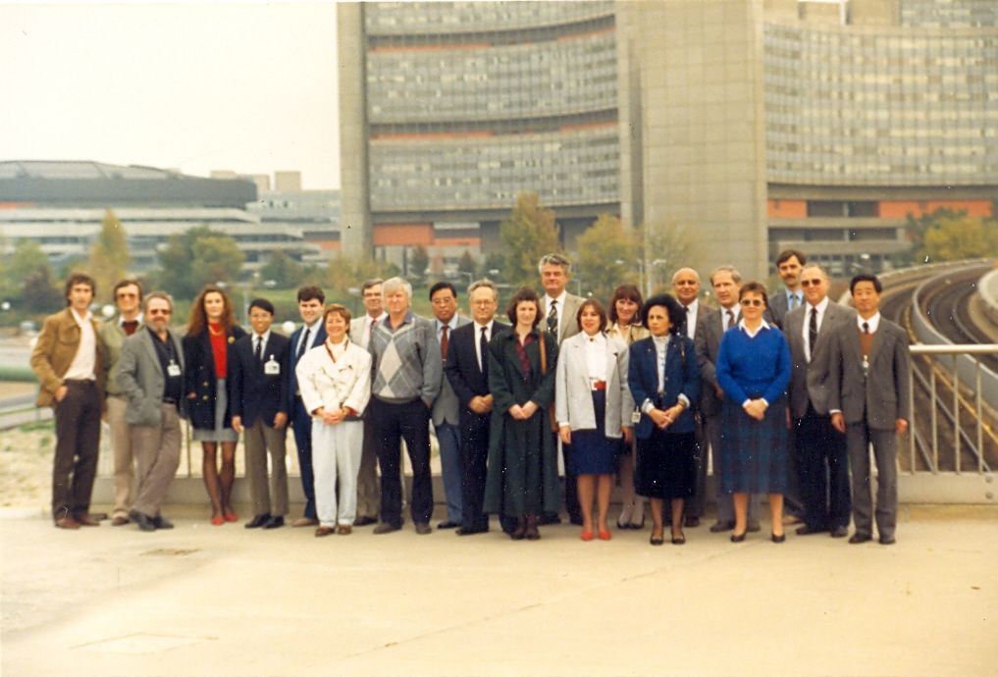
1988-Nuclear Data Section
Notes:
1988-NDS

Slide 42
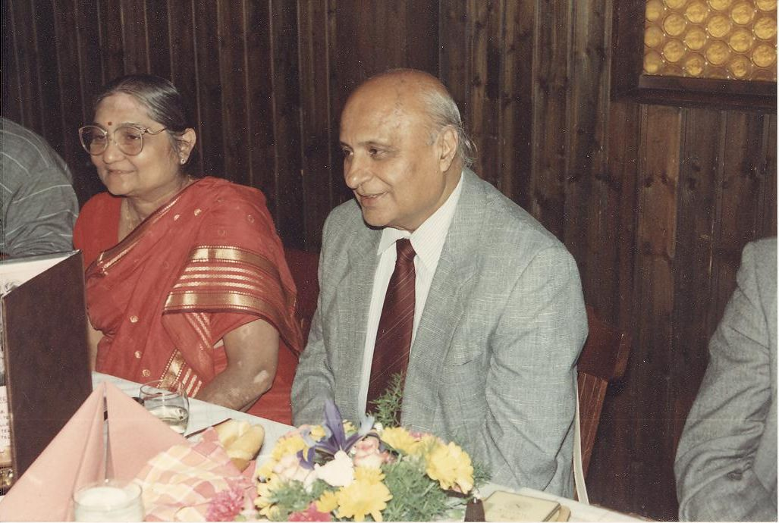
1989-Madhu Mehta
Notes:
1989-Madhu Mehta

Slide 43
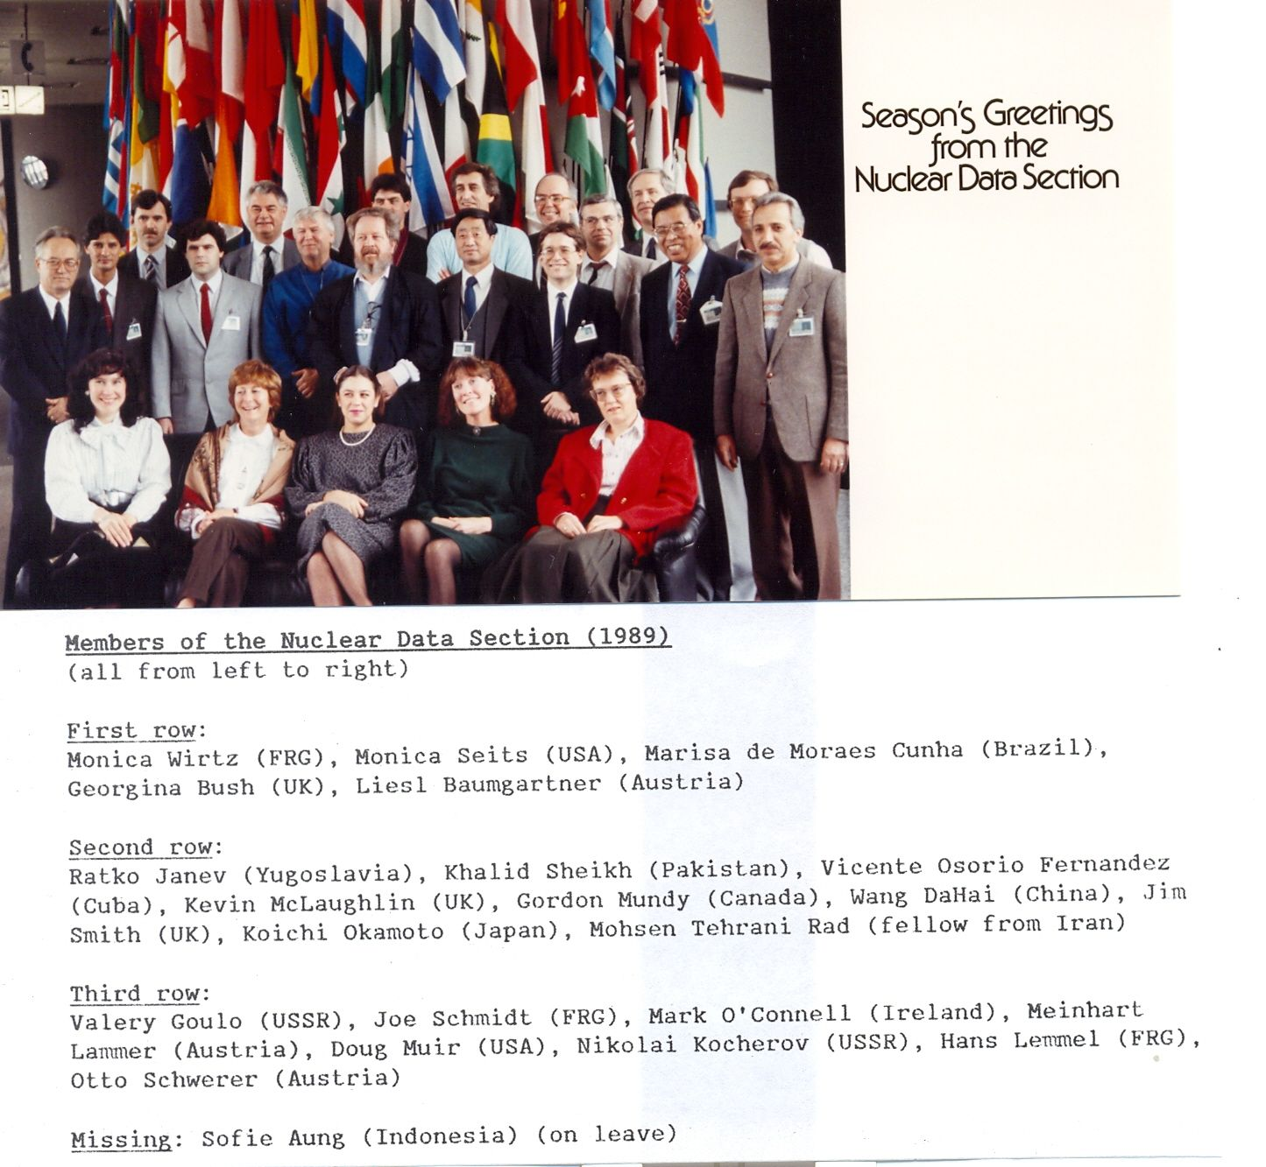
Notes:
1989-NDS

Slide 44
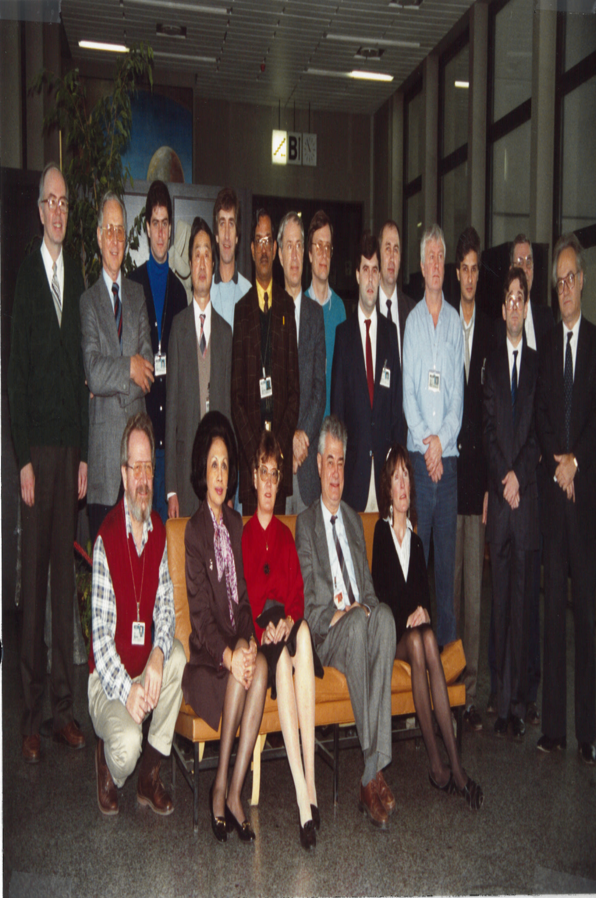
1990-Nuclear Data Section

Slide 45
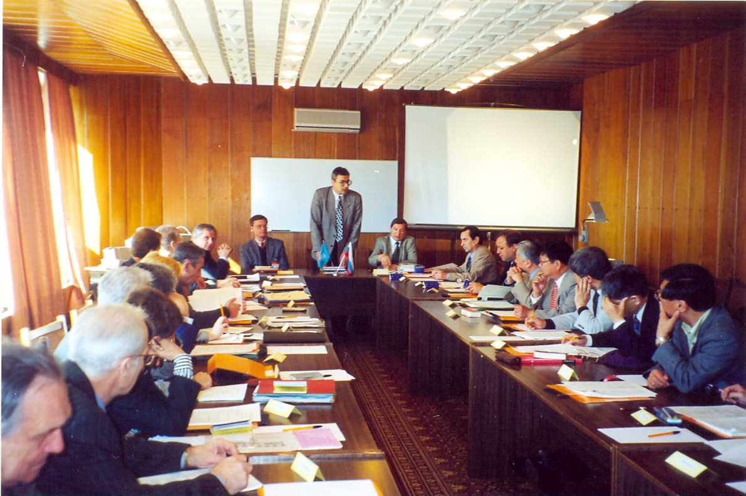
1990-NRDC

Slide 46
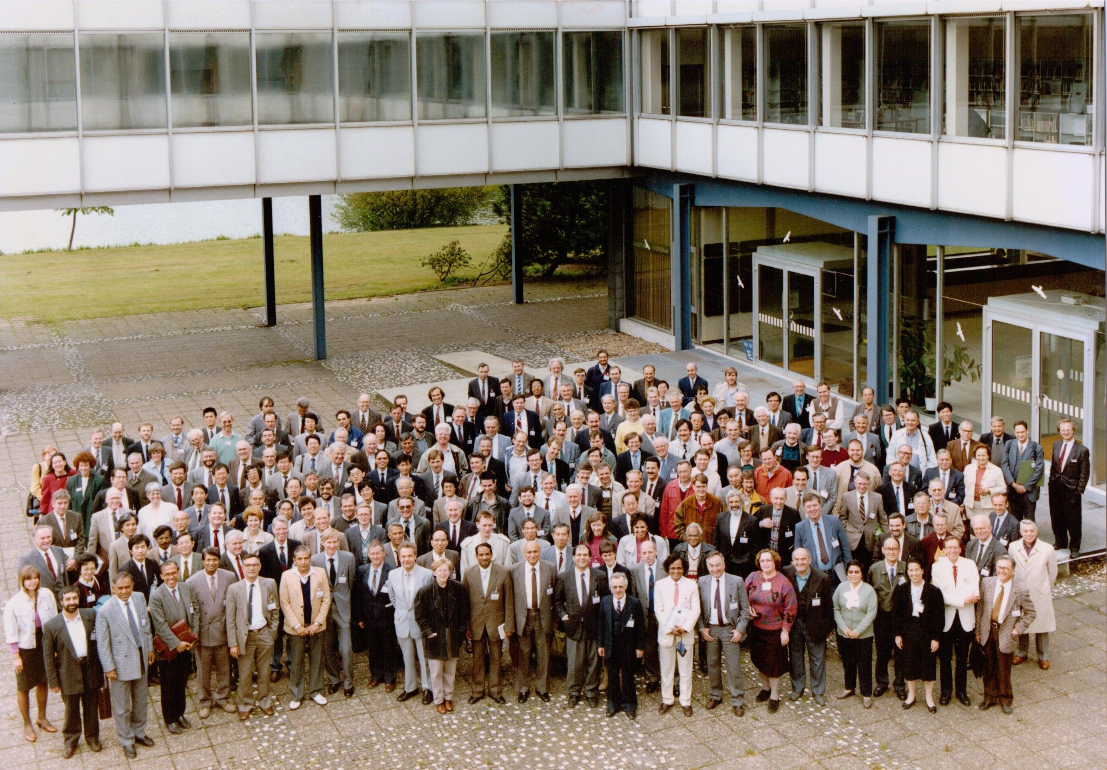
1991-Nuclear Data Conference, Juelich
Notes:
1991-ND Conference Juelich

Slide 47
Notes:
1992-NDS

Slide 48
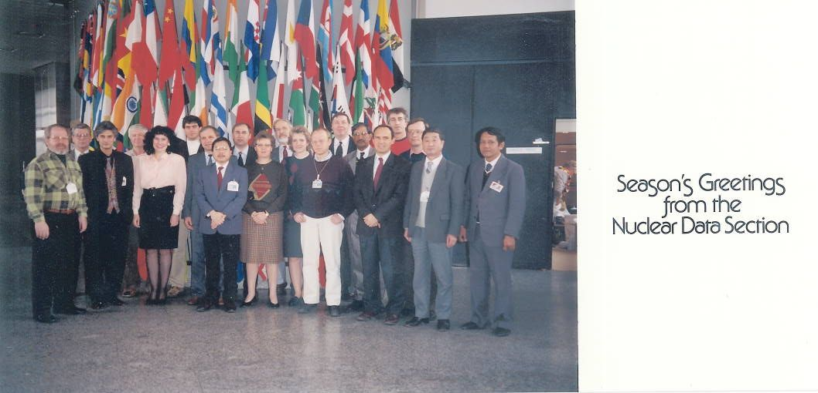
1993-Nuclear Data Section
Notes:
1993-NDS

Slide 49
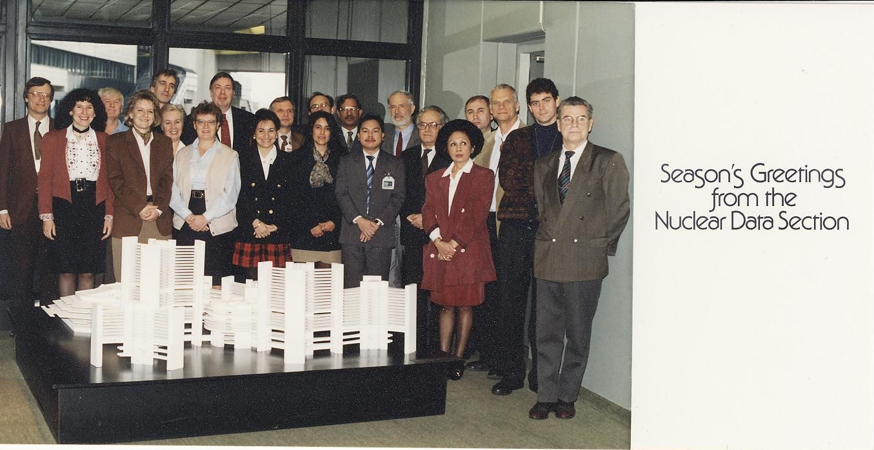
1994-Nuclear Data Section
Notes:
NDS-1994

Slide 50
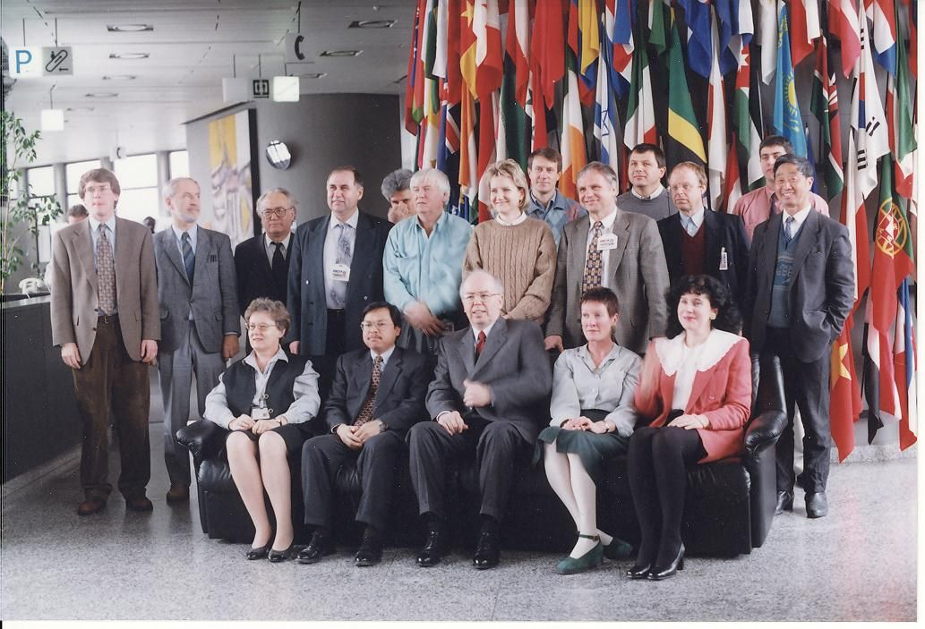
1995-Nuclear Data Section
Notes:
1995-NDS

Slide 51
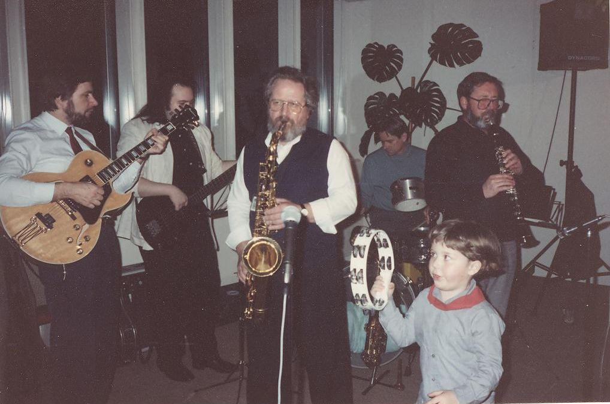
1995-Nuclear Data Section-Christmas Party
Notes:
1995-Xmas party-1

Slide 52
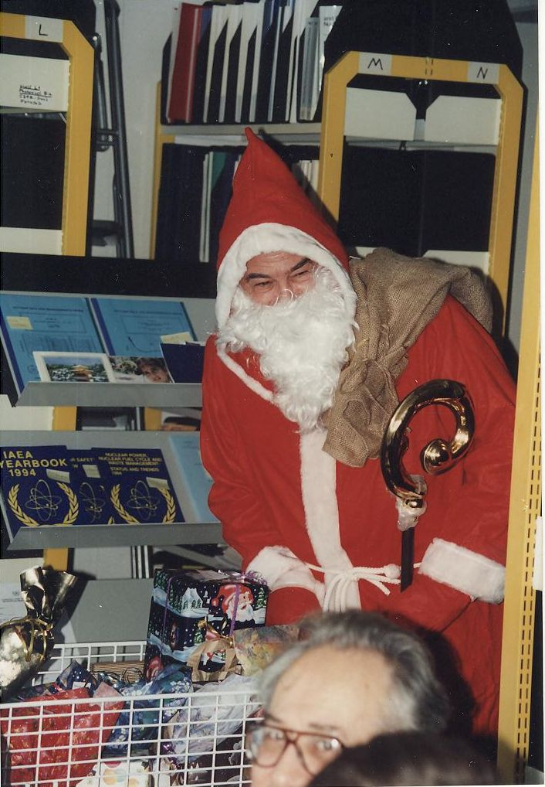
1995-NDS-Christmas Party with Joe Schmidt as Santa Claus
Notes:
1995-Xmas party-2 (Joe Schmidt as Santa Claus)

Slide 53
1995-NDS-Christmas Party-presents time
Notes:
1995-Xmas party-3-presents

Slide 54
1995-Nuclear Reaction Data Centre Meeting
Notes:
1995-Nuclear Reaction Data Centre Meeting

Slide 55
1997-Nuclear Data Section

Slide 56
1997-Nuclear Data Section –A.B. Paschenko and J. Schmidt
Notes:
1997-NDS

Slide 57
1997-NDS-Doug Muir
Notes:
1997-NDS-2

Slide 58
1998

Slide 59
1999-Nuclear Data Section
Notes:
1999-NDS

Slide 60
2000-Nuclear Data Section
Notes:
2000-NDS

Slide 61
2002-Nuclear Data Section
Notes:
2002-NDS-Christmas card

Slide 62
2003-NRDC Workshop

Slide 63
2003-Alan Nichols’s Farewell with Joe Schmidt and Charlie Dunford
Notes:
2003-Alan Nichols’s Farewell with Charlie Dunford and Joe Schmidt

Slide 64
2008-International Nuclear Data Committee Meeting
Notes:
2008-International Nuclear Data Committee

Slide 65
2010-Nuclear Data Conference, Jeju Island, Korea
Notes:
2010-ND Conference in Jeju Island, Korea (Daniel Abriola, Saed Mughabghab, Andrej Trkov, Mike Herman and Robin Forrest)

Slide 66
2010-Nuclear Data Conference, Jeju Island, Korea
Notes:
2010-ND Conference in Jeju Island, Korea-2

Slide 67
2010-NDS-J. Schmidt, D. Seeliger, R. Forrest and V. Pronyaev
Notes:
2010-NDS-J. Schmidt, D. Seeliger, R. Forrest and V. Pronyaev

Slide 68
2010-NDS-with Joe Schmidt and D. Seeliger
Notes:
2010-NDS-with Joe Schmidt and D. Seeliger

Slide 69
2011-Technical Meeting on Long-term Nuclear Data Needs
Notes:
2011-Technical Meeting on Long-term Nuclear Data Needs

Slide 70
2012-International Nuclear Data Committee Meeting
Data Workshop in India
2012
International Nuclear Data Committee Meeting
Notes:
2012-International Nuclear Data Committee Meeting

Slide 71
2012-Nuclear Data Workshop in India
Notes:
2012-Nuclear Data Workshop in India

Slide 72
2013-DAE-BRNS EXFOR Workshop in Varanasi, India
Notes:
2013-EXFOR Workshop in India

Slide 73
2013-Nuclear Reaction Data Centre Meeting-Vienna
Notes:
2013-Nuclear Reaction Data Centre Meeting-Vienna

Slide 74
2014-Nuclear Data Section today from left: Alexander Oechs, Vivian Dimitriou, Mark O’Connell, Valentina Semkova, Viktor Zerkin, Rosalinda Rangel-Alvarez, Andrej Trkov, Andras Vasaros, Robin Forrest (SH), Naohiko Otsuka, Marco Verpelli, Lidija Vrapcenjak, Baastian Braams, Ann Jensby

Slide 75
2014-Nuclear Data Section today

Slide 76
Representing NDS on duty travels around the world (and therefore not on the picture)

