Slide 1
Status Report of the Nuclear Structure and Decay Data evaluation activities at the Australian National University (2011-2013)
T. Kibèdi
Tibor Kibèdi, Dep. of Nuclear Physics, Australian National University
20th NSDD, Kuwait, 27 – 31 January 2013

Slide 2
BrIcc - Theoretical conversion coefficients
Conversion coefficients for superheavy elements
(with M. B. Trzhaskovskaya, P.N.P.I. Gatchina, M. Gupta, Manipal Univ., Manipal and. A.E. Stuchery, ANU)
Theoretical DF atomic binding energies with semi-empirical corrections: new calculations with Breit electron interaction and QED corrections are needed
Tables will be incorporated into BrIcc V3.0
2012Ki04
Tibor Kibèdi, Dep. of Nuclear Physics, Australian National University
20th NSDD, Kuwait, 27 – 31 January 2013

Slide 3
BrIcc - Theoretical conversion coefficients
BrIcc – v2.3 (2-Oct-2012)
Different default MR values when no MR is given (with Balraj Singh, McMaster)
MR=1.o for E2/M1 and E3/M2; MR=0.1 for the rest
MERGE operation and documentation improved
Windows/Linux/Machintosh supported
BrIccMixing – v2.3 (2-Oct-2012)
Windows/Linux/Machintosh using GNUPLOT
MR values deduced from subshell CE intensity ratios need to be reviewed! With BrIcc theoretical ICC`s often changed
Comments and suggestions are welcome
Tibor Kibèdi, Dep. of Nuclear Physics, Australian National University
20th NSDD, Kuwait, 27 – 31 January 2013

Slide 4
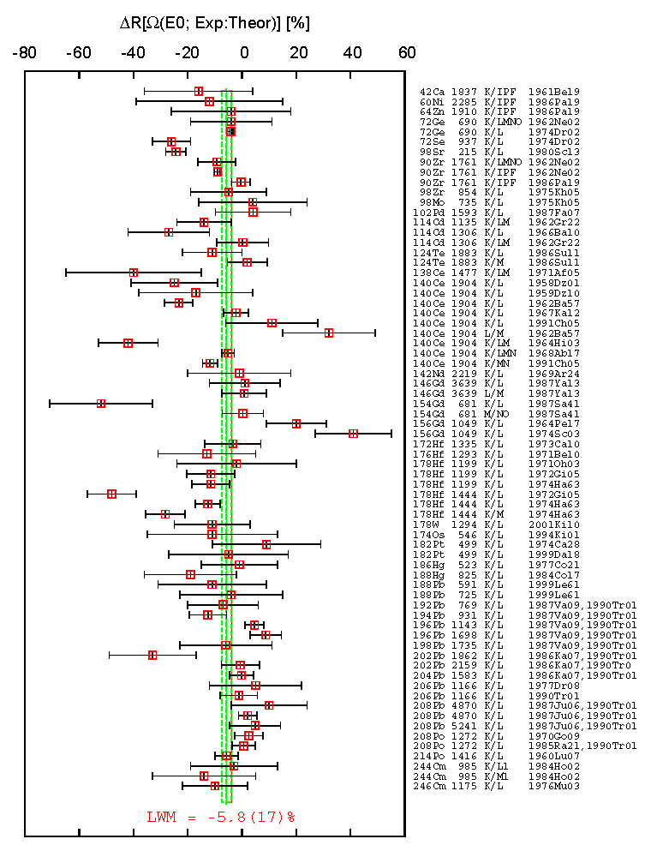
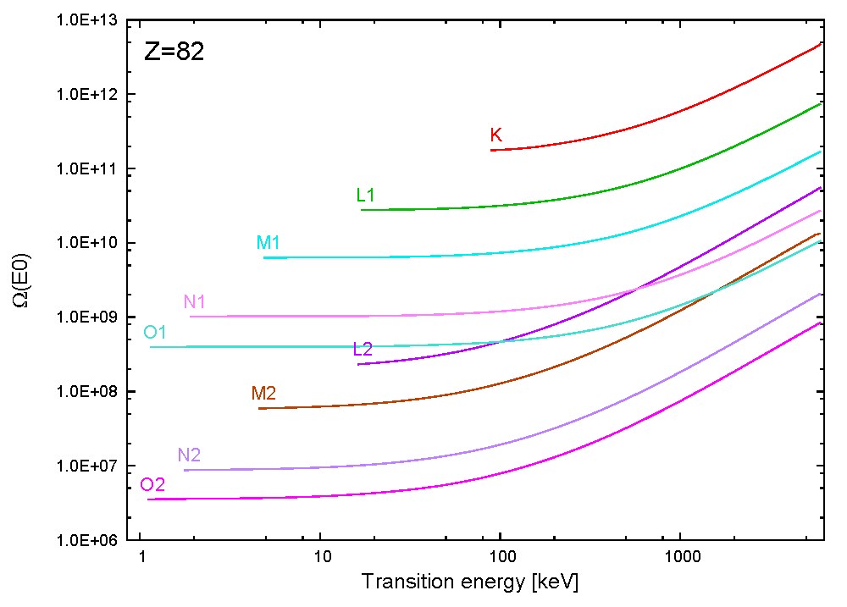
BrIcc - Theoretical conversion coefficients
Electronic factors for E0 transitions (with G. Gosselin, V. Meot, and M. Pascal, CEA, Saclay)
Z=10-95, E=1-600 keV tables compiled and tested
Ω_{CE}(E0) values and ratios are compared previous calculations (1969Ha61, 1970Be87, 1986PaZM)
New horizontal evaluation of ratios of experimental Ω_{CE}(E0)
ADNDT publication & ND2013 presentation
How accurate are they?
Tibor Kibèdi, Dep. of Nuclear Physics, Australian National University
20th NSDD, Kuwait, 27 – 31 January 2013

Slide 5
Nuclear Structure evaluations
Mass chain evaluations
The ANU has primary responsibilities for A=172-175:
A172 with C. Baglin (evaluation continued)
A174 with F.G. Kondev (ANL) and H. Xiaolong (CIAE, China) (evaluation started)
Tables of Prolate Deformed Nuclear K-Isomers (with F.K. Kondev, ANL and G.D. Dracoulis, ANU)
Adopted spectroscopic information on K-forbidden transitions depopulating high-K isomeric states in nuclei ranging from A>100 has been deduced by critical evaluation of the available experimental data. Values of f_{ν}, the reduced hindrance factor per degree of K-forbiddenness, have been determined. The work was continued to collect primary experimental information from published works, conference proceedings and other sources. The evaluated information is stored in ENSDF format and BrIcc and a modified version of the RULER code is used for the analysis. The ANU responsible for the Z=74-75 isotopes.
Tibor Kibèdi, Dep. of Nuclear Physics, Australian National University
20th NSDD, Kuwait, 27 – 31 January 2013

Slide 6
Other activities and future directions
New model to evaluate atomic radiation in nuclear decay
with A.E. Stuchbery, B.Q. Lee, K. Robinson (ANU), F.G. Kondev (ANL)
See presentations by A. Nichols, and T. Kibedi later this week
Coordinated Research Project (CRP) on "Nuclear data for charged-particle monitor reactions and medical isotope production"
ND2013 presentation
2012Le09
Presentations on workshops and meetings
"Frontiers of Nuclear Data Physics and Related Applications"
Faculty of Science, King Abdulaziz University (KAU), Jeddah, Saudi Arabia, September 10-12, 2011
DDEP workshop 8th – Weds 10th October 2012, Paris
Future plans
BrIcc
Z=5 -126 using ICC with “Frozen Orbitals” approximation
Z=10-95 Electronic factors for E0
Correct treatment of mixed E0+E2+M1 transitions
Atomic radiations
Ab initio calculation of transition rates and energies
Develop a tool for evaluators
Tibor Kibèdi, Dep. of Nuclear Physics, Australian National University
20th NSDD, Kuwait, 27 – 31 January 2013

