Slide 1
Progress report from the Indian Nuclear Data Centre A. K. JAIN Indian Institute of Technology Roorkee Sukhjeet Singh M.M. University, Ambala Paresh Joshi Homi Bhabha Centre (TIFR), Mumbai

Slide 2
ENSDF evaluators in India
Roorkee group:
A.K. Jain, Sukhjeet Singh, Paresh Joshi.
Working independently:
S.K. Basu - VECC
Gopal Mukherjee - VECC
Mohini Gupta - Manipal
Expected to join:
Sudeb Bhattacharya - SINP

Slide 3
Mass Chain Published
The A=222 mass chain has been published Sukhjeet Singh et al.Nuclear Data Sheets 112, 2715 (2011), November 2011

Slide 4
Mass Chains Submitted for Review from the ICTP workshop
Sukhjeet Singh, Monika and Neha Sharma participated in the workshop and did a part of the evaluation work for A=211 mass chain.

Slide 5
Mass Chains Submitted to Dr. B. Singh
Two nuclides namely ²¹⁵Ac and ²¹⁵FR were assigned to Roorkee students during the VECC workshop. One of them ²¹⁵Ac has already been submitted to Dr. B. Singh and other ²¹⁵FR, is ready.

Slide 6
A=139 Mass Chain
This work is now coming to completion. Paresh Joshi is the main evaluator assisted by Sukhjeet Singh. Out of 16 nuclides, 15 are done except Pm.
Balraj Singh, A.K. Jain and J. Tuli are also participating in it.
An experiment was conducted arising out of this evaluation. A report will be presented by Paresh Joshi.

Slide 7
A=224 is under progress
There are total of 10 nuclides and three nuclides namely ²²⁴At, ²²⁴Bi, ²²⁴Th have been updated. Out of these three nuclides, ²²⁴At has been included in the ENSDF database.
Evaluation of remaining nuclides is going. We are planning to submit this evaluation by the end of May-2013

Slide 8
M.M. University, Ambala
The data evaluation activity at the M. M. University, Mullana has been going on in collaboration with IIT Roorkee.
One research grant from IAEA has been received and a project fellow has been appointed in this project to further strengthen the data evaluation activity at MMU, Mullana.

Slide 9
Gopal Mukherjee
Contribution to the CRP of “Updated Decay Data Library for Actinides”
Evaluation of the Decay data on ²³³U
Evaluation of the Decay data on ²²⁹Th

Slide 10
S.K. Basu
"Mass Cain Evaluation for A = 95", Swapan Kr. Basu, Gopal Mukherjee and A.A. Sonzogni, Journal of the Korean Physical Society, Vol. 59, No. 2, pp. 1518-1520 (2011)
"Nuclear Data Sheets for A = 150", S.K. Basu and A.A. Sonzogni, Nuclear Data Sheets (2013) -to be published

Slide 11
Funding from the Nuclear Data Physics Centre of India, D.A.E., Mumbai
Funding for Data evaluation work is now being released by NDPCI.
Roorkee center also has a grant and a project fellow has recently been appointed.
An ENSDF training workshop was recently held at VECC, Kolkata, which was sponsored by NDPCI. It was hugely successful.
Gopal Mukherjee, the convener, will report its outcome.

Slide 12
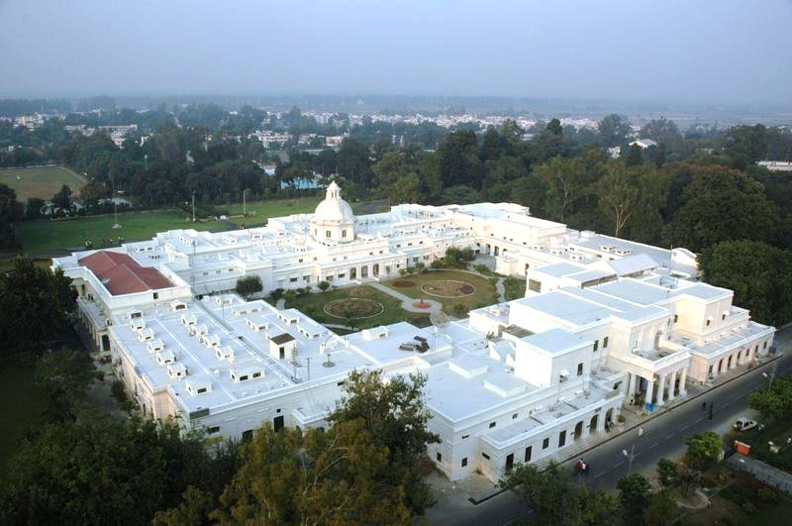
THANK YOU

