Slide 1
ENSDF Analysis Codes
Tim Johnson
National Nuclear Data Center
November, 2012

Slide 2
Analysis and Utility Codes
ALPAD, BrIcc, DELTA, fmtchk, ensdat, gtol, logft, pandora and others still available at :
http://www.nndc.bnl.gov/nndcscr/ensdf_pgm/
Compilers needed: Compaq/Digital Visual and Lahey/Fujitsu FORTRAN for Windows and Lahey/Fujitsu FORTRAN 95 for Linux
Mac? I am slated to get a new Mac very soon.
Codes added to source control (Control Tier coming)

Slide 3
Release Status
Code revisions:
See relevant “Read Me’s” for details
BrIcc: Updates to version 2.3 Available (T. Kibedi)
Fixed various problems users had reported.
More to be coming later based on upcoming discussions
FMTCHK
Extended max gammas to 2000 from 800. Currently available.

Slide 4
In Progress
gabs
Work with E. Browne on new version testing

Slide 5
To be done this year
RULER
Need to fix handling of large uncertainties (discussion)
Add minimum mixing ratio similar to BrICC?
Others?

Slide 6
ENSDF/XUNDL Web
Moved to latest version (older version still available)
Fixing bugs as they are found by users
To be done this year
Save steps on downloading
Add option to get XUNDL files with ENSDF

Slide 7
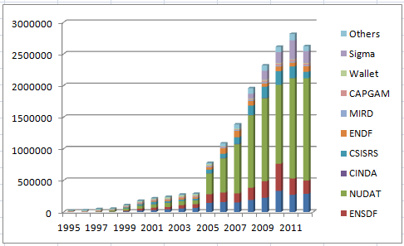
Web Statistics

