Slide 1
Sample Preparation for (n,γ) Cross Section Measurements of Actinides
M. Rossbach, Institute for Energy and Climate Research, Nuclear Waste Disposal and Reactor Safety, IEK-6, Forschungszentrum Juelich GmbH, 52425 Juelich, Germany
Mitglied der Helmholtz-Gemeinschaft

Slide 2
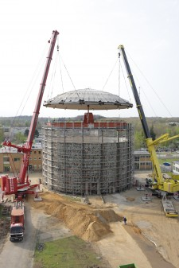
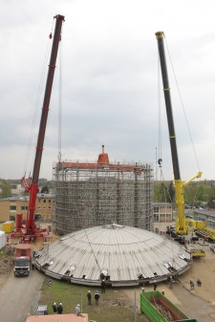
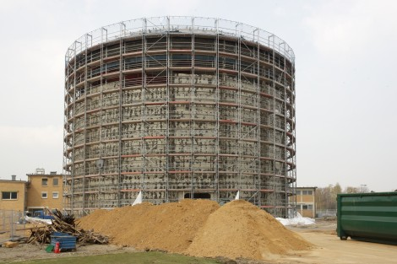
Content:
Motivation – Nuclear Data of Actinides
Sample preparation
Irradiation and spectrum evaluation

Slide 3
Motivation
Comparison of thermal capture cross sections for ²⁴³Am(n,γ)²⁴⁴Am with existing and evaluated data
Thermal σ_{n,γ} | Method | Year | Reference
81.8 ± 3.6 b | Activation + spectroscopy | 2006 | F. Marie et al. NIM A 556, 547
84.4 b | Activation + spectroscopy | 1997 | Y. Hatsukawa et al. JAERI Tokai Report Series, 98-003, 221
83 ± 6 b | Activation + spectroscopy | 1975 | V.D. Gravilov et al. Atomnaya Energiya 41, 185
73.6 ± 1.8 b | Activation + spectroscopy | 1957 | J.P. Butler et al. Canad.J.Phys. 35, 147
78.0 b | radiochemistry | 1968 | R.L. Folger et al. Nucl. Cross-Section Tech. Conf., Washington, 2
66 < σ < 84 b | Activation + spectroscopy | 1966 | C.H. Ice, Savannah River Reports, MS-66, 69
140 ± 50 b | Activation + spectroscopy | 1954 | B.G. Harvey et al. Phys. Rev. 95, 581
115 b | radiochmistry | 1954 | C.M. Stevens et al. Phys. Rev. 94, 974
75.1 b | ENDFB-VI.8 |  | www.nndc.bnl.gov/exfor/endf00.html
76.75 b | JENDL3.3 |  | www.ndc.tokai.jaeri.go.jp/jendl/j33/j33.html
76.72 b | JEFF3.1 |  | www.nea.fr/html/dbdata/JEFF

Slide 4
Motivation
Comparison of thermal capture cross sections for ²³¹Pa(n,γ) ²³²Pa with existing and evaluated data
Thermal σ_{n,γ} | Method | Year | Reference
175 ± 26.5 b | Activation + spectrometry | 1946 | G.T. Seaborg et al., Chicago University Metallurgical Labs Reports No.3471, p.2
293 ± 44 b | Activation + spectrometry | 1953 | R. Elson et al., Physical Review 90, 102
200 ± 15 b | Activation + spectrometry | 1956 | R.R. Smith et al., Phys. Rev. 101/3, 1053
260 ± 13 b | Activation + spectrometry | 1972 | B.M. Aleksandrov et al., Atomnaya Energiya 32, 178
201 ± 22 b | Activation + spectrometry | 1974 | E.M. Gryntakis et al., J. Inorg and Nucl. Chem. 36/7, 1447
219 ± 6 b | Activation + spectrometry | 1984 | L.N.Jurova et al., Vop. At.Nauki i Tekhn., Ser.Yadernye Konstanty 1/55, 3
186 ± 13 b | Activation + spectrometry | 1988 | T. Hashimoto et al., J. Radioanal. Nucl. Chem. 120/1, 185
200 b | ENDF | 2010
201,7 b | JENDL-4.0 | 2010
226,9 b | JEFF3.3 | 2010

Slide 5
Motivation
Vergleich von Wirkungsquerschnitten einiger relevanter Actinide in unterschiedlichen evaluierten Datenkatalogen, ENDF (Brookhaven, USA), JENDL-4.0 (Japan) und JEFF3.3 ( OECD-NEA)
Nuclide | Half life (s) | Half life (years) | ENDF (b) | JENDL-4.0 (b) | JEFF 3.3 | our value
²³¹Pa | 1.03E+12 | 3,28E+04 | 200 | 201,7 | 226,9
²³³U | 5,02E+12 | 5,02E+05 | 45,3 | 45,26 | 45,2
²³⁴U | 7,74E+12 | 2,46E+05 | 100,9 | 100,3 | 119,2
²³⁶U | 7,39E+14 | 2,34E+07 | 5,1 | 5,123 | 13,7
²³⁷Np | 6,76E+13 | 2,14E+06 | 180 | 178,1 | 195,8 | 180,3 ± 7,4
²³⁹Pu | 7,60E+11 | 2,41E+04 | 289 | 271,5 | 272,4
²⁴¹Pu | 4,51E+08 | 14,29 | 360 | 363,1 | 363,0
²⁴²Pu | 1,18E+13 | 3,73E+05 | 19 | 19,88 | 18,8 | 16,7 ± 1,6
²⁴¹Am | 1,36E+10 | 432,6 | 550 | 684,3 | 647,0
²⁴³Am | 2,32E+11 | 7,37E+03 | 78 | 79,26 | 76,7
²⁴³Cm | 9,18E+08 | 29,1 | 130 | 131,4 | 130,2
²⁴⁴Cm | 5,71E+08 | 18,11 | 15 | 15,24 | 10,4
²⁴⁵Cm | 2,68E+11 | 8,5E+04 | 360 | 347,0 | 359,1
²⁴⁸Cm | 1,07E+13 | 3,4E+05 | 2,63 | 2,87 | 2,57

Slide 6
Motivation
Actinide content of reprocessed nuclear waste from La Hague or Sellafield is estimated through delayed neutron counting and an estimated nuclide vector. No direct measurements are available.
Development of a PGAA based analytical method could help to evaluate actinide content in complex samples, such as nuclear waste or Safeguard swipe samples.
Accurate cross section data are needed to apply PGAA as an analytical method for actinide quantification. Low uncertainty of these data will help to improve reliability of results.
At the Budapest Research Reactor a versatile PGAA instrument and high level of expertise is avalable for experiments (thermal equivalent cold neutron flux = 2.3x10⁷ cm⁻² s⁻¹).
At the Forschungsneutronenquelle Heinz Maier-Leibnitz (FRM-II) in Garching the highest neutron flux of 7x10⁹ cm⁻² s⁻¹ is available for sample irradiations.

Slide 7
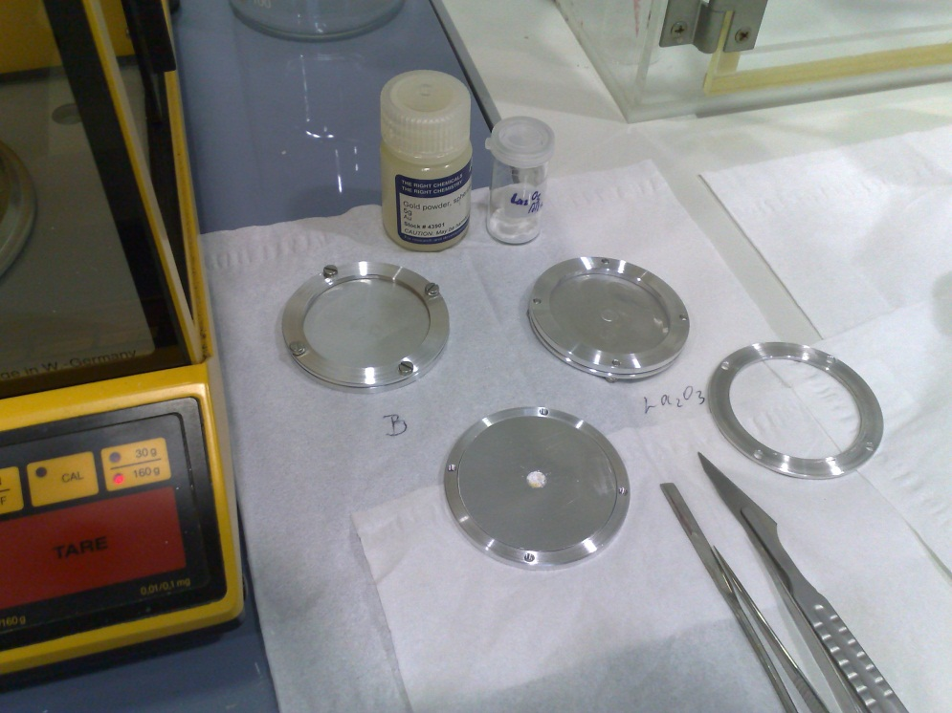
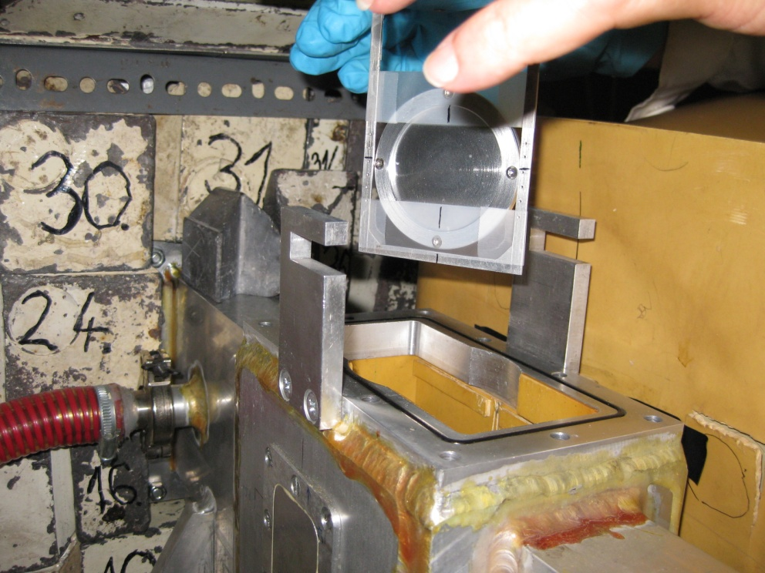
Sample preparation for cold neutron irradiation
First atempt of small pallets in aluminium failed because the pallets could move around in the sandwich.

Slide 8
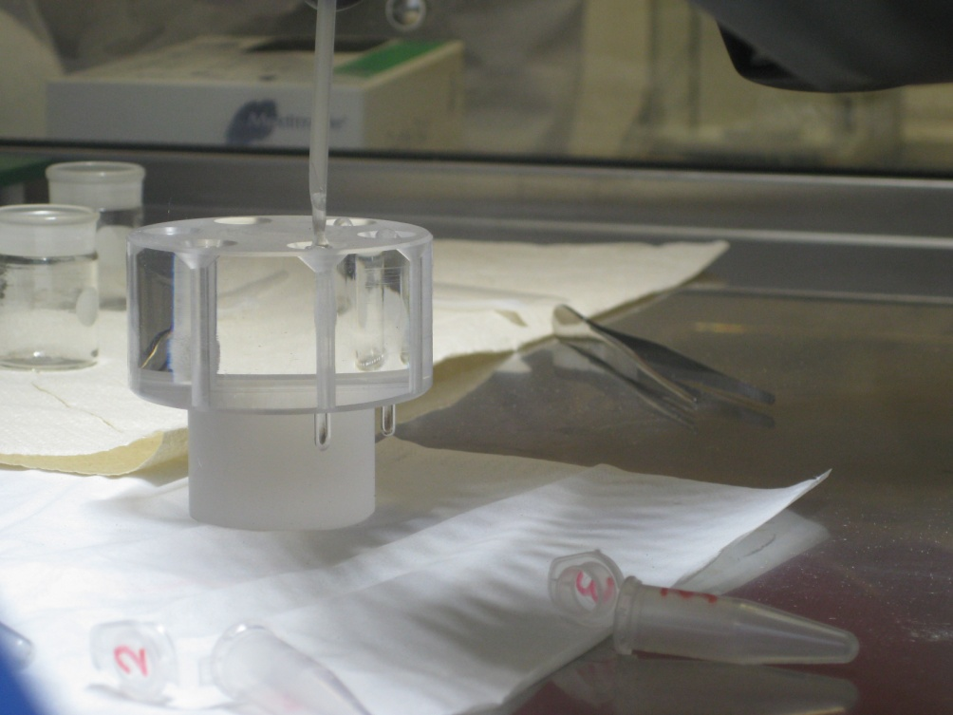
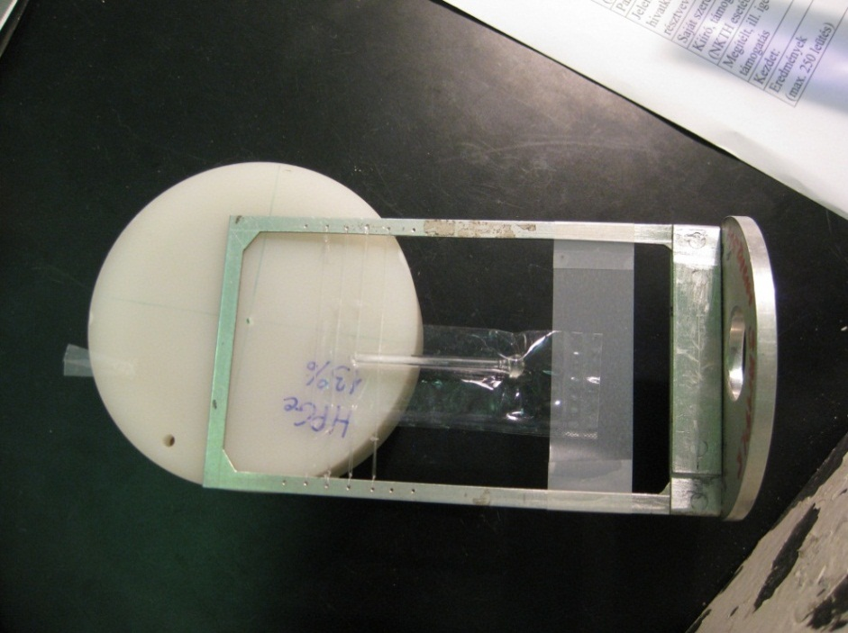
Sample preparation for cold neutron irradiation
Encapsulation in small Suprasil quartz ampoules was not conclusive because of badly defined geometry and segregation of Au powder.

Slide 9
Sample preparation for cold neutron irradiation
Neutron radiographic image of the ²⁴²PuO₂ samples in quartz ampules. The first two contain gold powder as a flux monitor.

Slide 10
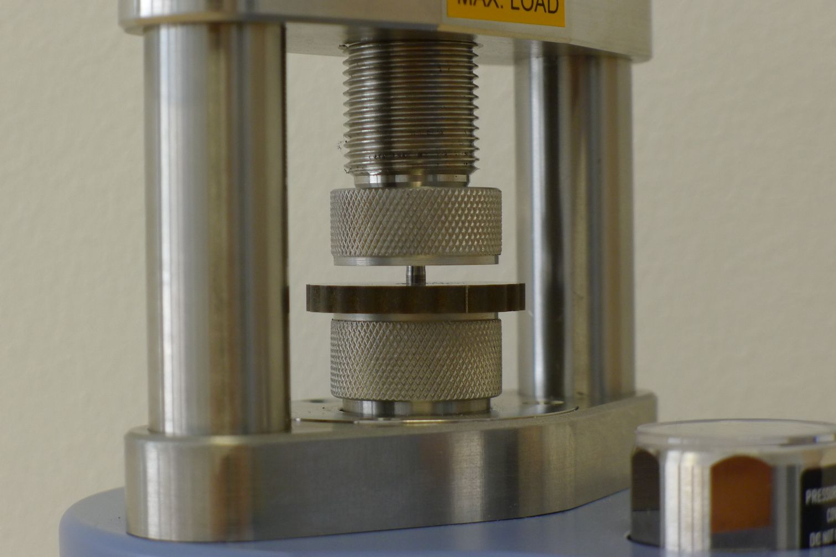
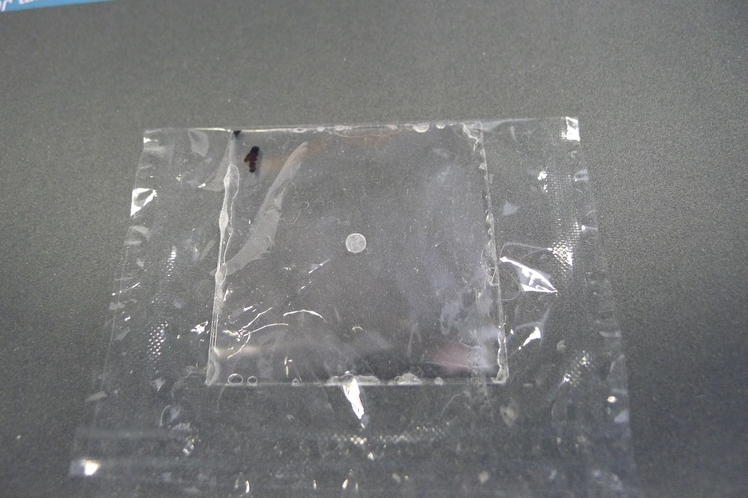
Sample preparation for cold neutron irradiation
Therefore we decided to press 3mm diam. pallets and place them in a sandwich of 3 quartz glass plates, the middle one with a 3 mm diam. hole in its center:

Slide 11
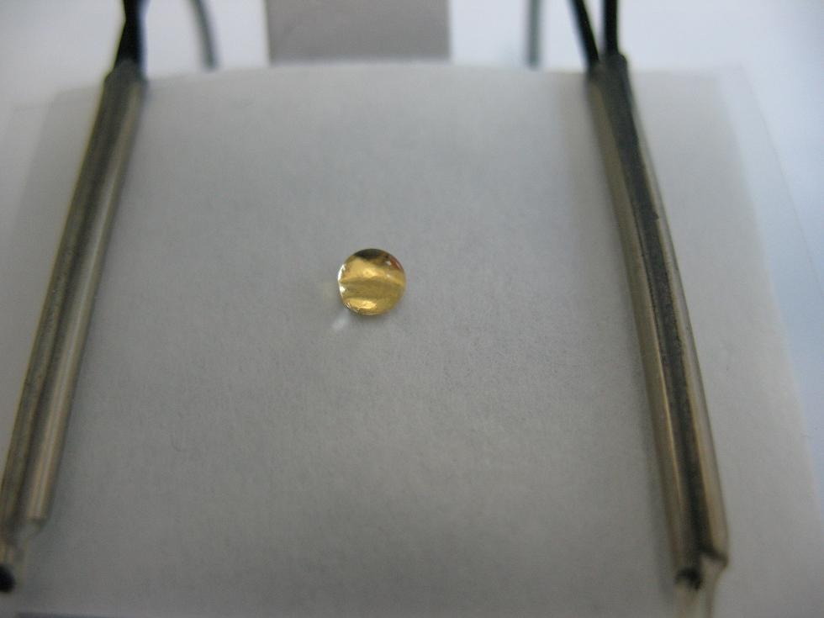
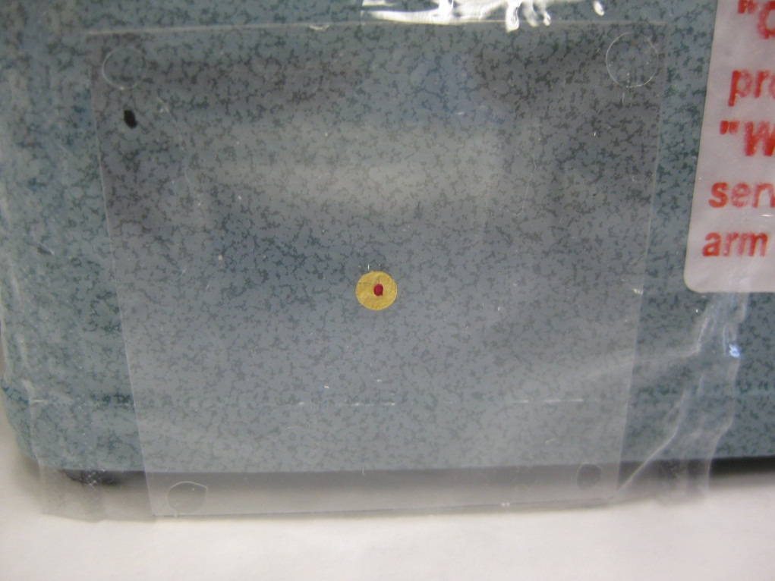
Sample preparation for cold neutron irradiation
…or a tiny drop of activity on a 3mm diam. Au foil centered on a quartz plate for flux monitoring. Another quartz plate to cover the activity is glued on top with epoxy.

Slide 12
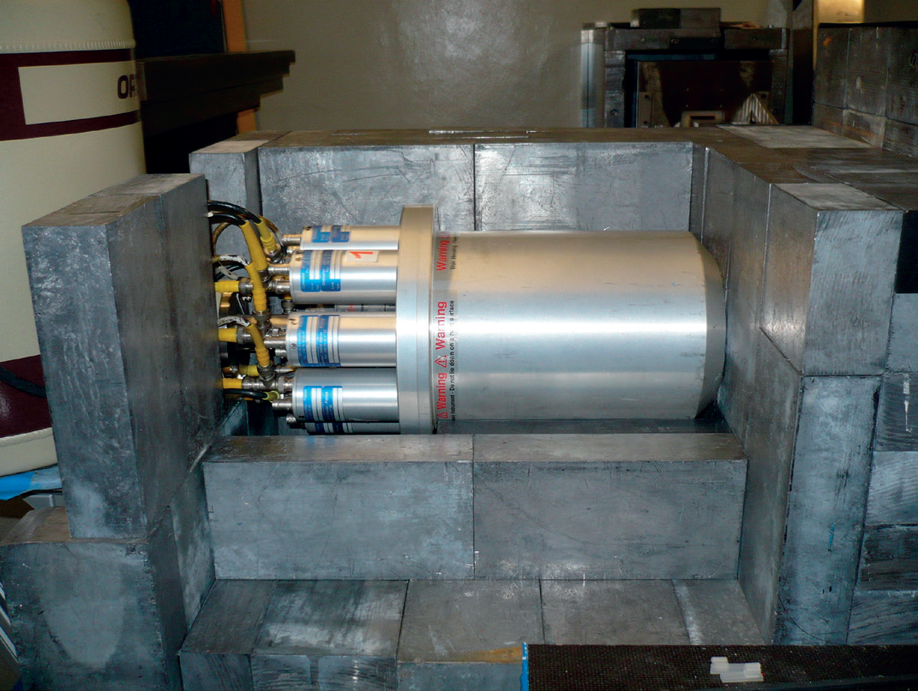
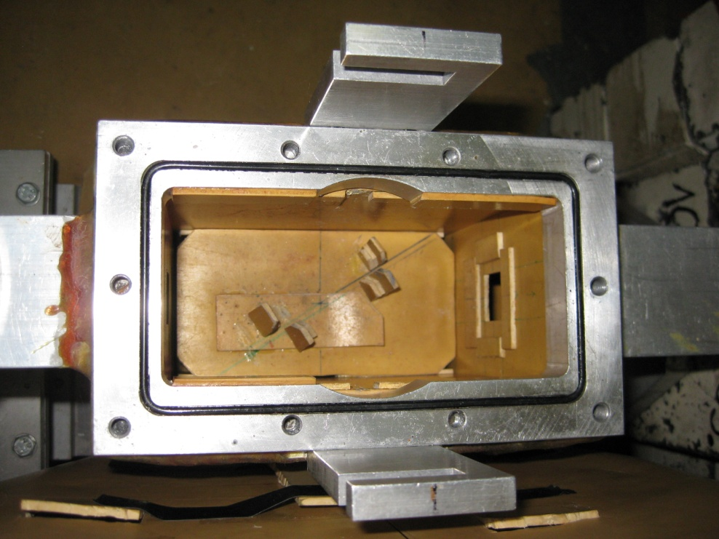
Irradiations
FRM II irradiation facility, 7 x 10⁹ n cm⁻² s⁻¹ Compton suppressed
Budapest irradiation facility, 2 x 10⁷ n cm⁻² s⁻¹, Compton suppressed

Slide 13
Results
²³⁷Np prompt Gamma Spektrum
²⁴²Pu prompt Gamma Spektrum
Prompt ²⁷Al
Prompt ²⁸Si
Prompt ²⁹Si
Prompt ³⁰Si
Prompt ¹⁴N
Prompt ²³⁷Np
Decay ²³⁸Np
Decay ²³⁷Np
Decay ²³³Pa
Prompt ²⁷Al
Prompt ²⁸Si
Prompt ²⁹Si
Prompt ³⁰Si
Prompt ¹⁴N
Prompt ²⁴²Pu
Decay ²⁴³Pu
Decay ²⁴³Am
Decay ²⁴¹Am
Spectrum consists of about 600 peaks in the energy range from 40 keV to 12 MeV
Spectrum consists of about 600 peaks in the energy range from 40 keV to 12 MeV

Slide 14
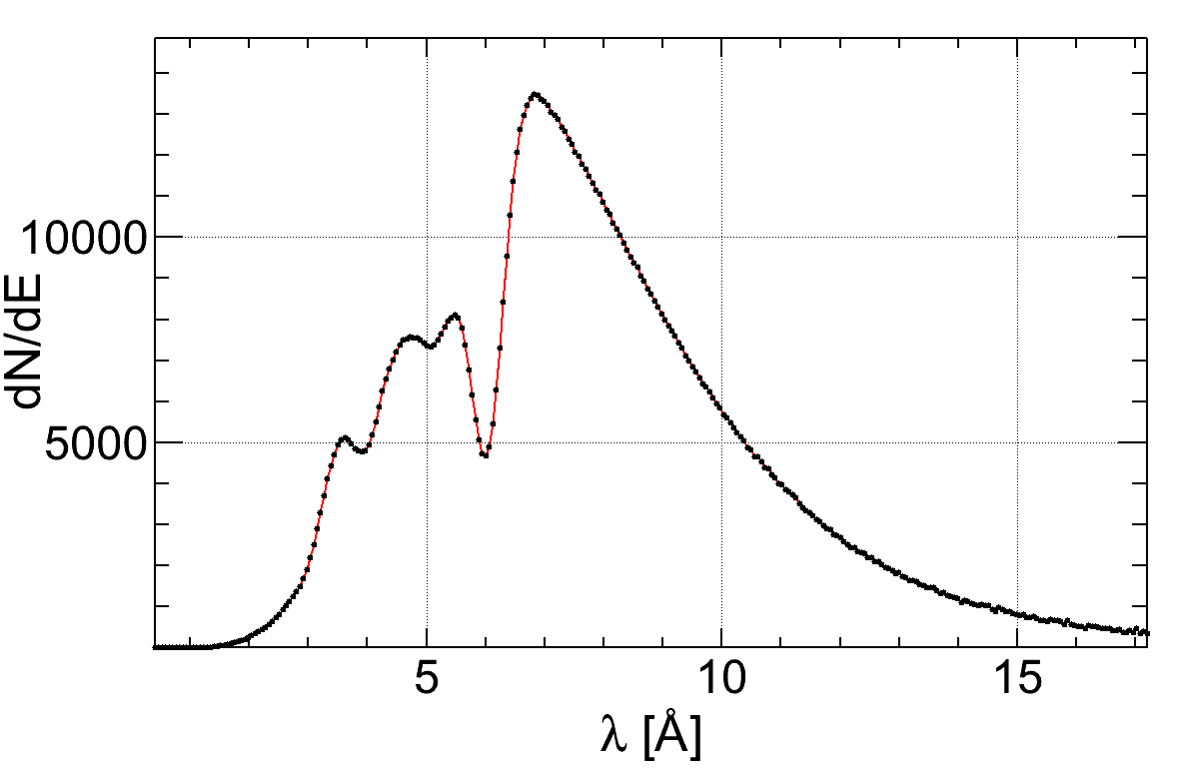
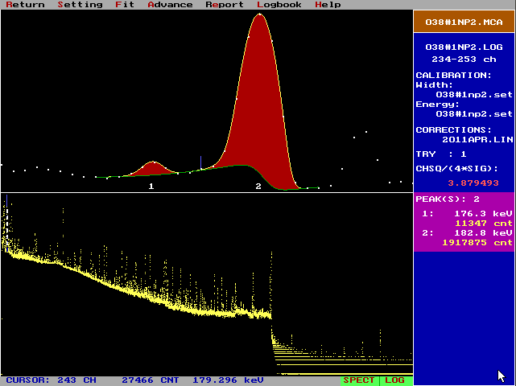
Evaluation of spectra
Φ
=
P
thermal equivalent
neutron flux in
the sample
is:
n
⋅
411
,
N
σ
⋅
Au
411
t
irr
partial gamma ray production cross section is
Monte Carlo simulations using the Geant4 code were carried out to account for self-shielding effects in the sample.
P is the corrected peak area, σ the corresponding partial gamma ray production cross section , N the number of atoms and t_{irr} the irradiation time.
gamma ray spectra were evaluated using Hypermet-PC

Slide 15
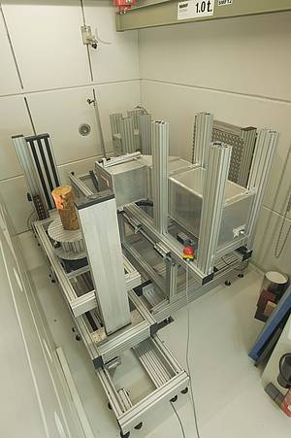
Future plans: PGAA using fission neutrons
At FRM II a position to use fission neutrons for irradiation exists (1-2 MeV, 4.9 E+6 cm⁻²s⁻¹, cross section: 30 x 30 cm)
A uranium target close to the biological shield
of the reactor generates a beam of fast neutrons
extracted to a bunker.
We expect to investigate other reaction channels
such as (n,n‘), (n,2n), (n,α) or (n,p).
Considering a neutron generator based analytical
method this would constitute an important step
forward.

