Slide 1
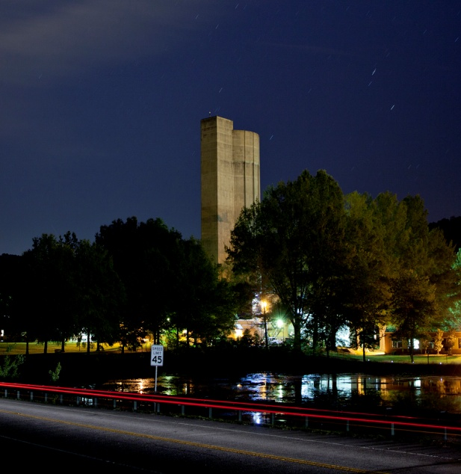
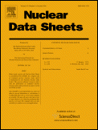
STATUS REPORT ON NUCLEAR STRUCTURE AND DECAY DATA
ACTIVITIES AT
OAK RIDGE NATIONAL LABORATORY
NUCLEAR DATA PROGRAM
20th Meeting of the Nuclear Structure and Decay Data
(NSDD) Network
Caroline Nesaraja , Murray Martin
& Michael Smith

Slide 2
Members:
Michael Smith: Group Leader -Experimental Astrophysics, Nuclear Data
Caroline Nesaraja: ENSDF Evaluator
Murray Martin: ENSDF Evaluator and consultant
Eric Lingerfelt: Software Developer
Activities:
Nuclear Structure Data
Nuclear Astrophysics Data
Online Software Systems

Slide 3
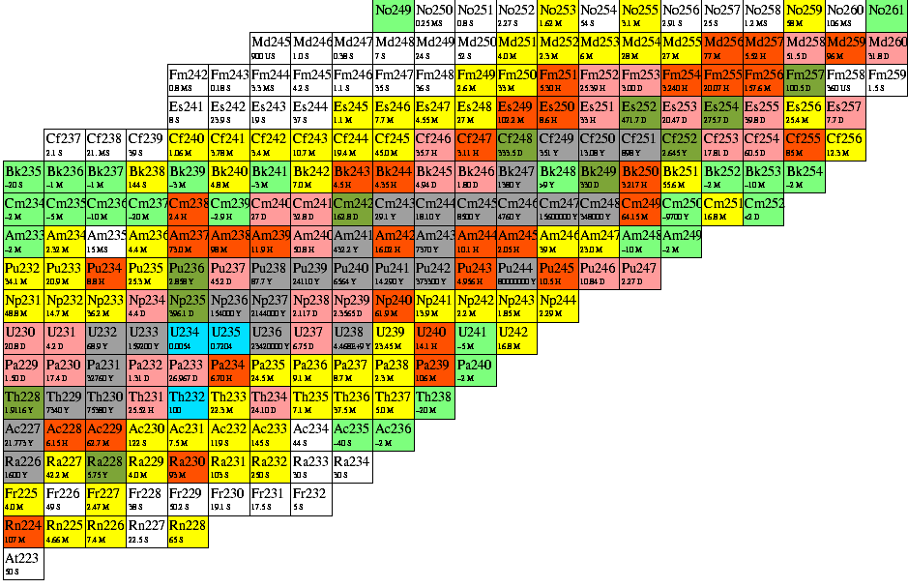
Nuclear Structure Data:
Mass Chain Evaluation
ORNL responsibility: A=241-249
Mass Chain Current ENSDF Database (from NNDC website)
M.J. Martin (NDS 106, 89 (2005) (Lit cut-off June, 2005)
Y. A. Akovali (NDS 96, 177 (2002) (Lit cut-off Sept., 2001)
243 Y. A. Akovali (NDS 103, 515 (2004) (Lit cut-off March, 2004)
244 Y. A. Akovali (NDS 99, 197 (2003) (Lit cut-off June, 2002)
E. Browne & J.K. Tuli (NDS 112,447 (2011)
E. Browne & J.K. Tuli (NDS 112,447 (2011)
Y. A. Akovali (NDS 102, 515 (2004) Lit cut-off August, 2003)*
Y. A. Akovali (NDS 87, 249 (1998) (Lit cut-off July, 1998)*
Khalifeh Abusalem (NDS 112, 2129 (2011)
* Under revision at ORNL

Slide 4
Since the last NSDD meeting in 2011
Current status of mass chain evaluation.
Mass Chain Evaluator #Nuclides #Pages *Status
152 Martin 17 373 Post Review
69 Nesaraja 12 172 Post Review
248 Martin 7 ? Under Evaluation
247 Nesaraja 8 40 Pre Review
* To be moved into the next stage of processing within a month

Slide 5
Future Activities:
A=241, 242, & 243
Other nuclei-especially those relevant for nuclear astrophysics

