Slide 1
TUNL Contributions in the US Nuclear Data Program and NSDD
Nuclear Data Evaluation Program
J.H. Kelley, Jim Purcell, and Grace Sheu

Slide 2
Nuclear Structure Evaluation TUNL Nuclear Data Evaluation Project
We are responsible for nuclear structure evaluation in the A=2-20 mass region
Energy Levels of Light Nuclei reviews published in Nuclear Physics A
ENSDF files for A=2-20
XUNDL from A=2-20
Web interface for A=3-20 Information

Slide 3
Evaluation Activities
Energy Levels of Light Nuclei
Follow style of Fay Ajzenberg-Selove
Broad scope of reactions is included – discussion format.
Adopted levels/gammas, Energy Level Diagrams
ENSDF
More rigorous information required
Better documentation of original sources
reaction data sets/decay data sets
Adopted levels/gammas, decay widths, etc.

Slide 4
Recent Evaluation Activities
Published “Energy Levels of Light Nuclei A=11”
Added A=11 ENSDF data set
Updated 7 β-n data sets (more to come)
Other work in progress:
A=12 Evaluation for “Energy Levels”
A=13 Evaluation for “Energy Levels” (Jim Purcell)
Preparing A=12 ENSDF file

Slide 5
Recent Compilation Activities
Committed to XUNDL (A=3-20)
63 data sets 2012 (5-6/month)
Compilation of ground state decay & β-decay references and data
Compilation of (p,X) and (α,X) excitation functions
TUNL Dissertations-
http://www.tunl.duke.edu/~gsheu/Theses/TUNL_Theses.shtml

Slide 6
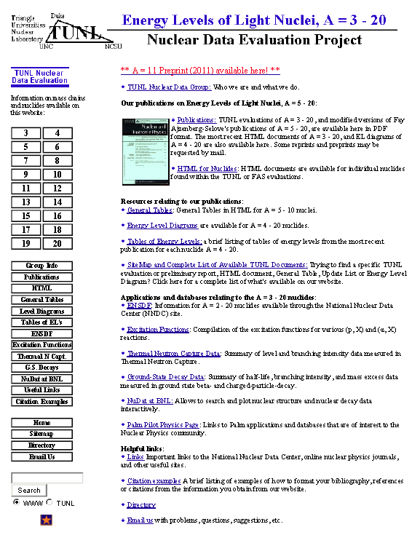

Slide 7
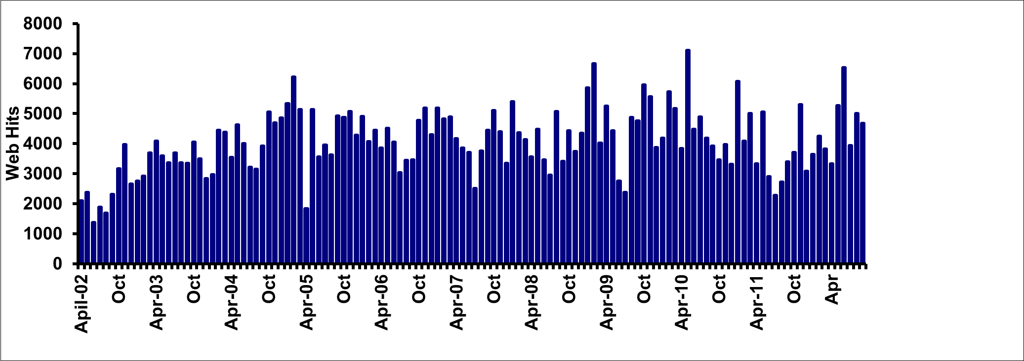
WWW (April 02 –present) FY12: Σ=52.6k
Using Analog - finding issues with excluding new search engine "robots"

Slide 8
