Slide 1
¹³⁹Ba decay: precise half-life measurement and gamma-spectroscopy at BARC: an offshoot of ENSDF evaluation work.
P.K.Joshi
Homi Bhabha Centre for Science Education, TIFR

Slide 2
Acknowledgements
Ashok Jain
B. Singh
J. Tuli
Sukhjeet Singh
For A=139 Chain evaluation which is completed (preliminary submission)

Slide 3
Acknowledgements
L. S. Danu,
P. K. Joshi,
D. C. Biswas,
S. Mukhopadhyay,
A. Goswami,
P. N. Prashanth,
L. A. Kinage,
R. K.Choudhury,
Balraj Singh
Eur. J. Phys A December 2012, 48:186

Slide 4
DATA EVALUATION : A= 139
The data evaluation of mass 139 Chain : New experience
The nuclei to be evaluated
Sb, Te, I, Xe, Cs, Ba, La, Ce, Pr, Nd Pm, Sm, Eu, Gd, Tb, Dy
The Nuclei that are completed
Sb, Te, I, Xe, Cs, Ba, La, Ce, Pr, Nd, Pm, Sm, Eu, Gd, Tb, Dy
Ba isotope, descrepencies
Experiment at BARC
Results
Conclusion

Slide 5
DATA EVALUATION : AN EXPERIENCE
A certain delay in grasping the concept
BUT has been a great learning experience
Several subtleties of Nuclear experiments became clear.
For example : Different techniques takes us to different regions of Nuclear levels and very few overlap regions
During publications: An oversight of numbers of data being published, For example : 3 different E_{γ} values in text, table and figure.
Two experiments with similar reactions can produce level schemes which may agree only 90 percent. The authors have been contacted and revised level schemes’ mis-matches are reduced.

Slide 6
DATA EVALUATION : Nuclei completed
Number of new data sets included / upgraded
I : 1
Xe : 3
Cs : 1
Ba : 2
La : 4
Ce : 2
Pr : 1
Nd : 3
Sm : 1
Eu : 2
Rest of the nuclei : No new data since last evaluation

Slide 7
DATA EVALUATION : Ba special case
Ba isotope study led to a new direction
Several lifetimes measured but fall in two discrepant states
An unexpected result in terms of some γ transitions assigned to ¹³⁹Ba, shunted out.
The uncertainties in one of the recent publications were too small to have been estimated correctly.

Slide 8
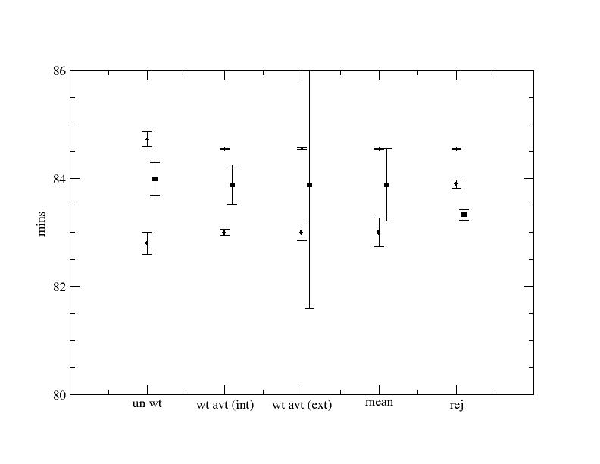
Spectroscopy of ¹³⁹Ba (Motivation)
Wt Avg : 83.00(16) & 84.545(18)

Slide 9
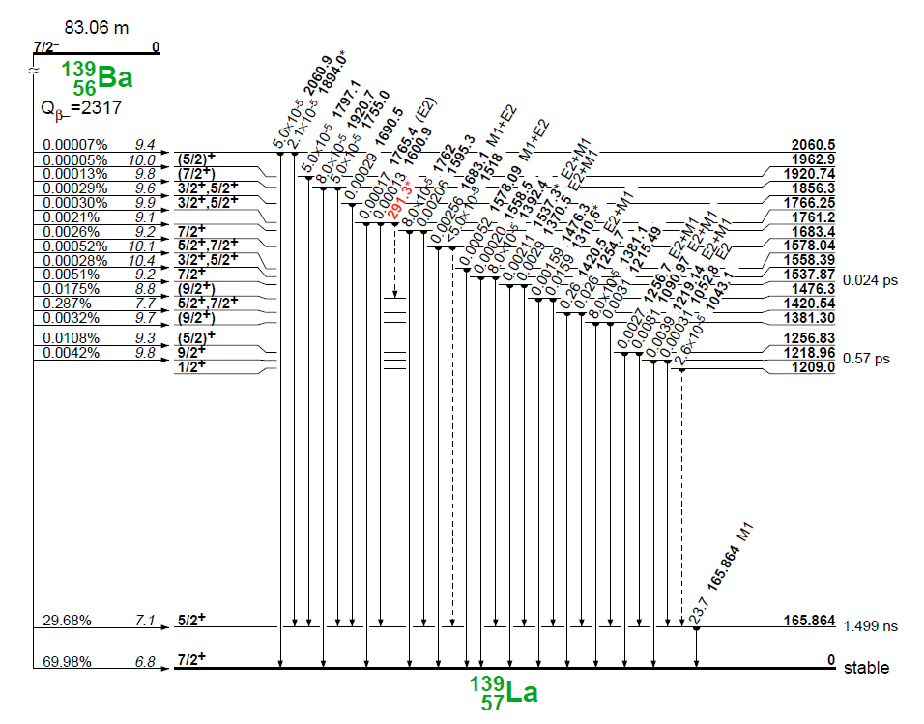

Slide 10
Spectroscopy of ¹³⁹Ba (Motivation)
The 1691 keV γ-ray was reported to be associated with long-lived activity (contaminant) by Hill and Wiedenbeck; whereas Berzins et al., attributed this transition to the β-decay of ¹³⁹Ba.
A level at 1209 keV decaying through a 1043 keV γ-ray transition to the level at 166 keV was proposed by Faller et al.. This level at 1209 keV was also previously suggested by Wildenthal et al. in a proton-transfer reaction.
The 1525 keV transition proposed by Zamboni et al.

Slide 11
Spectroscopy of ¹³⁹Ba (Experiment)
Sample 40-mg, in form of Ba(NO₃)₂ (99% enrichment) .
Irradiated in the thermal neutron flux of 5 × 10¹³ n/cm²sec, in the DHRUVA Reactor at BARC, Mumbai.
The duration of each irradiation was 1 min.
¹³⁸Ba after irradiation leads to ¹³⁹Ba

Slide 12
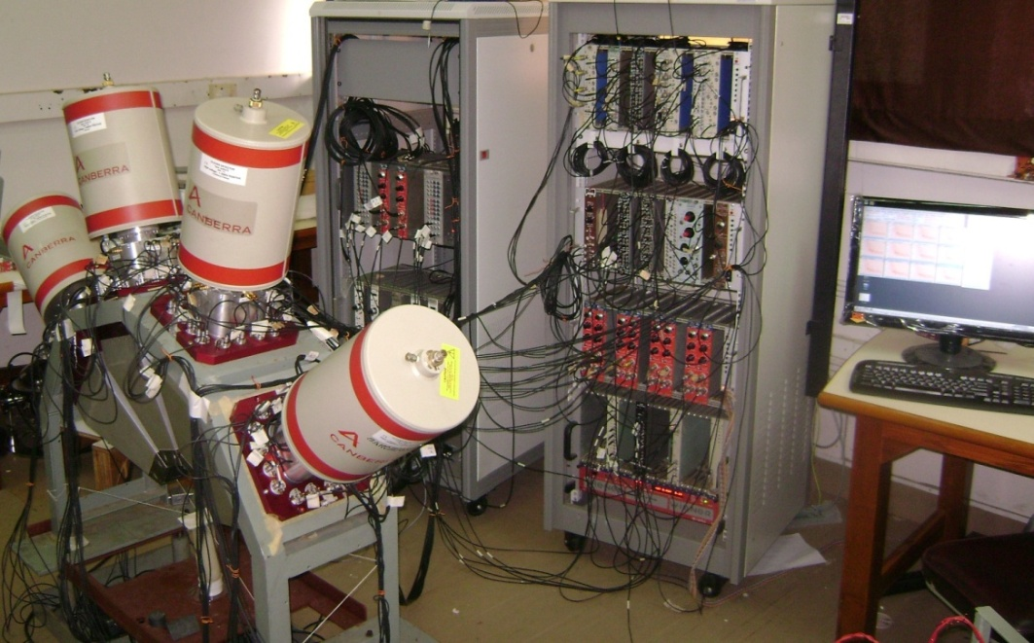
Spectroscopy of ¹³⁹Ba (Experiment)
Experimental set-up for the Spectroscopy of ¹³⁹Ba
The decay of ¹³⁹Ba has been investigated using singles and γ-γ coincidence with four Compton suppressed Clover HPGe Detectors.

Slide 13
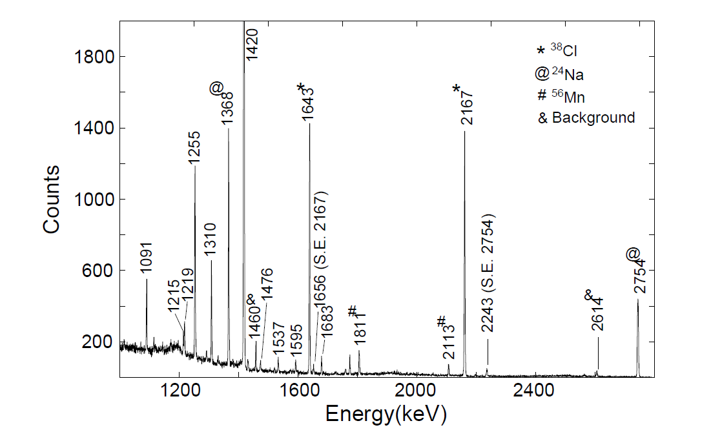
RESULTS
FIG. The high energy (1000-2800 keV) region of γ-ray singles spectrum observed in the decay of ¹³⁹Ba.

Slide 14
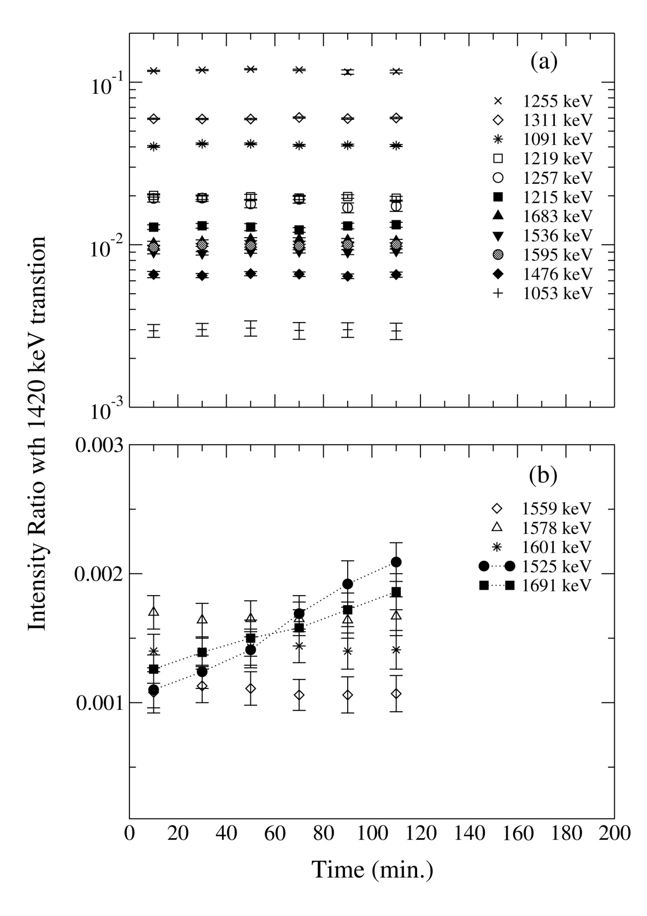

Slide 15
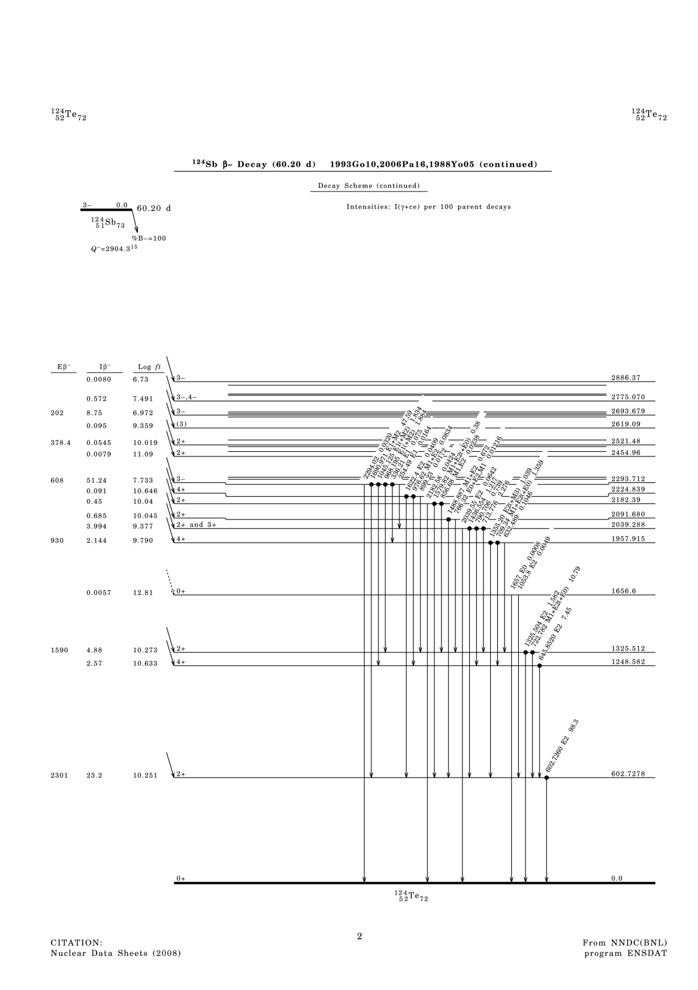
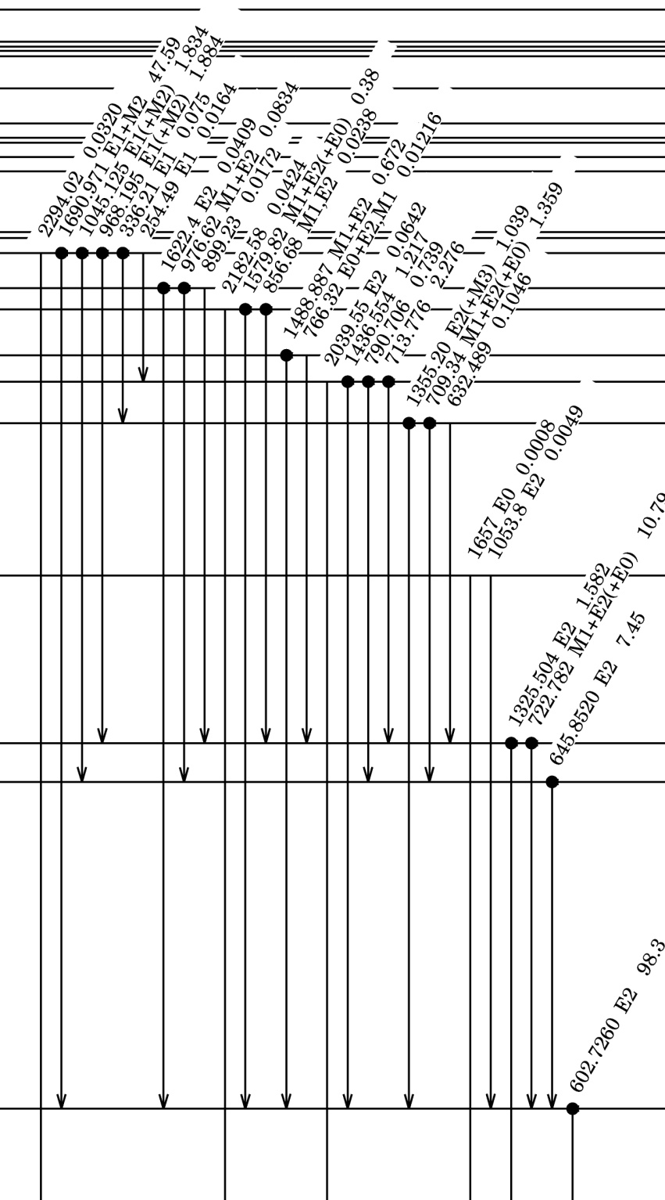
¹²⁴Sb

Slide 16
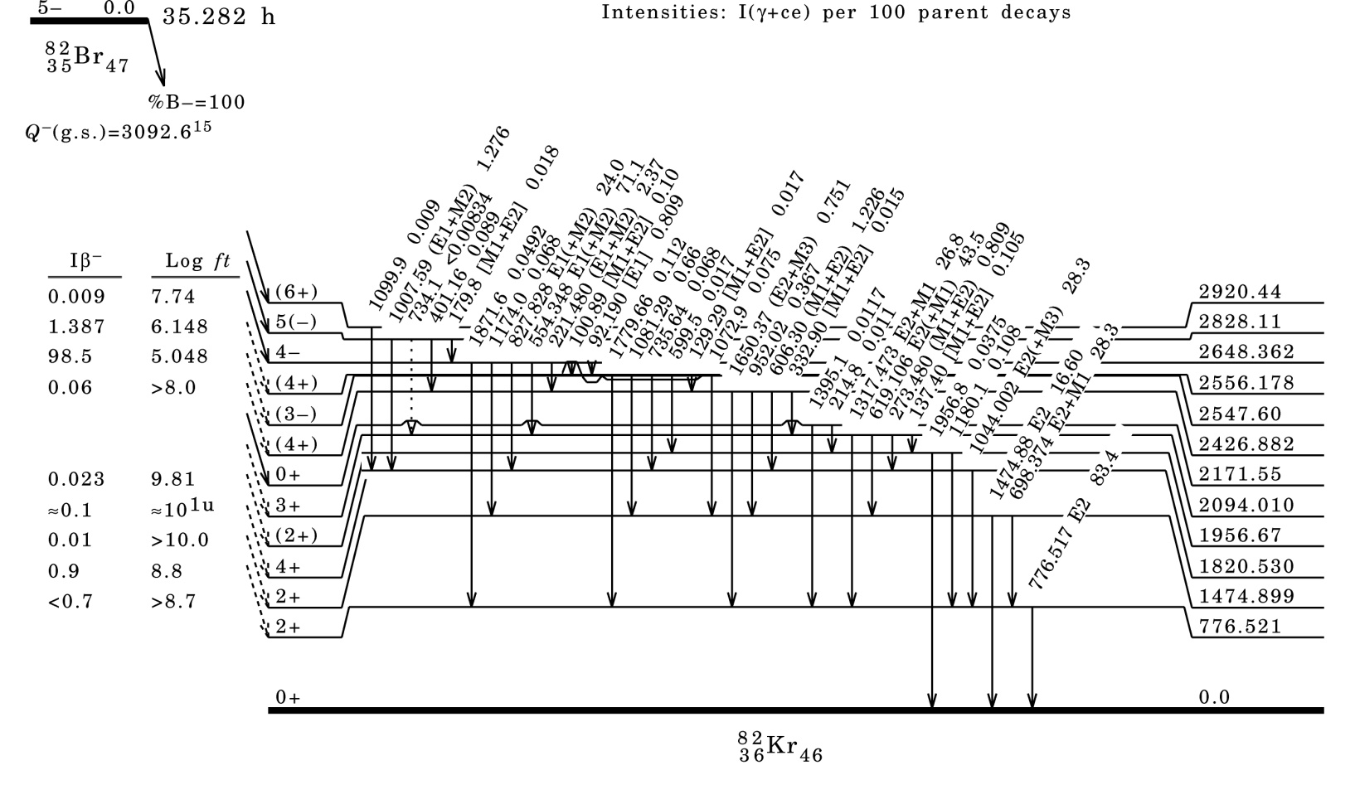
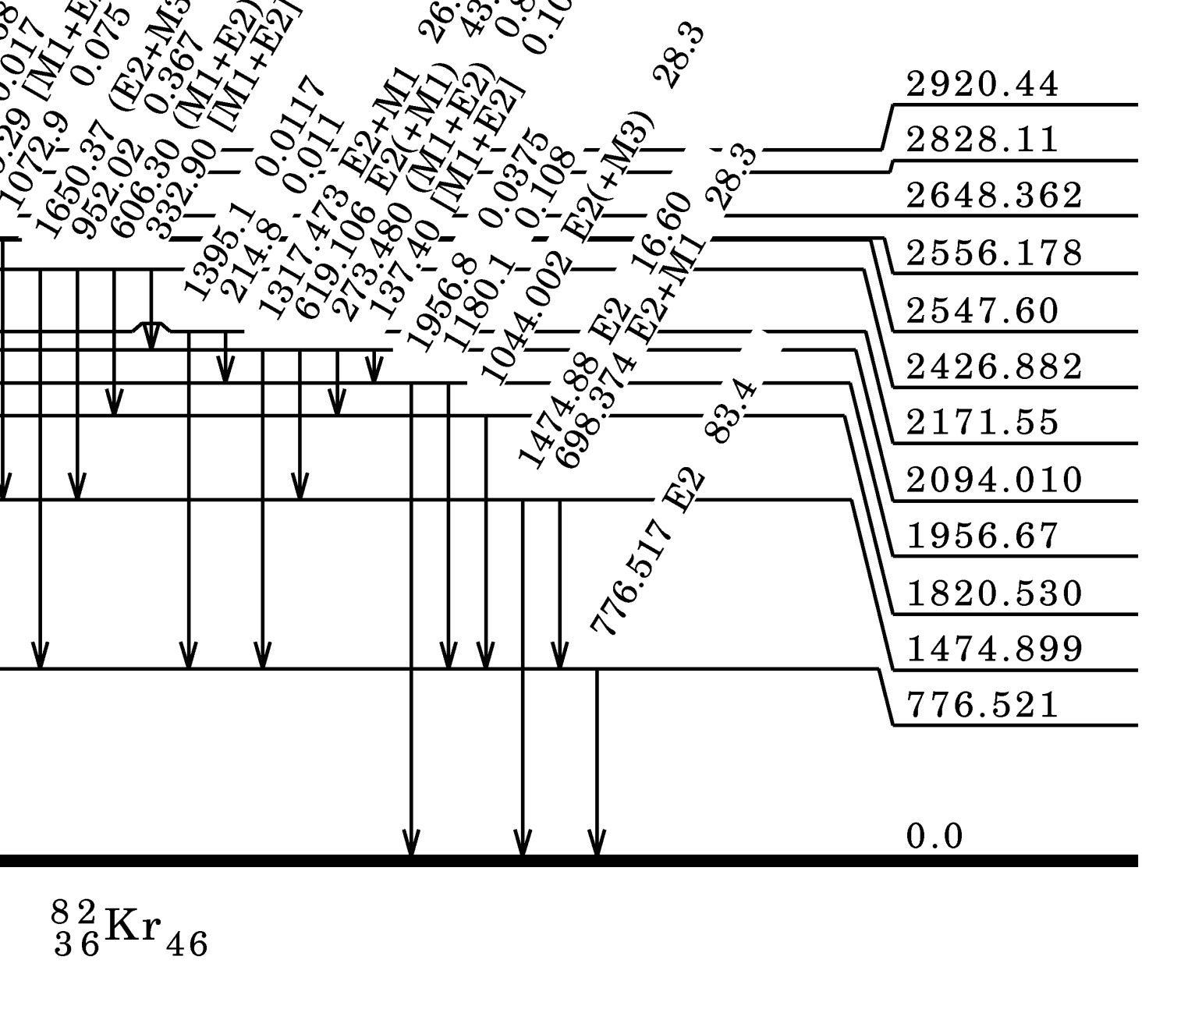

Slide 17
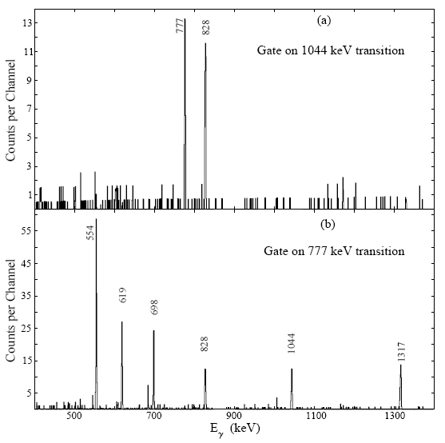
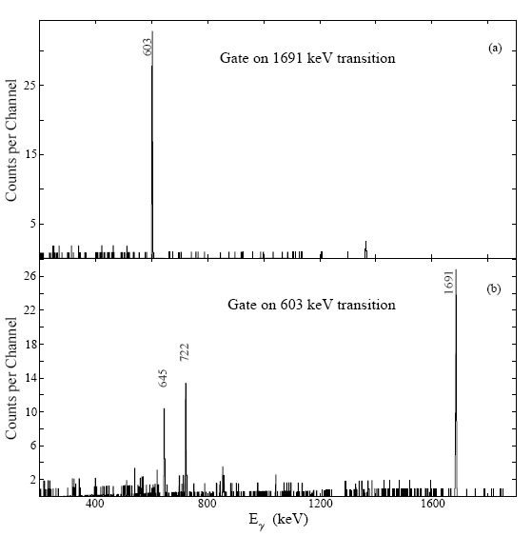
The 1044-,1524- and 1691 keV γ-transitions
Coincident spectra, showing gates on the 1044 and 777 keV γ-transitions. [⁸²Br]
Coincident spectra, showing gates on the 1691 and 603 keV γ-transitions. [¹²⁴Sb]
The sources of the 1044 and 1691 keV transitions have been identified unambiguously using the γ-γcoincidence measurement.
The source of 1524 transition was identified measuring the half-life of the 1524 keV transition. The half-life (T_{1/2}=12.56 ± 0.43 h.) obtained is in good agreement with the adopted half-life (12.321 (43) h.) for ⁴²K.

Slide 18
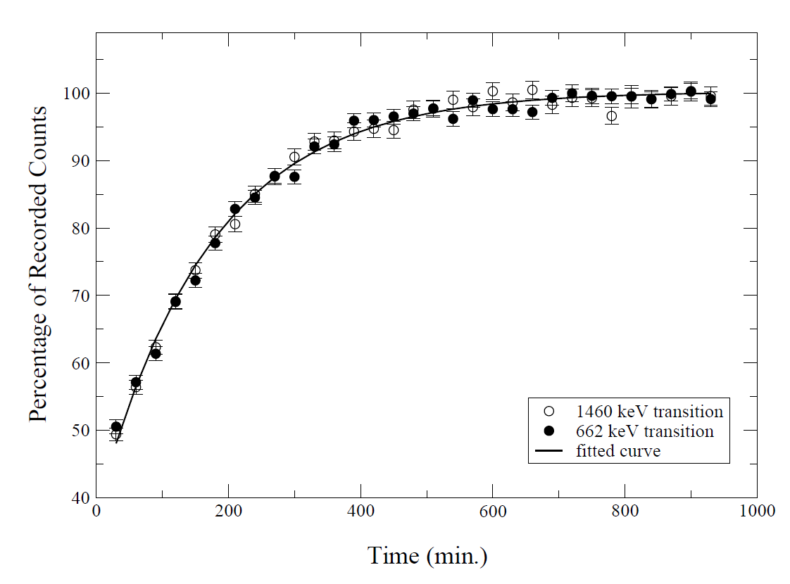
Spectroscopy of ¹³⁹Ba (Half-life measurement)
A ¹³⁷Cs source was counted simultaneously with the sample to estimate the count rate losses.
The count rate losses was estimated from the counts/intensity of the 662-keV (¹³⁷Cs reference source) and 1460-keV (natural-background from ⁴⁰K) γ- rays.
The parameters obtained from the fits were used to estimate the count rate losses.
The reliability of the fitted parameters was checked by extracting the half-lives of the nuclei ³⁸Cl and ⁵⁶Mn (which were present as contaminants).
Half -life of ³⁸Cl | Half -life of ⁵⁶Mn
37.20 (25) min. (present work) | 2.56 (3) h. (present work)
37.24 (5) min. (adopted) | 2.5789 (1) h. (adopted)
The percentage of recorded counts of the 662 and 1460 keV γ-rays plotted as a function of time

Slide 19
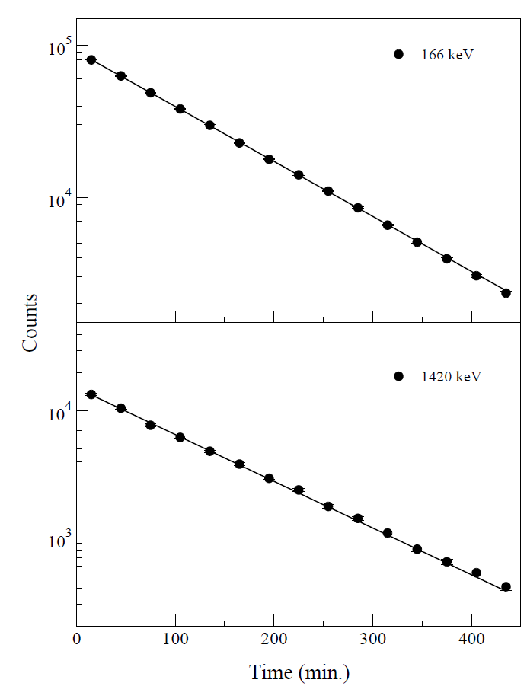
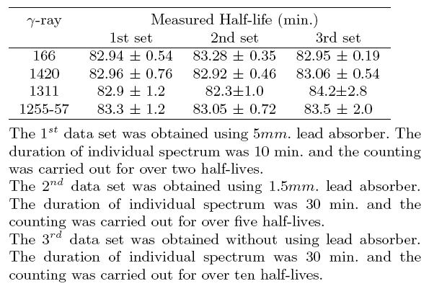
Half-life measurement
The values of T_{1/2} obtained from various data sets in present work
Decay curve of 139Ba as determined from the 166 and 1420 keV transitions.
The weighted average (reduced χ²=0.13) of the present measurements gives the value
T_{1/2} = 83.01 ± 0.14 min.

Slide 20
CONCLUSION
ENSDF T_{1/2} = 83.06 ± 0.28 min
Recent work 83.25 ± 0.08 min
Wt Avg : 83.09 ± 0.09 min
3 Transitions were modified.
Data evaluation : led to a new measurement and refinement of data
Standardization of measured values
Discussions after data evaluation have led to some ideas about possible experiments
It has helped in discussing Nuclear Physics, with the younger generation, richer

Slide 21
Thank You.

