Slide 1
Improving systematic predictions of β-delayed neutron emission probabilities
E. A. McCutchan
A.A. Sonzogni
T.D. Johnson
NNDC
D. Abriola
IAEA
M. Birch, B. Singh
McMaster

Slide 2
Beta-delayed neutron emission
What is it ?
P_{n} :
the probability to emit a neutron following β decay
β
^{A}Z
n
Q_{βn}
Q_{β}
^{A-1}Z+1
S_{n}
^{A}Z+1

Slide 3
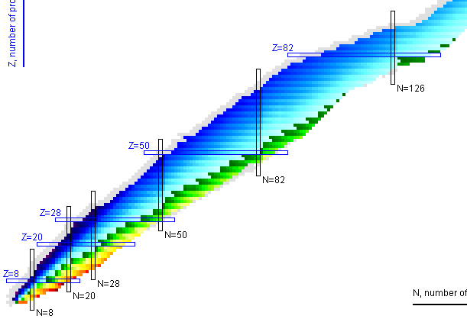
Beta-delayed neutron emission
Where is it ?
214 nuclei with measured P_{n} values
http://www.nndc.bnl.gov/nudat2

Slide 4
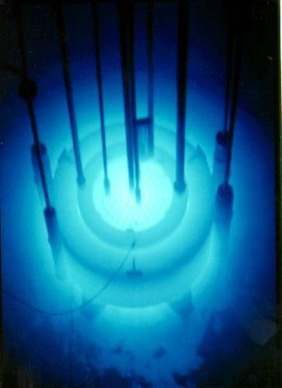
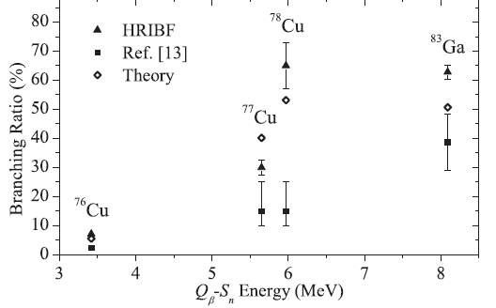
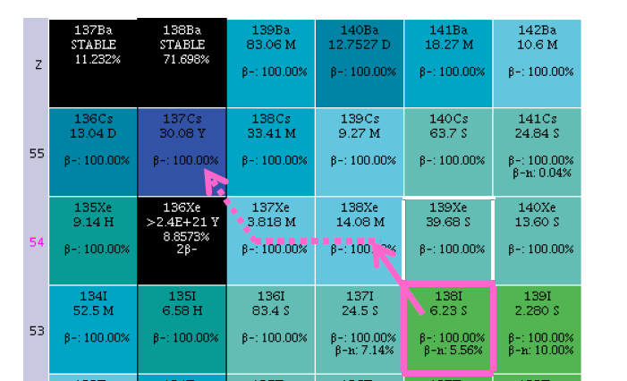
Beta-delayed neutron emission
Why do we care?
Basic structure physics
Reactor control and post-processing of fuel
r-process nucleosynthesis
and abundances

Slide 5
Traditional systematic studies
Kratz -Herrmann Formula (KHF)
Two parameter fit with ‘a’ and ‘b’
$$P_{n}≈a{\left[\frac{Q_{β}−S_{n}}{Q_{β}−C}\right]}^{b}$$
Cut off parameter C (MeV)
$$C=0$$
even-even
Log-log plot gives straight line
with slope=b
$$C=\frac{13}{\sqrt{A}}$$
even-odd
$$C=\frac{26}{\sqrt{A}}$$
odd-odd
K.-L. Kratz and G. Herrmann, Z. Phys. A 263, 435 (1973)

Slide 6
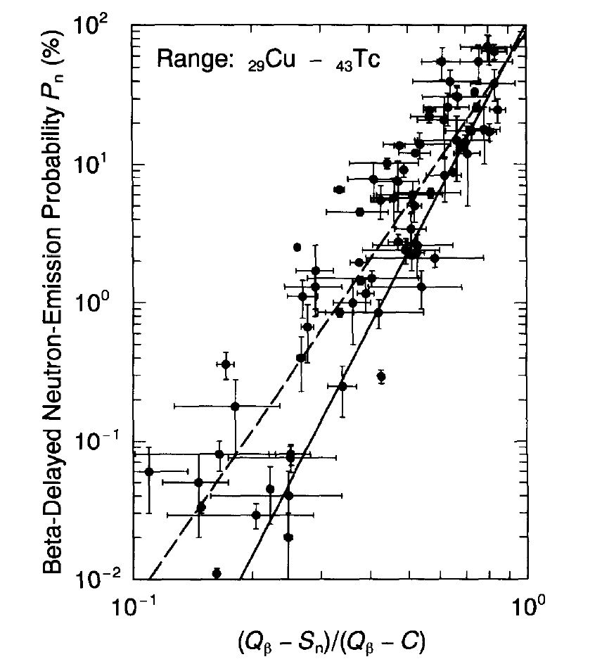
The standard for systematic studies
Linear regression
a = 106(38)
b = 5.5(6)
red χ² = 81
Weighted least-squares
B. Pfeiffer et al., Prog. Nucl. Energy 41, 39 (2002).

Slide 7
Effect of improved Q values
Masses from :
Audi and Wapstra (1995)
Audi and Meng (2011)
a = 106(38)
b = 5.5(6)
red χ² = 81
a = 119(42)
b = 5.45(48)
red χ² = 146

Slide 8
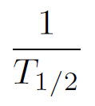
A better parameterization?
Strength function
Fermi integral
Applying same concept as KHF
$$\frac{P_{n}}{T_{1/2}}\sim a{(Q_{βn})}^{b}$$

Slide 9
With this approach
a = 119(42)
b = 5.45(48)
red χ² = 146
a = 0.0097(9)
b = 4.87(7)
red χ² = 35

Slide 10
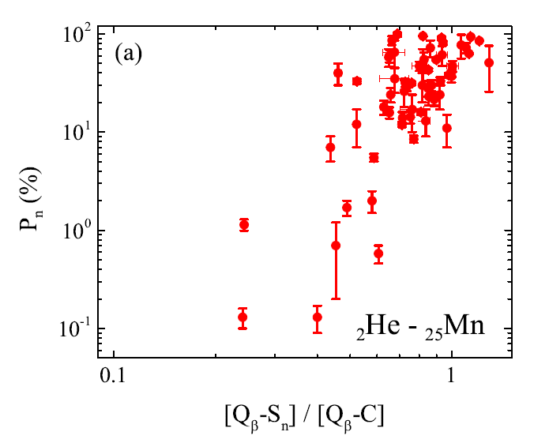
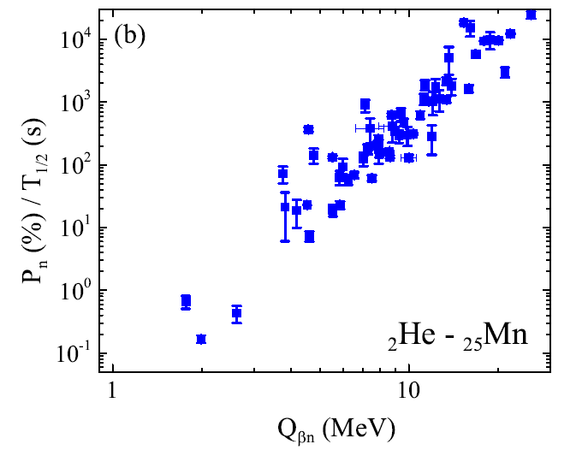
A surprising correlation
a = 45(6)
b = 4.4(4)
red χ² = 280
a = 0.037(9)
b = 4.11(9)
red χ² = 87

Slide 11
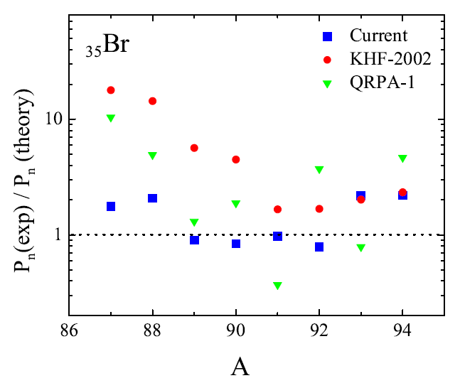
How do we do ??
KHF-2002: B. Pfeiffer et al., Prog. Nucl. Energy 41, 39 (2002).
QRPA-1: P. Moller et al., Phys. Rev. C 67, 055802 (2003).

Slide 12
Summary
New prescription for systematics of P_{n} values
Ratio of P_{n} to T_{1/2}
More compact trajectory
Seems to work across nuclear chart

Slide 13
Relevance to ENSDF
Some evaluators give Pfeiffer KHF results (2002Pf04) for cases where P_{n} has not been measured
Should we replace with values from new systematics ?

Slide 14
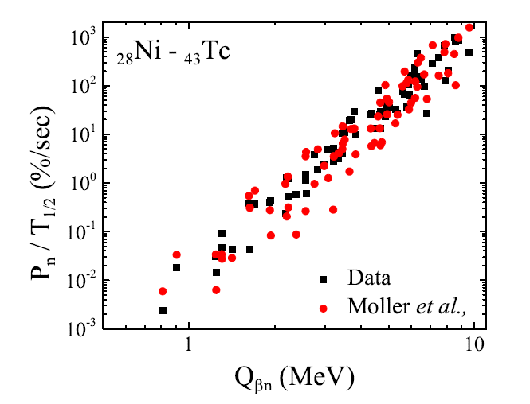
Another surprising correlation
P. Moller et al., Phys. Rev. C 67, 055802 (2003).

