Slide 1
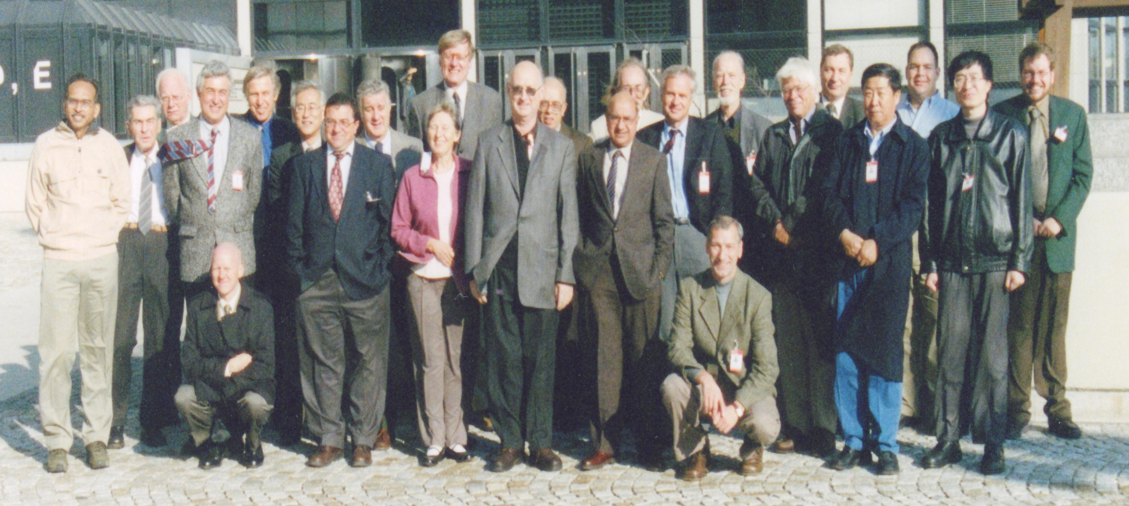
IAEA, November 2003 Nuclear Structure and Decay Data Evaluators’ Network meeting

Slide 2
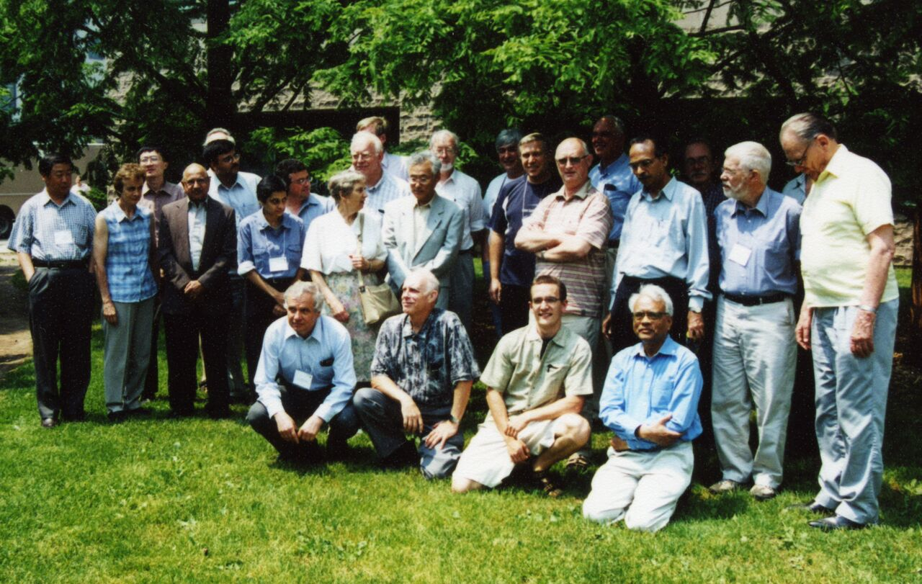
McMaster University, Hamilton, Canada, June 2005 Nuclear Structure and Decay Data Evaluators’ Network meeting

Slide 3
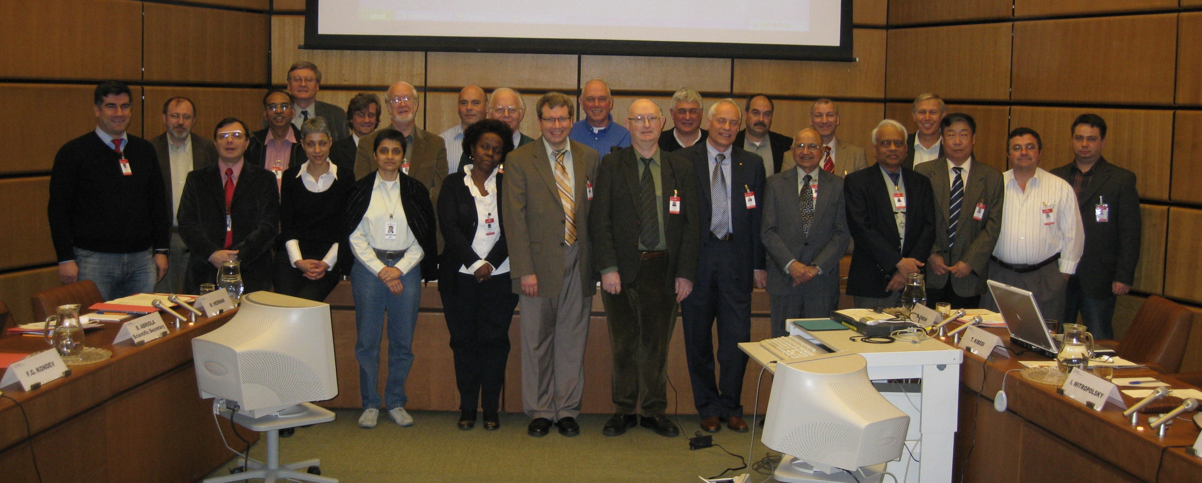
IAEA, March 2009 Nuclear Structure and Decay Data Evaluators’ Network meeting

Slide 4
IAEA, November 2008 – dealing with those pesky Euros

Slide 5
IAEA, November 2008 – dealing with those pesky Euros

Slide 8
crème de la crème
Balraj and Jag
May 2017
NSDD evaluators’ network, University of California, Berkeley, USA

Slide 9
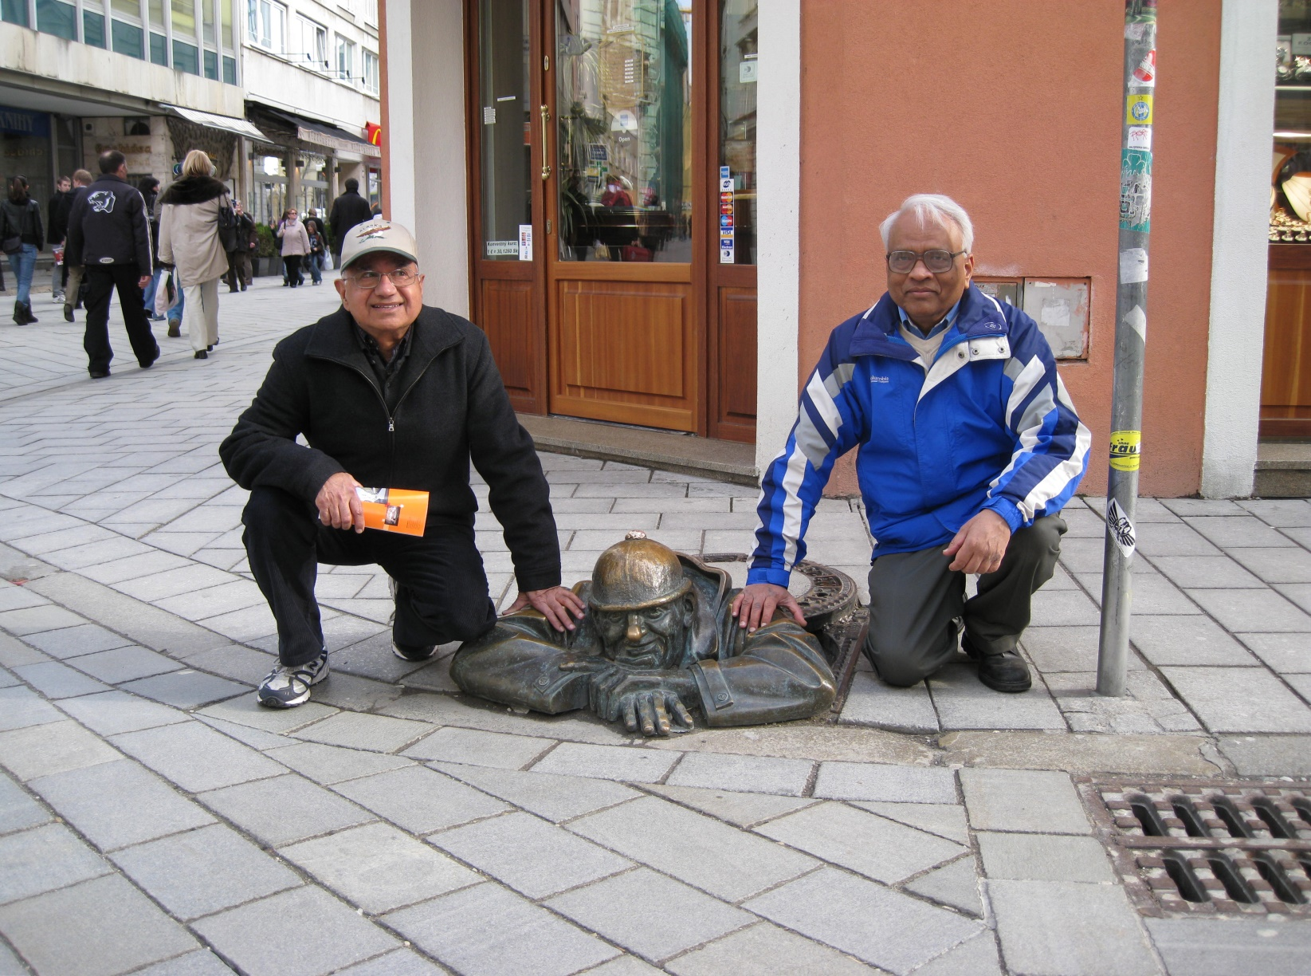
Balraj Singh Jagdish Tuli

Slide 10
Jag
Mass chain evaluator extraordinaire: as of May 2017
60(2), 62, 65(2), 66, 67, 69, 70, 82(2), 84(2), 94, 99(2), 119, 136, 137(2), 138(2), 141(3), 142(2), 143(3), 144(2), 145(2), 146, 150, 157, 158, 159, 160, 161, 173, 174, 211, 215, 220, 221, 222, 225, 227, 229, 230, 231, 233, 234, 235, 236, 238, 239, 245, 246, 251, 253, 254, 251→259 (odd, 5)
also ⁹⁹Tc only, ¹³⁷Ba only, ¹⁴³Nd only, ^{141,143}Eu only
Table of Isotopes, 7th edition, John Wiley and Sons Inc.,
New York (1978);
US Nuclear Data Services, logft reviews, ……. and much more
1973Tu06: Nucl. Data Sheets 9 (1973) 273, first mass chain was 157

Slide 11
Jag
Mass chain evaluator extraordinaire
Balraj Singh, Abriola, Baglin, Basu, Bhagwat, Bhat, Bostan, Browne, Dimitriou, der Mateosian, Erturk, Fadil, Galan, Huang, Huo, Jain, Johnson, Juutinen, Kibedi, Kondev, Kumar, Luca, McCutchan, Mukherjee, Negret, Nica, Nichols, Peker, Pfeiffer, Raut, Reed, S. Singh, Sonzogni, Symochko, Thompson, Timar, Venkova, Ward, Winchell, Zuber

Slide 12
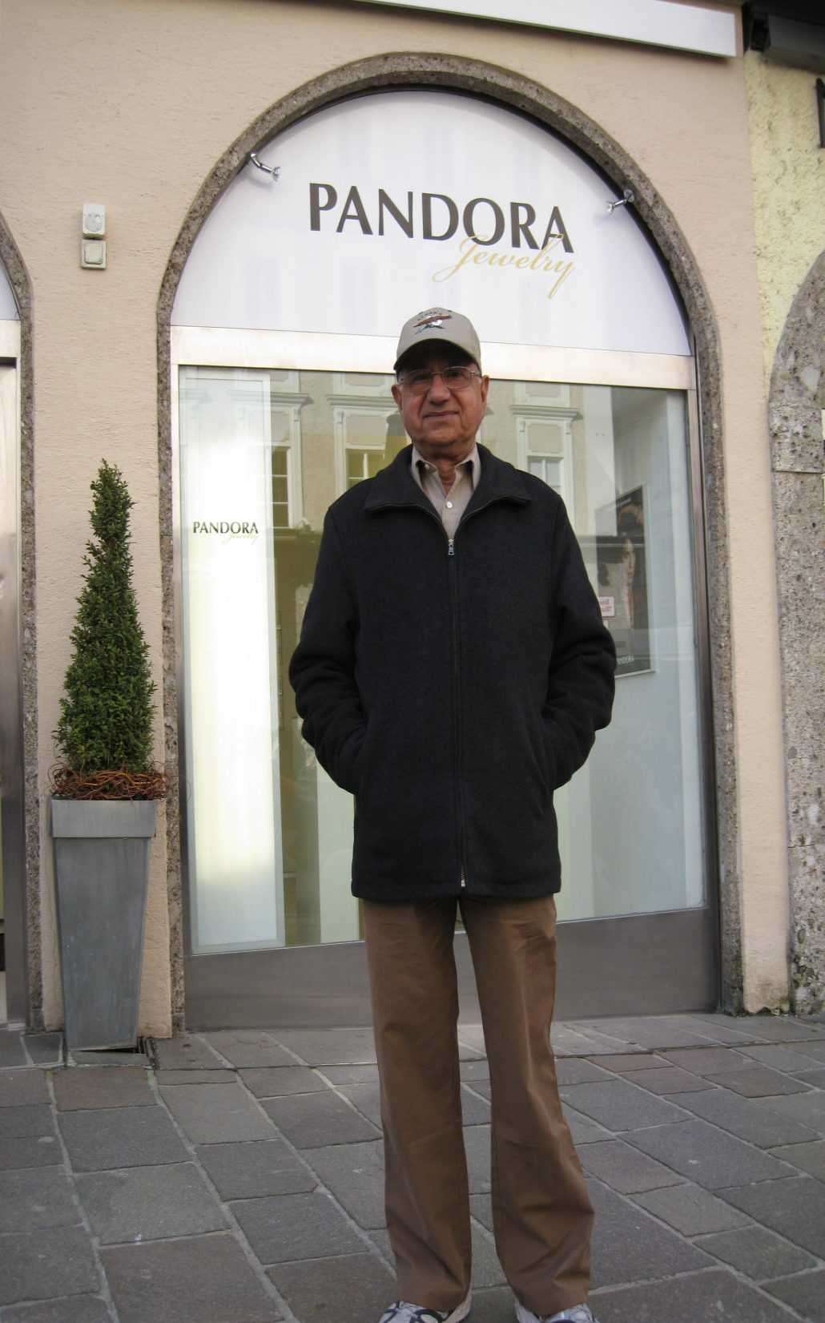
PANDORA: file checker
and editor
jewellery shop?
leader of the band

Slide 13
Balraj
Mass chain evaluator extraordinaire: as of May 2017
1, 31, 32, 33, 34, 35, 36, 37, 38, 39, 40, 41, 42(2), 43(2), 44(2), 50, 57, 58, 61, 62(2), 64(3), 71, 73(2), 74(2), 75(2), 76(3), 77(4), 78(2), 79(4), 80(3), 84, 85, 86(2), 89(2), 98(4), 99, 100(3), 129, 130(2), 132, 135(2), 139, 149(3), 151(3), 163(2), 164(2), 165(2), 172(2), 182(3), 188(3), 189, 190(3), 194(3), 199, 211, 215, 217, 218(2), 224, 227, 233, 240(2), 254, 256, 258, 266→
⁵⁸Cu only, ⁶²Ga only, ⁹⁹Tc only, ¹⁴³Tb only, ^{143,152}Dy only,
¹⁶⁵Lu only, ^{165,195}W only, ¹⁹⁹Pb only; selected 132, 135
XUNDL, B(E2) values, β‒ delayed-neutron emissions, E2 transition probabilities, data averaging, ……… and much more
1980Si05: Nucl. Data Sheets 29 (1980) 75, first mass chain was 77

Slide 14
Balraj
Mass chain evaluator extraordinaire
Jag Tuli, Abriola, Abusaleem, Baglin, Basu, Bostan, Browne, Cameron, Chen, Chukreev, Dimitriou, Elekes, Erturk, Fadil, Farhan, Firestone, Galan, Geraedts, Ghosh, Hu, Huo, Jain, Johns, Johnson, Joshi, Juutinen, Khazov, Kibedi, Kondev, Kumar, Luca, McCutchan, Mukherjee, Negret, Nesaraja, Nica, Nichols, Ouellet, Pascu, Pfeiffer, Rab, Reed, Reich, Rodionov, Roediger, Sakharov, Sergeenkov, S. Singh, Sonzogni, Szucs, Timar, Venkova, Viggars, Zuber

Slide 15
Trieste: teacher in his element
you name them – he can train them:
undergraduates, post graduates,
post doctorates, lecturers, readers, professors, nuclear physicists, ……..….even retirees

Slide 16
Balraj and Jag altogether
Mass chain evaluators extraordinaire
over 175 mass chain evaluations undertaken and on-going
……. as well as systematic reviews of nuclear parameters:
logft, B(E2), E2 transition probabilities, cluster decay,
β‒ delayed-neutron emissions probabilities and half-lives,
nuclear spins of ground states and long-lived isomers,
super deformed nuclear bands and fission isomers,
magnetic dipole rotational bands
……. as well as
ENSDF, XUNDL, Nuclear Wallet Cards,
Atlas of Nuclear Isomers
……. as well as
Editor, Nuclear Data Sheets

Slide 17
Taking on Bratislava:
in recovery mode

Slide 18
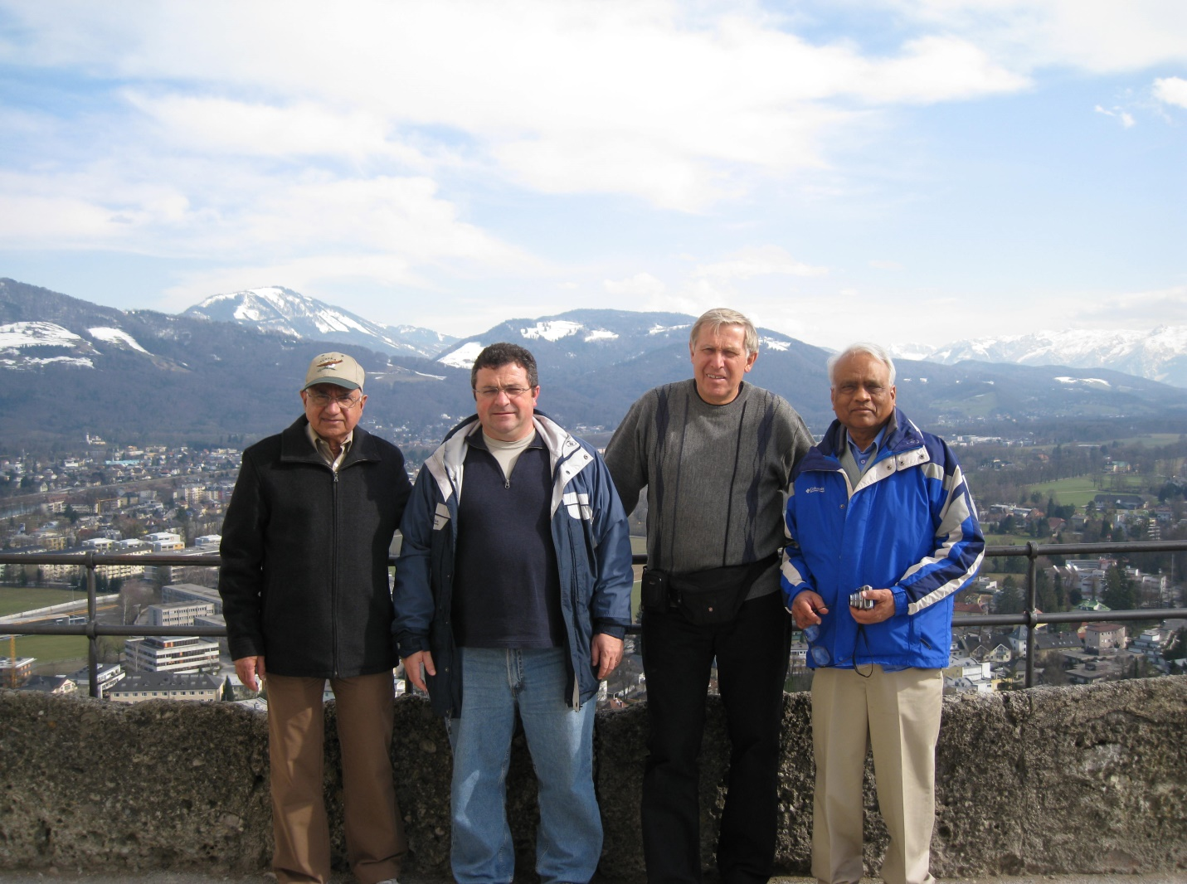
Salzburg:
with friends and acquaintances?

Slide 19
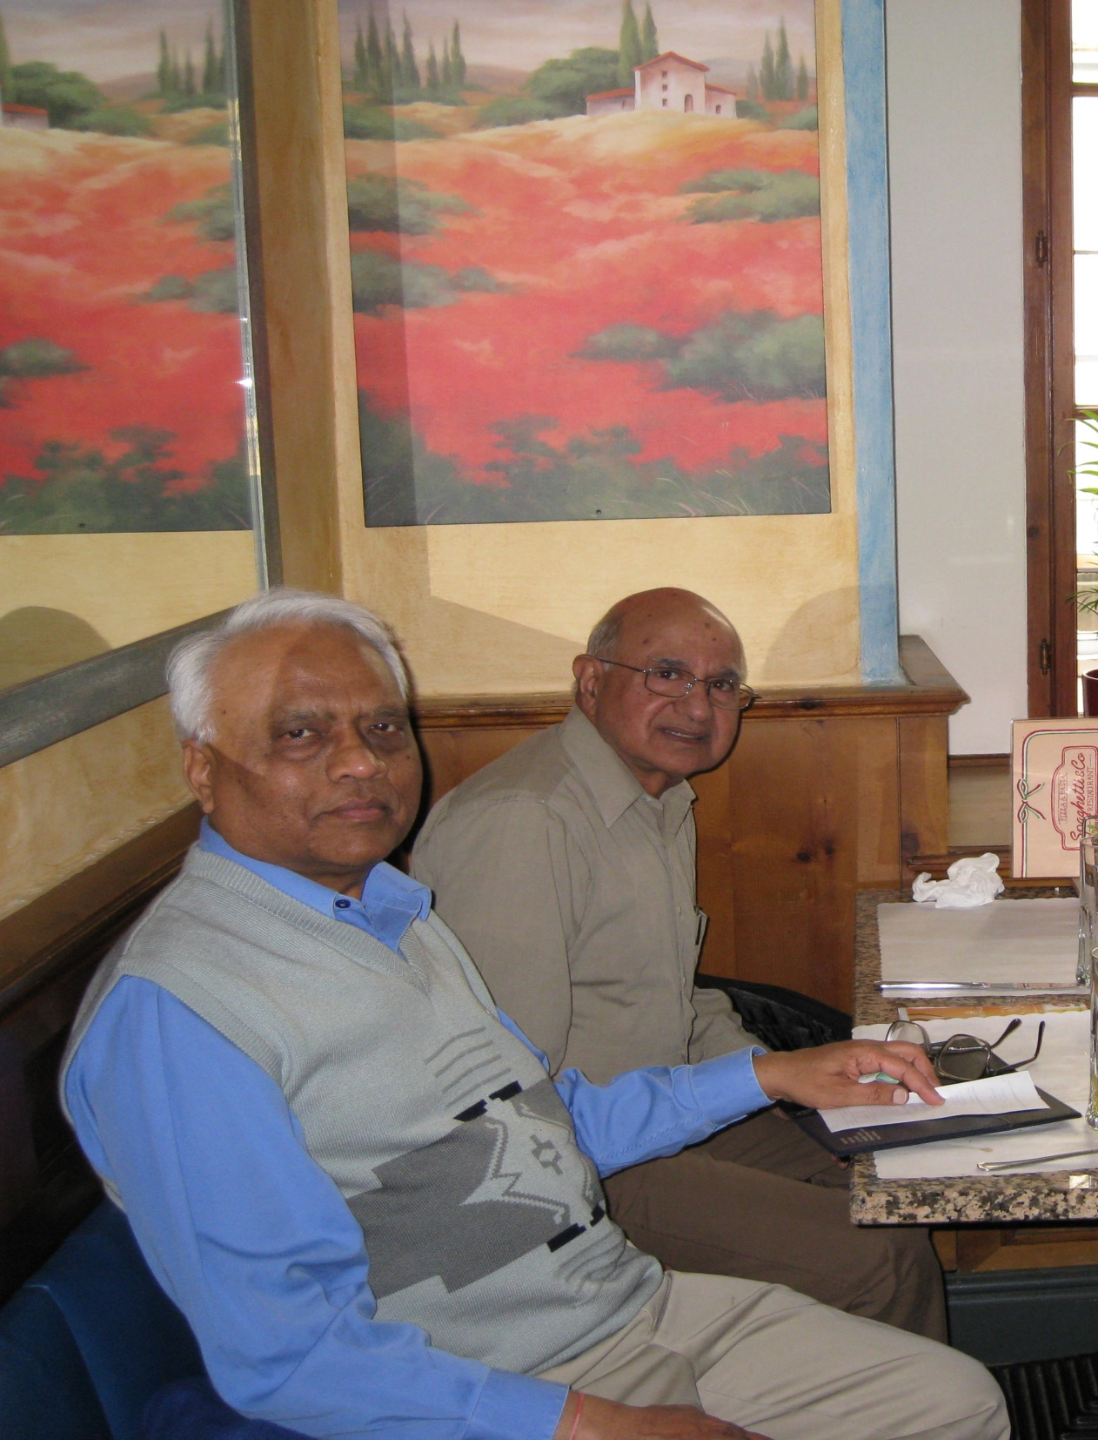
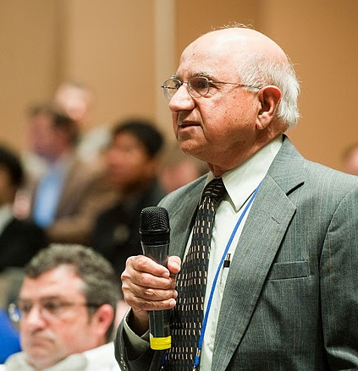
looking in fine fettle

Slide 20
Vienna: about to eat ………. yet again

Slide 21
assistance is gratefully acknowledged from
all those who wish to remain anonymous

Slide 22
Jag and Balraj

