Slide 1
Policies Discussion Topics

Slide 2
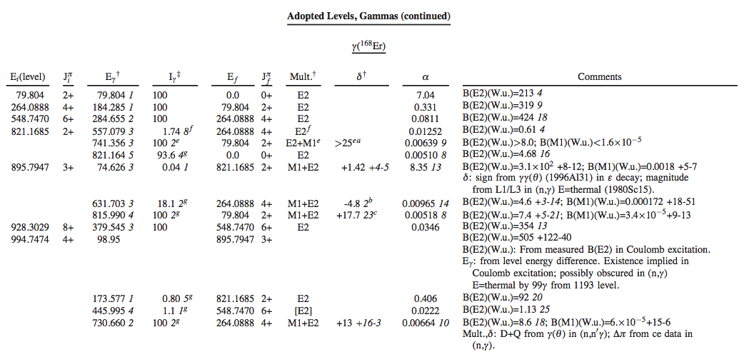
Footnote on alpha from BrICC
Below is taken directly from talk by R. Casten at Nuclear Data Needs for Basic Science Workshop
What are these α? Very confusing – poll (??)
Alpha
Answer: theoretical

Slide 3
Proposed Comment
JAVA-NDS generates a generic comment
Conversion coefficients, unless explicitly stated, are theoretical values from BrIcc with Frozen Orbital Approximation (2008Ki07).
Action on MSU to implement this in JAVA-NDS

Slide 4
Citation of Previous Evaluations
Some datasets do not change significantly(or at all)
from the previous evaluation
We should give proper credit to the previous evaluator
Add a few lines to the top of dataset indicating that it has not changed significantly from previous evaluation and provide citation.

Slide 5
Citation of XUNDL datasets
Some XUNDL datasets do not change significantly (or at all) when incorporated into an evaluation.
If no major changes, consider referencing XUNDL in the dataset
In general, please acknowledge XUNDL in the abstract

Slide 6
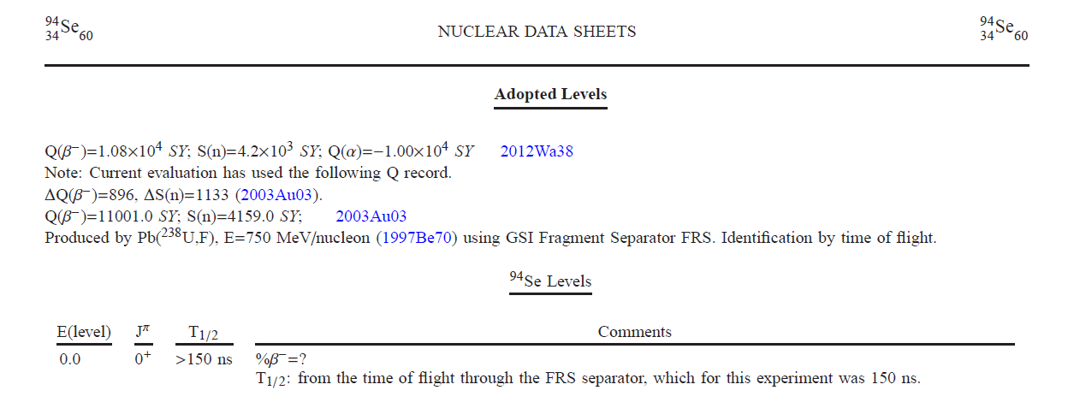
Very neutron-rich nuclides
One often encounters

Slide 7
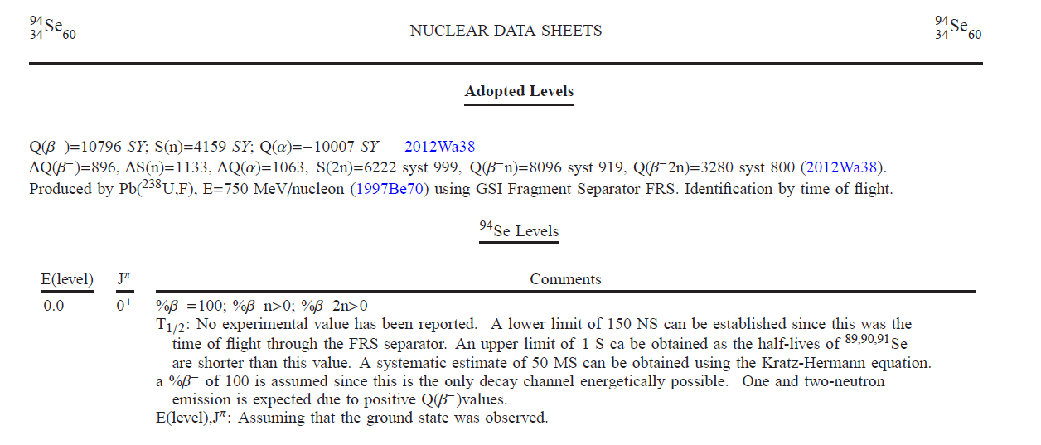
Very neutron-rich nuclides
New proposal

Slide 8
We need to define the year
Sideral year = 365.25636 days
Tropical year = 365.24219 days
Proposal:
We adopt the Tropical Year
We define it in the policies
We state it in the T1/2 comments when needed
Action on NNDC to parse ENSDF and identify
Nuclides which need looked into

Slide 9
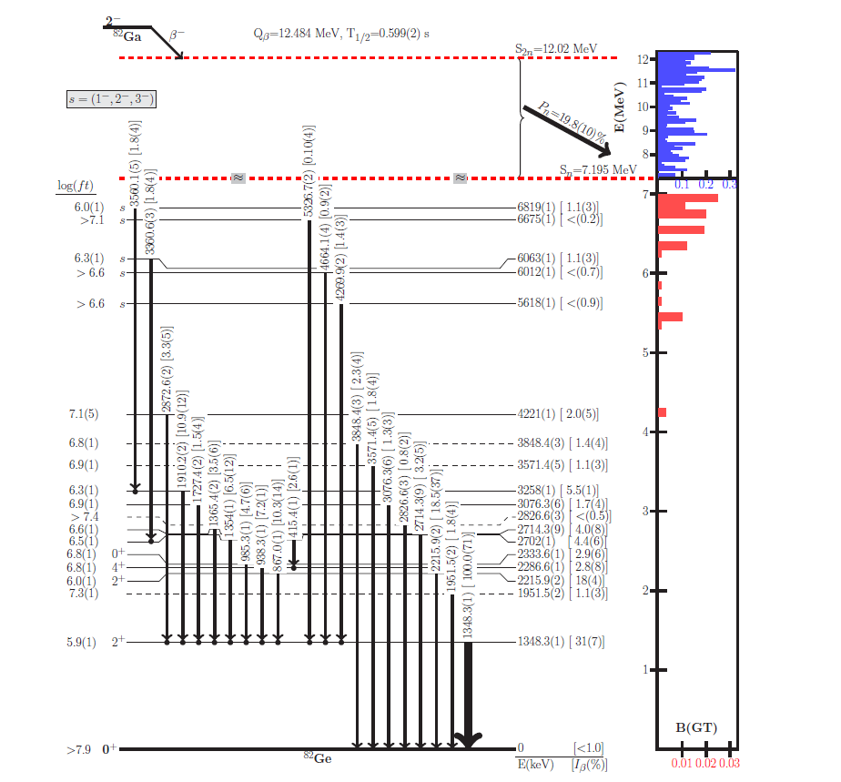
Incorporating %β-n into decay datasets

Slide 10
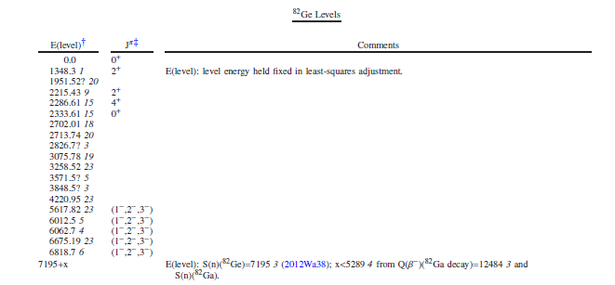
Incorporating %β-n into decay datasets

Slide 11
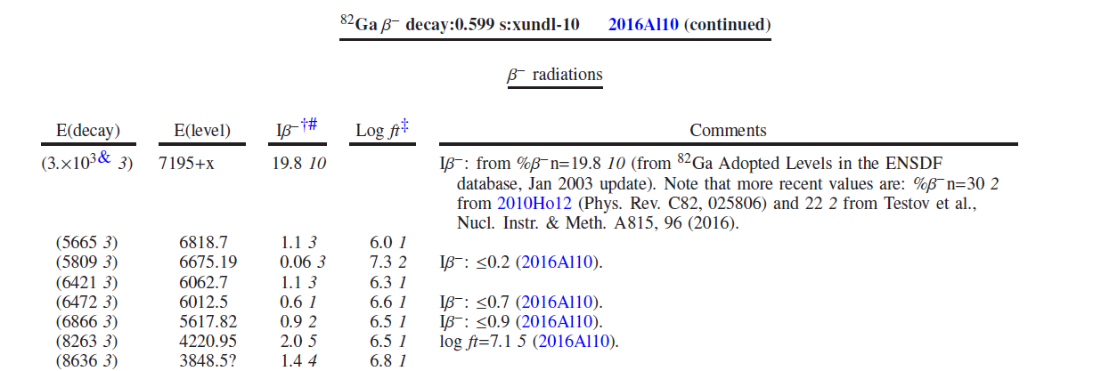
Incorporating %β-n into decay datasets

Slide 12
Presentation of High-spin Data
Jpi values in datasets should be as given by authors
Comment on discrepancies with Adopted Levels
Multipolarities should be backed by experimental evidence in datasets
Author’s and evaluators physics arguments are implemented in the Adopted Levels
If author’s give support, but don’t assign mults, evaluators can do so
DO NOT copy XUNDL multipolarities

Slide 13
Presentation of High-spin Data
Evaluators should put A2,A4 and DCO in 2G
DCO’s and POL should come with an explanation
Addition of POL in 2G record
Action on NNDC to have FMTCHK recognize POL
Action on NNDC and McMaster to provide listing of quantities which can be included in 2G

Slide 14
Standardizing Configurations
One can find configuration written in many ways
(examples below from Tibor)
- configuration=((|n 1/2[521])(|n 1/2[521]))
- configuration=|n1/2[521]~#|p9/2[514]
- CONF=NU{+2}(1/2[521],7/2[633])

Slide 15
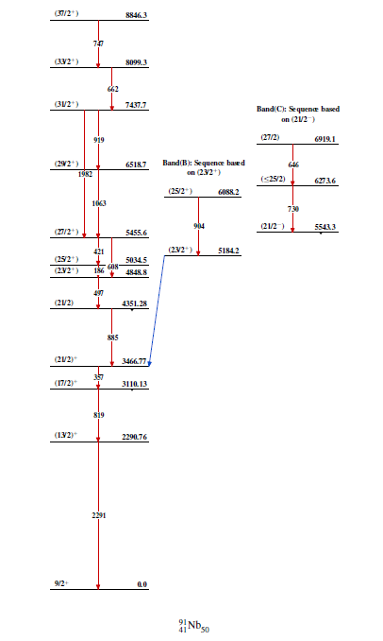
Expanding beyond BAND(A)
Propose in addition to BAND(A)$
We implement
SEQ(A)$

Slide 16
Energies in β-delayed proton decay
From the guidelines:
Quote what was actually measured in an experiment and not what the author quotes, in cases where these are different

Slide 17
Can we agree to phase out Capital C comments?

Slide 18
Deformed Nuclei

Slide 19
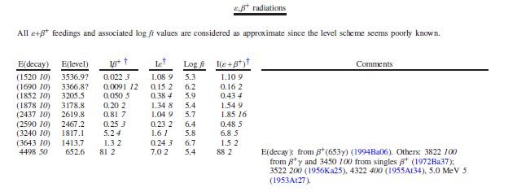
Consistency between Adopted Level and Decay Parent records

Slide 20
Gamow Teller
Can we make a new symbol?

