Slide 1
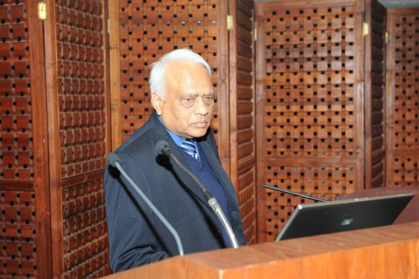
Balraj Singh
50 years in Nuclear Science and Nuclear Data
22nd Technical Meeting of the NSDD Network, 22-26 May, 2017, Berkeley, CA

Slide 2


Balraj was born in India in 194?

Slide 3
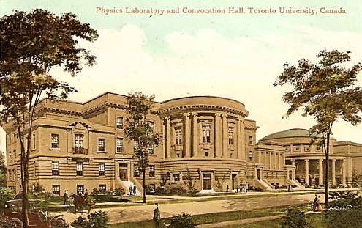
He went to the University of Toronto where he published his first research paper in 1969

Slide 4
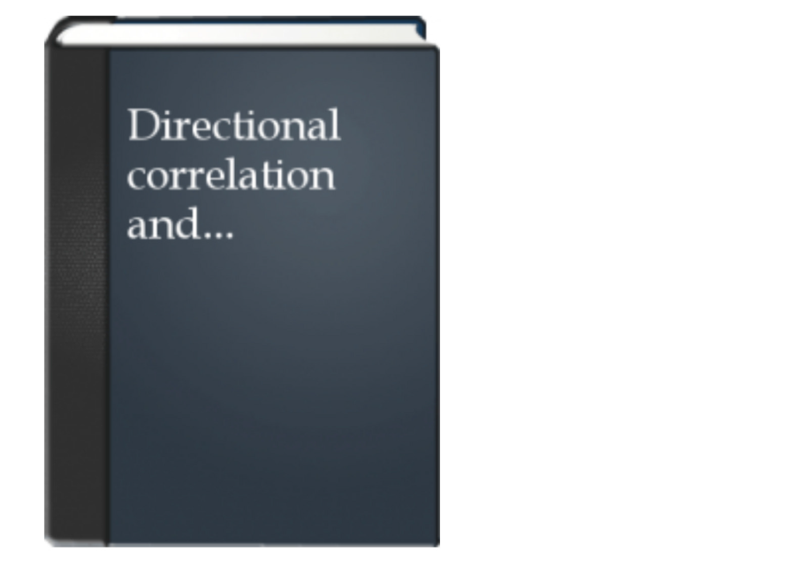
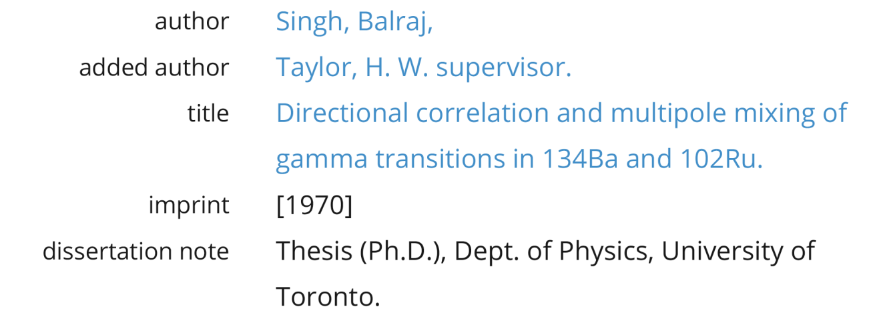

Balraj completed his PhD thesis in 1970

Slide 5
Postdoc in Canada 1970-1978
B.Singh, H.W.Taylor, A Coincidence Study of the Decay of 35.8 y ^{150m}Eu
H.W.Taylor, B.Singh, Levels in ¹⁴⁶Nd Populated by the β- Decay of 24 min ¹⁴⁶Pr
P.J.Tivin, B.Singh, H.W.Taylor, Gamma-Gamma Directional Correlations in ¹⁰⁶Pd
B.Singh, P.J.Tivin, H.W.Taylor, The Decay of 50.0 min ^{98m}Nb
B.Singh, H.W.Taylor, P.J.Tivin, A Study of the Gamma Radiation from the Decay of ⁹⁴Y
B.Singh, H.W.Taylor, Evidence Against the Presence of the 69.0, 70.3, 80.1 and 83.2 keV Gamma Rays in the Decay of ^{106m}Ag
H.W.Taylor, B.Singh, F.S.Prato, J.D.King, The Decay of ¹²⁹Ba
H.W.Taylor, B.Singh, Improved Gamma-Ray Energies for the Decay of ¹²⁹Cs
H.W.Taylor, B.Singh, Confirmation of the Existence of a 2044.1 keV State in ¹⁰²Ru
H.W.Taylor, B.Singh, Improved Values of the E2/M1 Mixing Ratios of the 22+→21+ Transitions in ¹²⁶Te and ¹²⁶Xe
H.W.Taylor, B.Singh, Multipole Mixing of Selected γ-Transitions in ⁵⁶Fe
H.W.Taylor, J.D.King, B.Singh, Low-Energy Gamma-Ray Spectrum of ^{184m,184}Re
H.W.Taylor, B.Singh, E2/M1 Mixing Ratios of the 22+ → 21+ Gamma Transitions in ¹³²Xe and ¹³²Ba
H.W.Taylor, B.Singh, F.S.Prato, R.McPherson, A Tabulation of Gamma-Gamma Directional-Correlation Coefficients
A.H.Kukoc, B.Singh, J.D.King, H.W.Taylor, The Decay of ^{184g}Re and ^{184m}Re
B.Singh, H.W.Taylor, M1/E2 Multipole Mixing of the 563 and 569 keV Transitions in ¹³⁴Ba
B.Singh, H.W.Taylor, A Note on the Decay Scheme of 13d ¹²⁶I
B.Singh, H.W.Taylor, Directional Correlation and Multipole Mixing of the Gamma Transitions in ¹⁰²Ru
H.W.Taylor, A.H.Kukoc, B.Singh, A Coincidence Study of the Decay of ^{102,102m}Rh
H.W.Taylor, B.Singh, Levels in ⁷¹Ga Excited by the Decay of 4h ⁷¹Zn
H.W.Taylor, B.Singh, R.J.Cox, A.H.Kukoc, A High-Resolution Spectroscopic Study of the Gamma Radiation from the Decay of ⁹⁶Nb

Slide 6



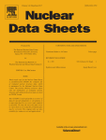
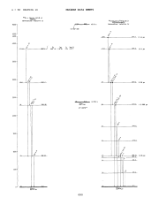
Kuwait Institute for Scientific Research 1978-1984

Slide 7
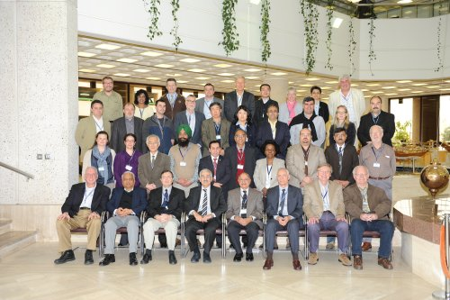

Valuable Contributor to the IAEA NSDD

Slide 8
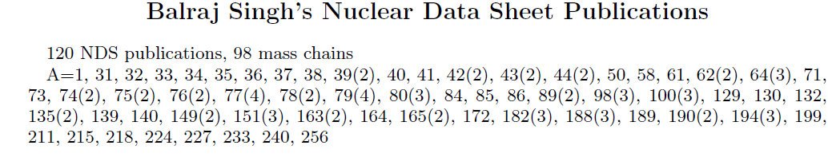
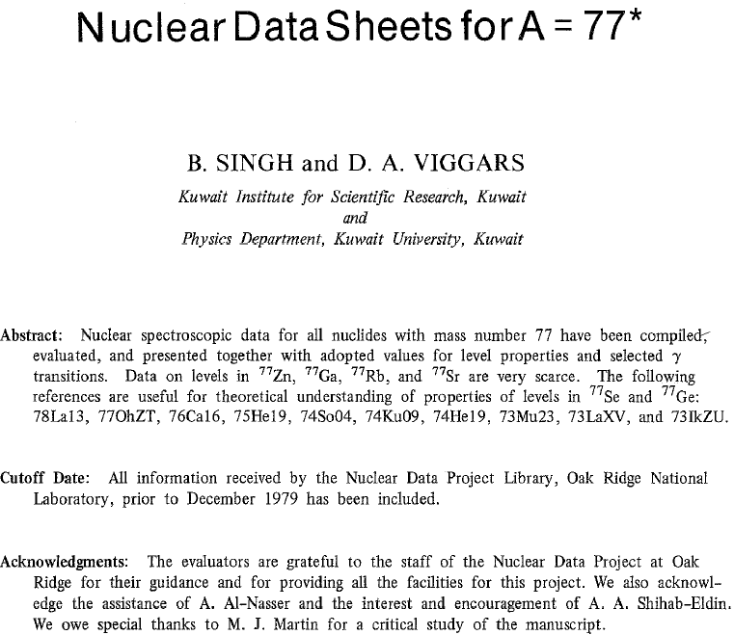
Mass chain evaluator par excellence

Slide 9
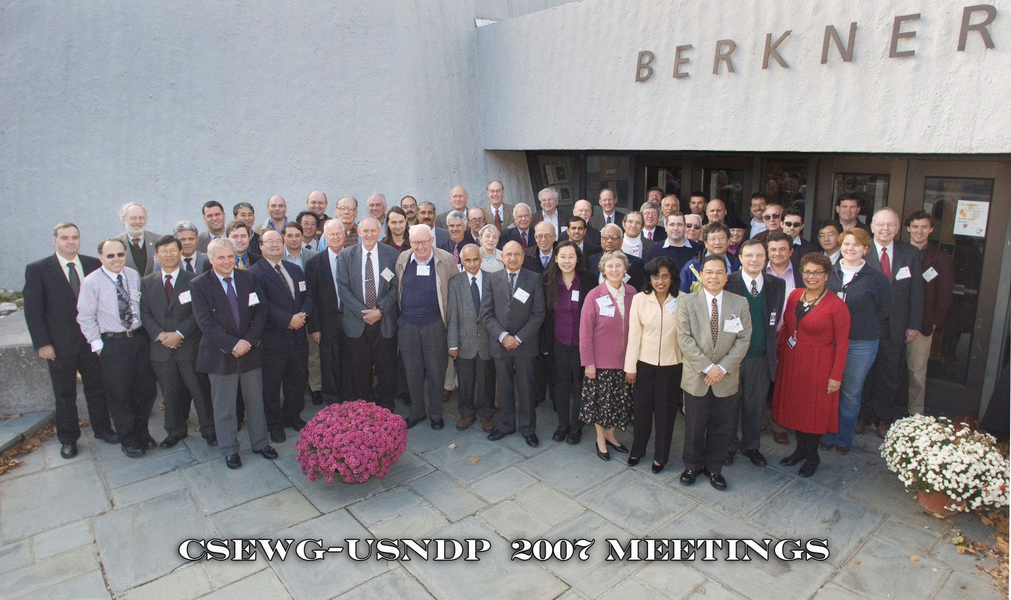

Valuable Contributor to the USNDP
LBNL/McMaster 1988-1997, McMaster 1984-1987, 1997-2013, Retired 2013-present

Slide 10
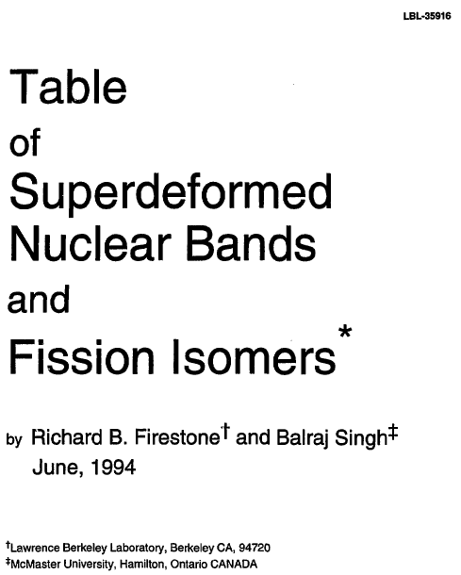
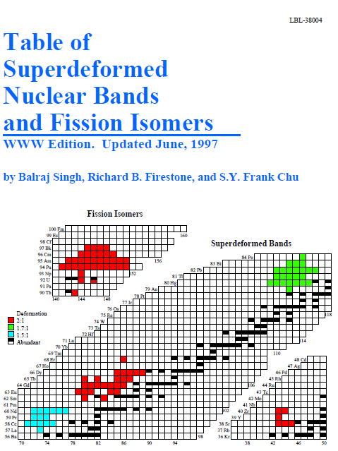
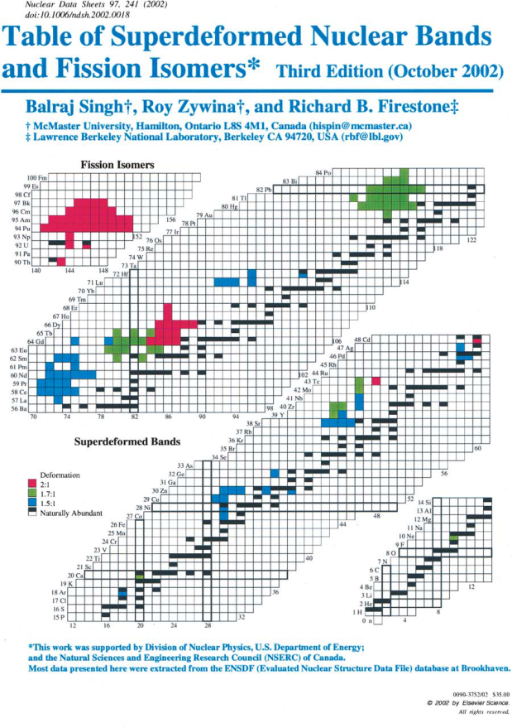
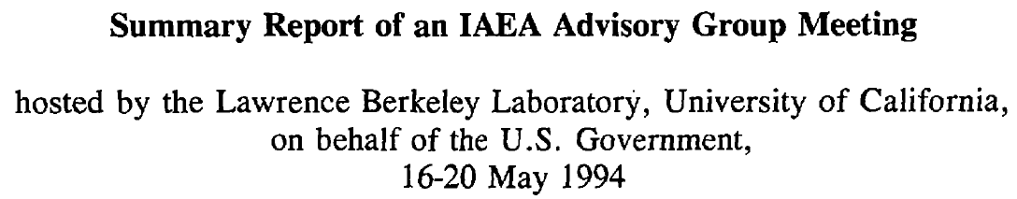
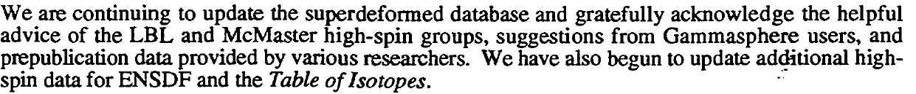
Table of Superdeformed Nuclear Bands

Slide 11




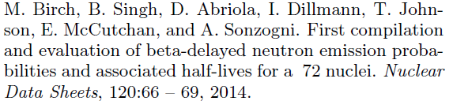

Horizontal Evaluations in NDS
Amita, A.K.Jain, B.Singh, At.Data Nucl.Data Tables 74, 283 (2000), Table of Magnetic Dipole Rotational Bands
B.Pritychenko, M.Birch, B.Singh, M.Horoi, At.Data Nucl.Data Tables 107, 1 (2016), Tables of E2 transition probabilities from the first 2+ states in even-even nuclei

Slide 12
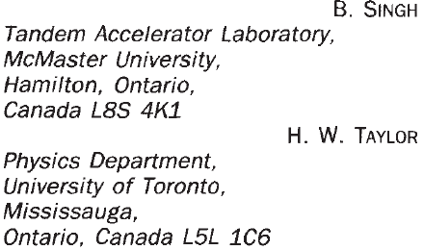

Environmental Interest

Slide 13
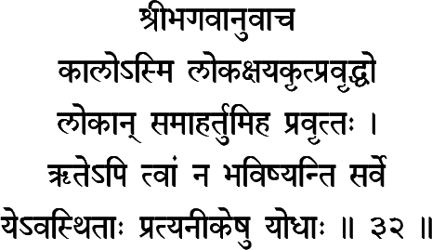
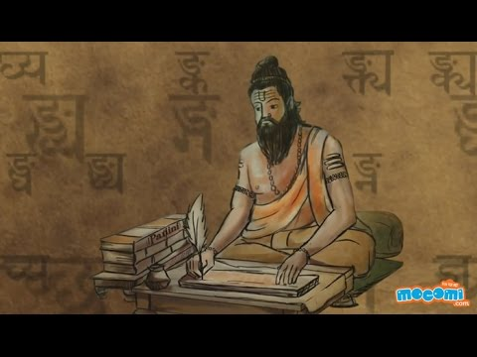

Official Translator of nuclear physics papers written in Sanskrit.
Lord Krsna said: I am terrible time the destroyer of all beings in all worlds, engaged to destroy all beings in this world; of those heroic soldiers presently situated in the opposing army, even without you none will be spared.
From Oppenheimer and the Gita by Alex Wellerstein, published May 23rd, 2014

Slide 14

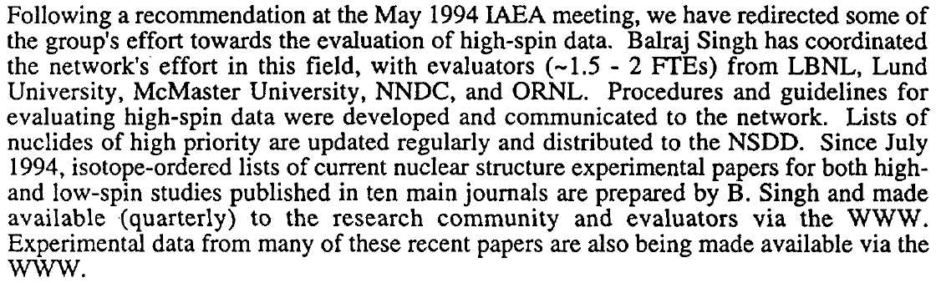

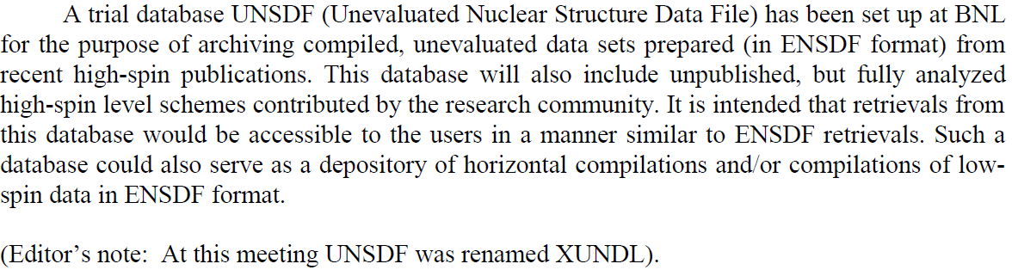
The birth of XUNDL

Slide 15
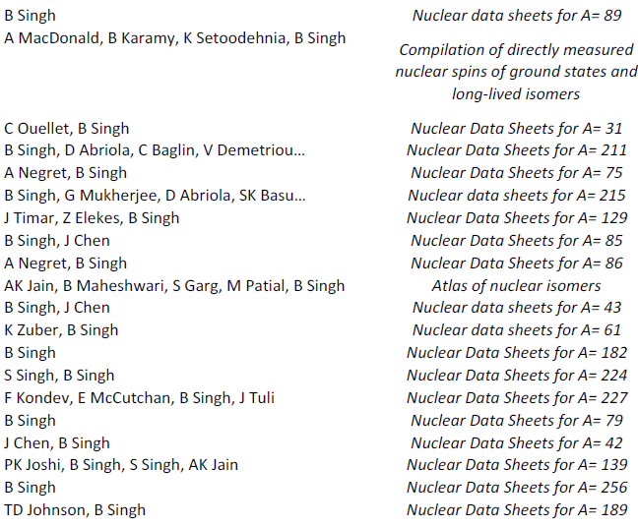
Retirement June 30, 2013
Post retirement publication list

Slide 16

Balraj

