Slide 1
Policies Discussion Topics

Slide 2
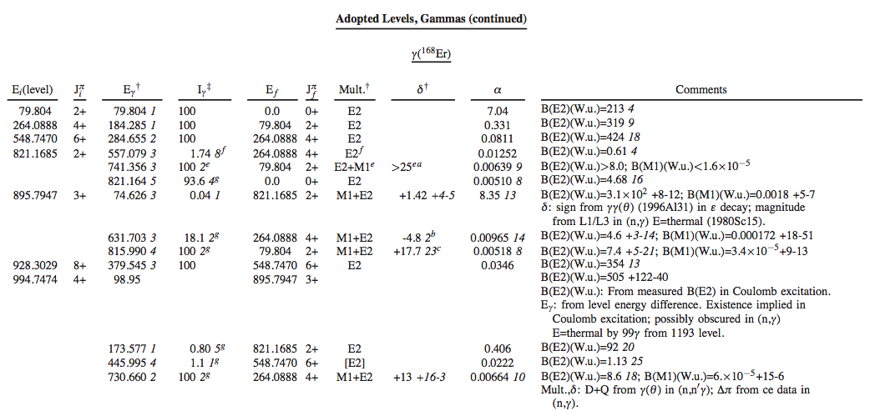
Footnote on alpha from BrICC
Below is taken directly from talk by R. Casten at Nuclear Data Needs for Basic Science Workshop
What are these α? Very confusing – poll (??)
Alpha
Answer: theoretical

Slide 3
Proposed Comment
JAVA-NDS generates a generic comment
Total conversion coefficients, unless explicitly stated, are theoretical values from BrIcc with Frozen Orbital Approximation (2008Ki07).
Action on Tibor to remove comment from BrIcc
Revise abstract discussing BrIcc

Slide 4
Citation of Previous Evaluations
Some datasets do not change significantly(or at all)
from the previous evaluation
We should give proper credit to the previous evaluator
Add a few lines to the top of dataset indicating that it has not changed significantly from previous evaluation and provide citation.

Slide 5
Citation of XUNDL datasets
Some XUNDL datasets do not change significantly (or at all) when incorporated into an evaluation.
If no major changes, consider referencing XUNDL in the dataset
In general, please acknowledge XUNDL in the abstract

Slide 6
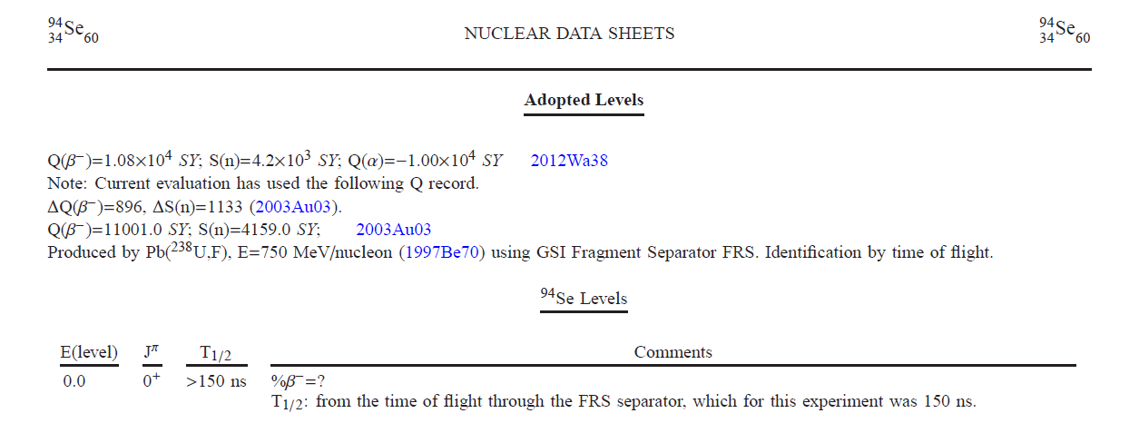
Very neutron-rich nuclides
One often encounters

Slide 7
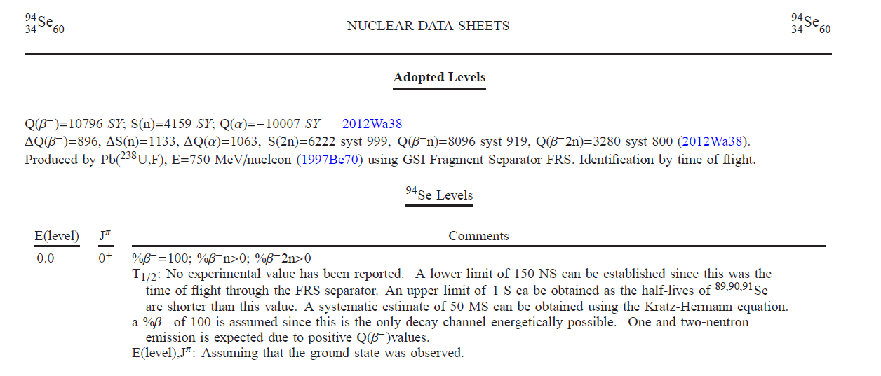
Very neutron-rich nuclides
New proposal

Slide 8
We need to define the year
Sideral year = 365.25636 days
Tropical year = 365.24219 days
Proposal:
We adopt the Tropical Year
We define it in the policies
We state it in the T1/2 comments when needed
Action on us to parse ENSDF for year T1/2s

Slide 9
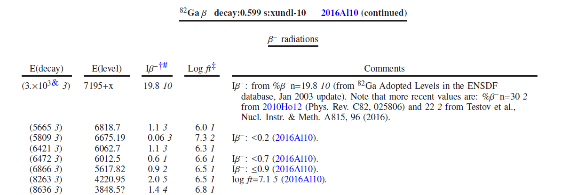
Incorporating %β-n into decay datasets

